Slide 1
A Holistic and People-Centered Approach to Accessible Exhibition Design
Walker Art Center
Doc Czypinski, Sarah Lampen, Erin McNeil
May 6, 2025
American Alliance of Museums Annual Meeting

Slide 2
Installation Guidelines for Accessible and Inclusive Exhibitions

Slide 3
What is it?
This guide is a living document designed to ensure that our audiences can successfully engage and interact with the art we present.
Installation Guidelines for Accessible and Inclusive Exhibitions

Slide 4
Accessibility at the Walker:
The Walker defines accessibility as a process of collaboration between individuals, communities, and institutions to make sure everyone has the resources they need to participate equitably.
Installation Guidelines for Accessible and Inclusive Exhibitions

Slide 5
From the beginning of exhibition planning, the Walker strives to go beyond legal compliance to assist staff and artists in centering audiences to improve access and deepen visitor engagement.
Installation Guidelines for Accessible and Inclusive Exhibitions

Slide 6
Context and Grounding

Slide 7
Project Working Group:
Doc Czypinski
Associate Director, Exhibition Installation
Sarah Lampen
Associate Director of Learning and Accessibility,
Public Engagement, Learning, and Impact Department (PELI)
Erin McNeil
Associate Director of Curatorial Affairs
Context and Grounding

Slide 8
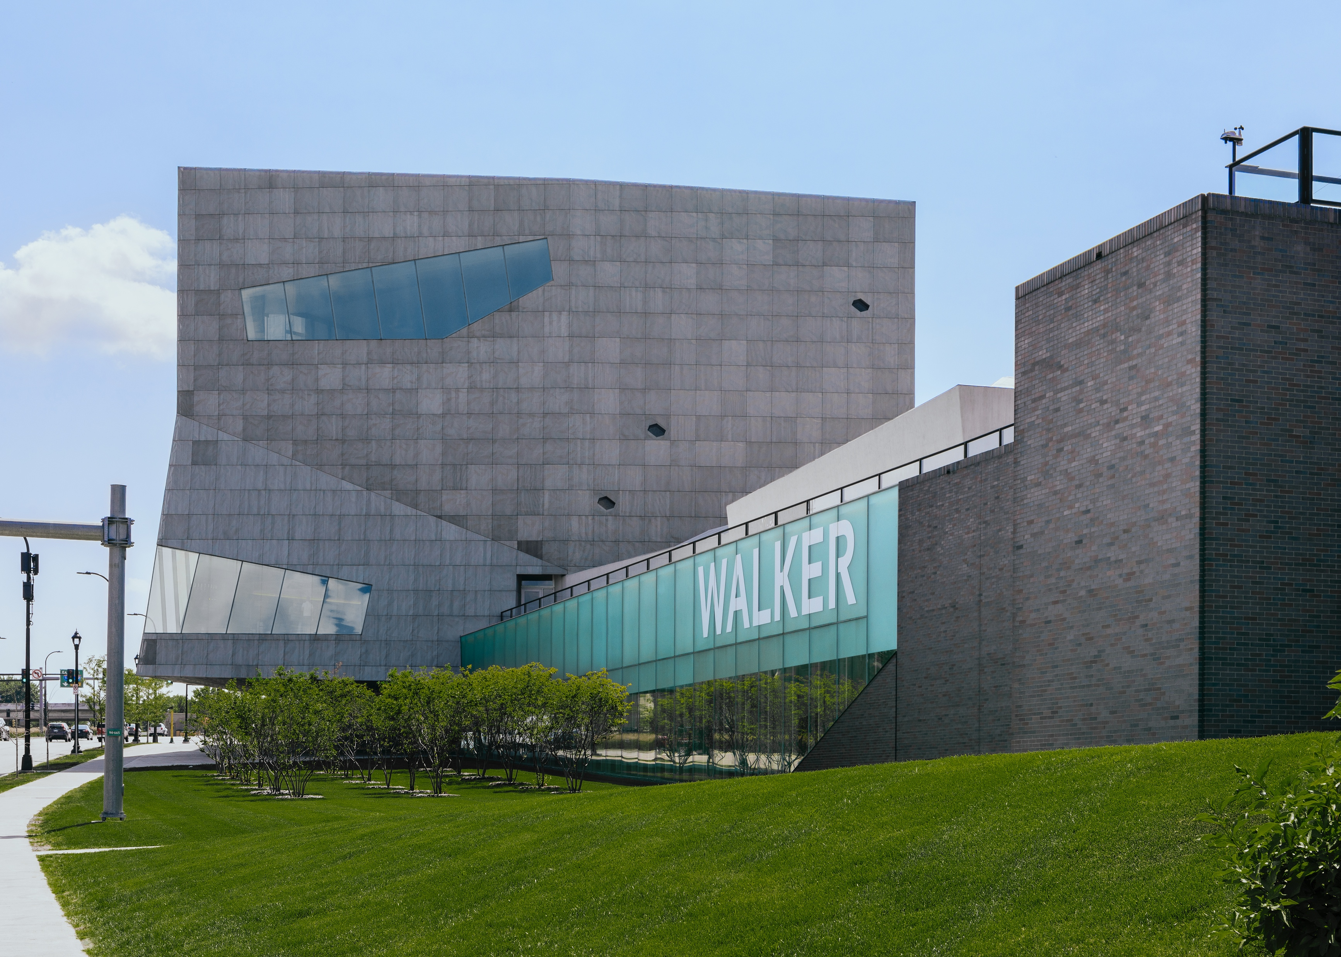
image

Slide 9
The Walker’s Mission:
The Walker Art Center empowers people to experience the transformative possibilities of the art and ideas of our time and to imagine the world in new ways.
Context and Grounding

Slide 10
The Walker’s Strategic Plan:
Our strategic plan articulates the intention to center audiences in the planning and presentation of programs to improve access and deepen engagement.
Context and Grounding

Slide 11
Process to develop these guidelines:
1. Identifying the need
2. Research phase
3. Iterative drafting, revision, and implementation a. User testing by staff b. Institute for Human Centered Design Review c. User testing by community stakeholders
4. Refine exhibition-making process, timeline, and milestones
5. Next steps
Presentation

Slide 12
Consider how you can initiate a collaborative process at your institution.
Breakout Groups

Slide 13
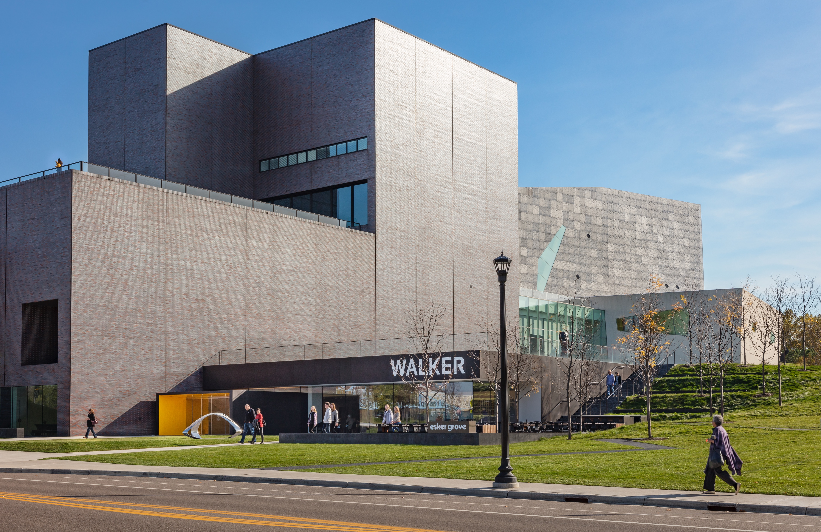
1. Identifying the Need.
Notes:
.

Slide 14
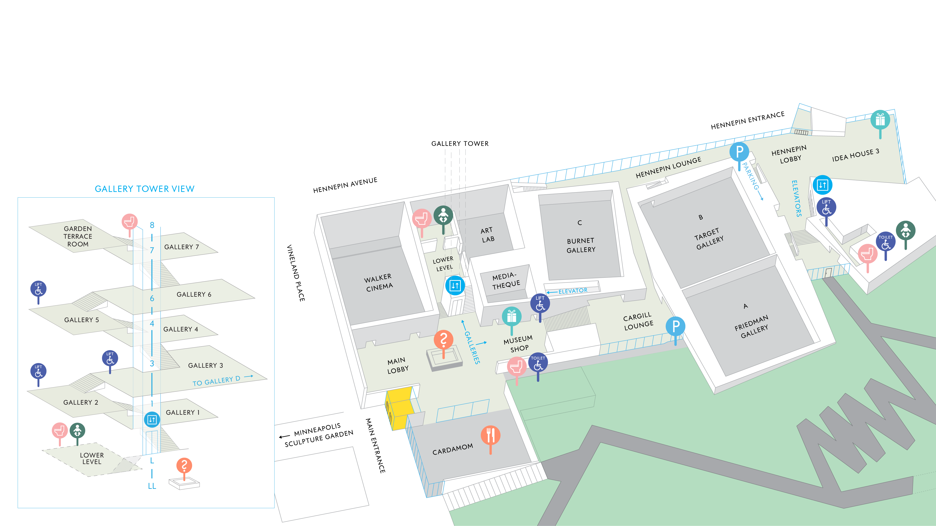
Walker Art Center Map

Slide 15
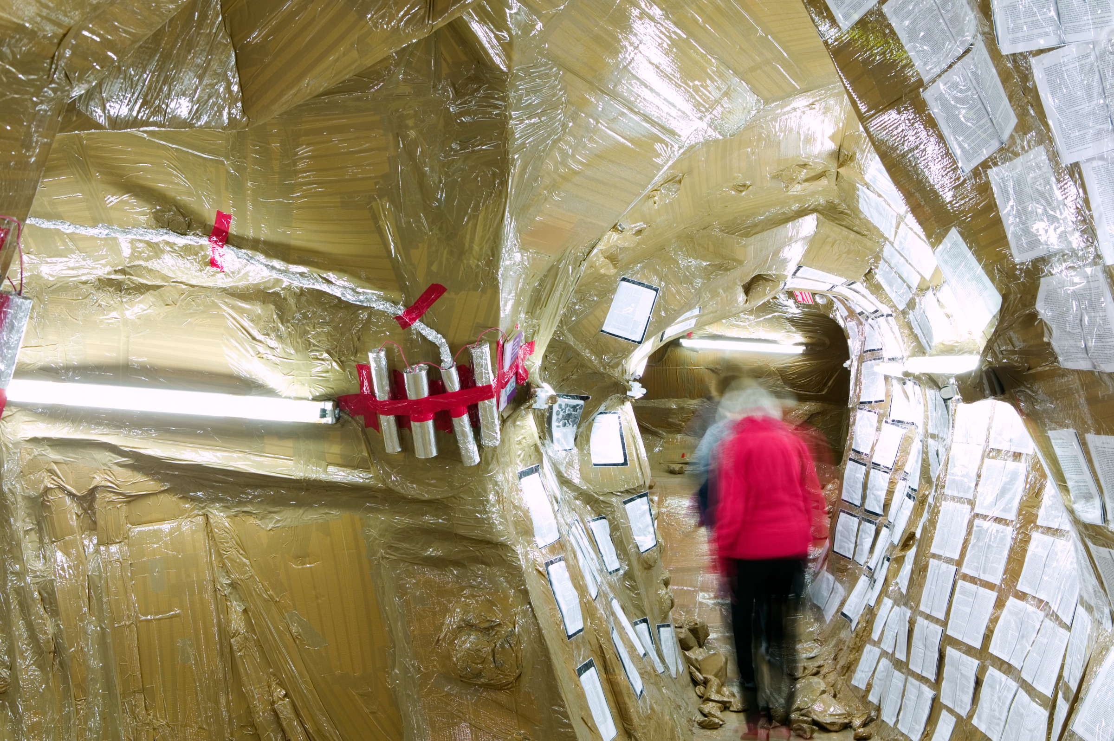
Installation view of the Thomas Hirschhorn environment, part of the exhibition Heart of Darkness, Galleries 4, 5, 6.
October 21, 2006 – January 14, 2007. Photo: Gene Pittman.

Slide 16
Laure Prouvost: They Are Waiting for You, Medtronic Gallery.
October 12, 2017 – February 11, 2018. Photo: Gene Pittman.

Slide 17
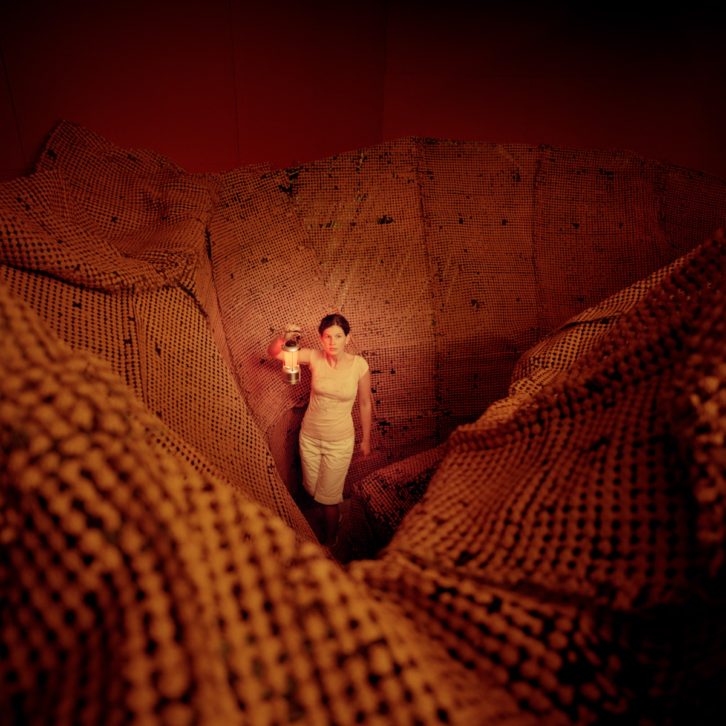
Installation view of Cameron Jamie, Target Gallery and Lecture Room.
July 16 – October 22, 2006. Photo: Cameron Wittig.

Slide 18
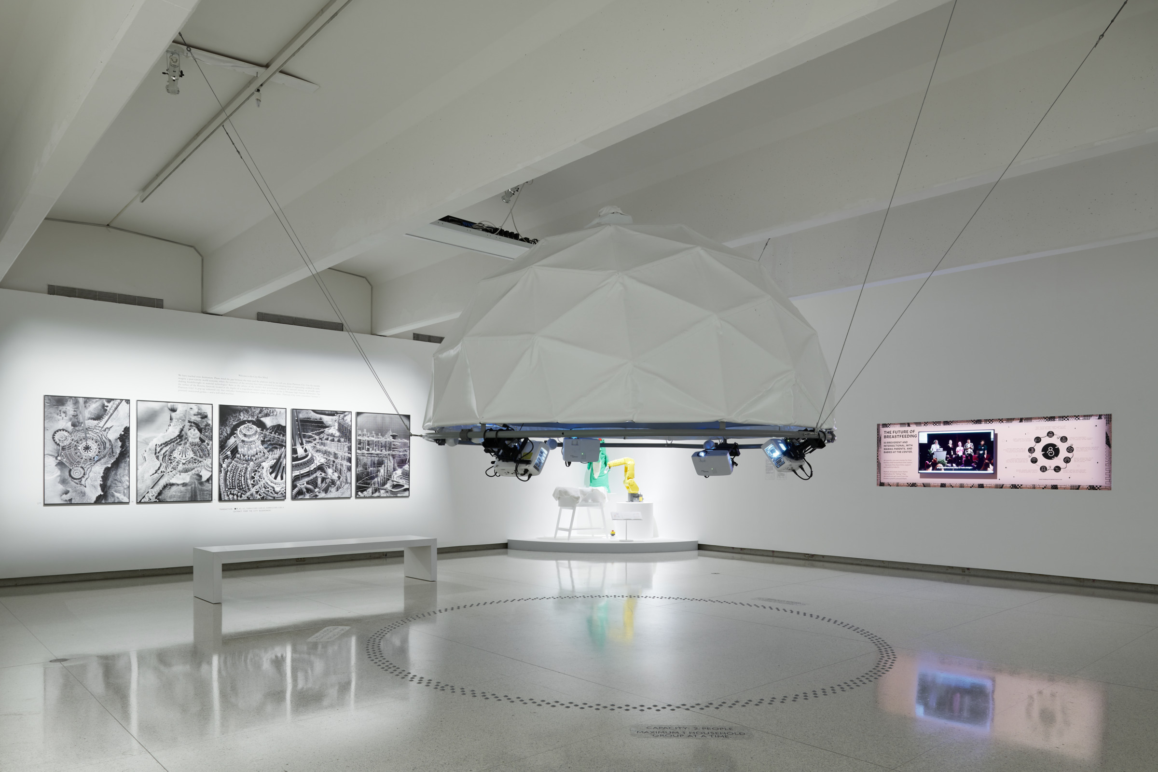
Installation view of Designs for Different Futures, Galleries 1, 2, 3, and Perlman.
September 12, 2020 – April 11, 2021. Photo: Peter VonDeLinde.

Slide 19
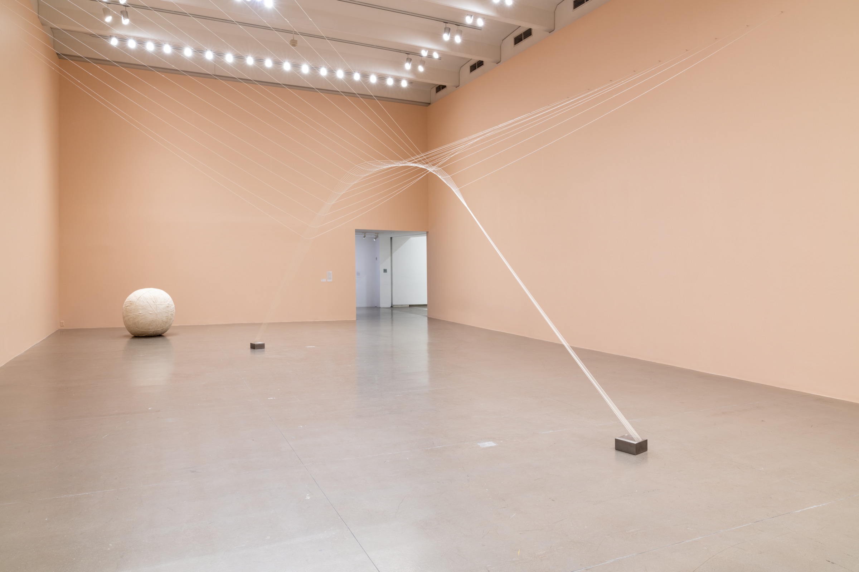
Installation view of Liz Larner: Don't put it back like it was, Galleries 1, 2, 3, and Perlman.
April 30 – September 4, 2022. Photo: Eric Mueller.

Slide 20
2. Research Phase

Slide 21
Sources Consulted
∙ Carolyn Lazard’s Accessibility in the Arts: A Promise and a Practice
∙ Smithsonian Guidelines for Accessible Exhibition Design
∙ Design for Accessibility: A Cultural Administrator’s Handbook
∙ National Museums of Scotland’s Exhibitions for All: A Practical Guide
for Designing Inclusive Exhibitions
∙ National Park Service’s Accessibility & Universal Design Standards
∙ Visitor feedback, partially summarized in A Welcoming & Confident Visitor
Experience, July 2022 Report; HGA and Walker Art Center
∙ Interviews with staff at:
Museum of Modern Art, New York
Portland Art Museum
Denver Art Museum

Slide 22
3. Iterative Drafting, Revision, and Implementation of Guidelines

Slide 23
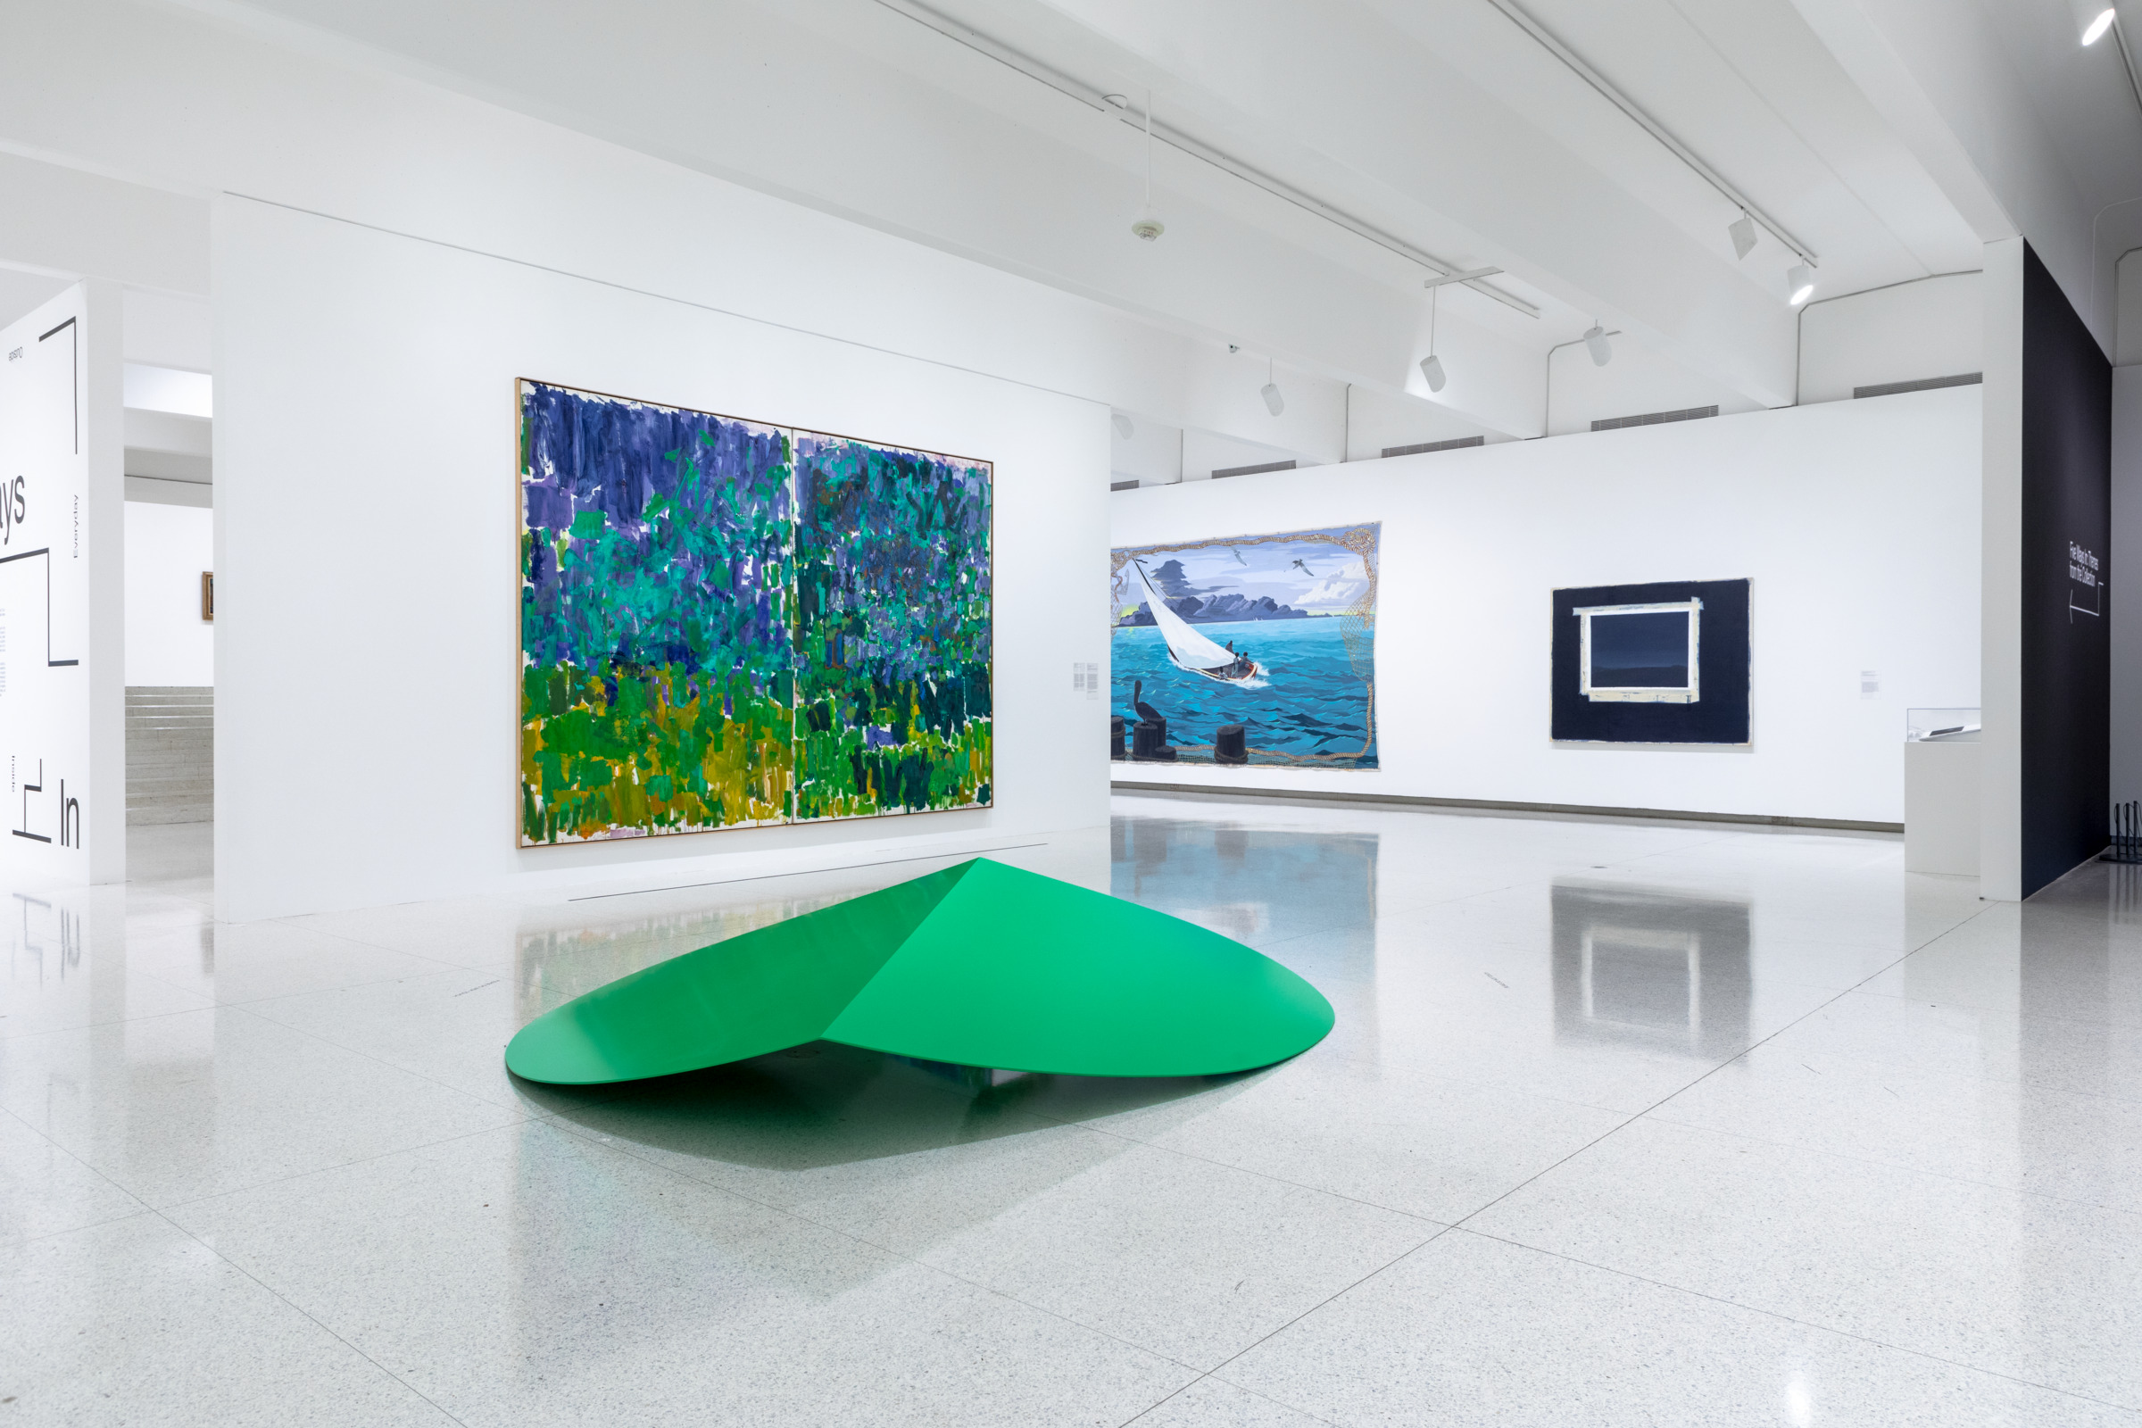
Installation view of Five Ways In: Themes from the Collection, Galleries 4, 5, 6.
February 14, 2019 – September 19, 2021. Photo: Bobby Rogers.

Slide 24
Refined Terminology
Instead of “circulation route,” we use:
Path of Travel or Approach: In an exhibition, the path of travel or approach is defined as the open floor space available to access and view/experience artwork on display. All art and non-art objects (furniture, benches, etc.) in an exhibition space should be placed so they are perceptible/detectable by a visitor as approached within the path of travel or approach.
Perceptible/detectable: An object is perceptible/detectable when its placement within the gallery provides multiple cues for a visitor to become aware of its presence, in order to avoid contact. The display of artworks that are less perceptible/detectable should employ mitigation solutions to improve their perceptibility.
3. Iterative Drafting, Revision, and Implementation of Guidelines

Slide 25
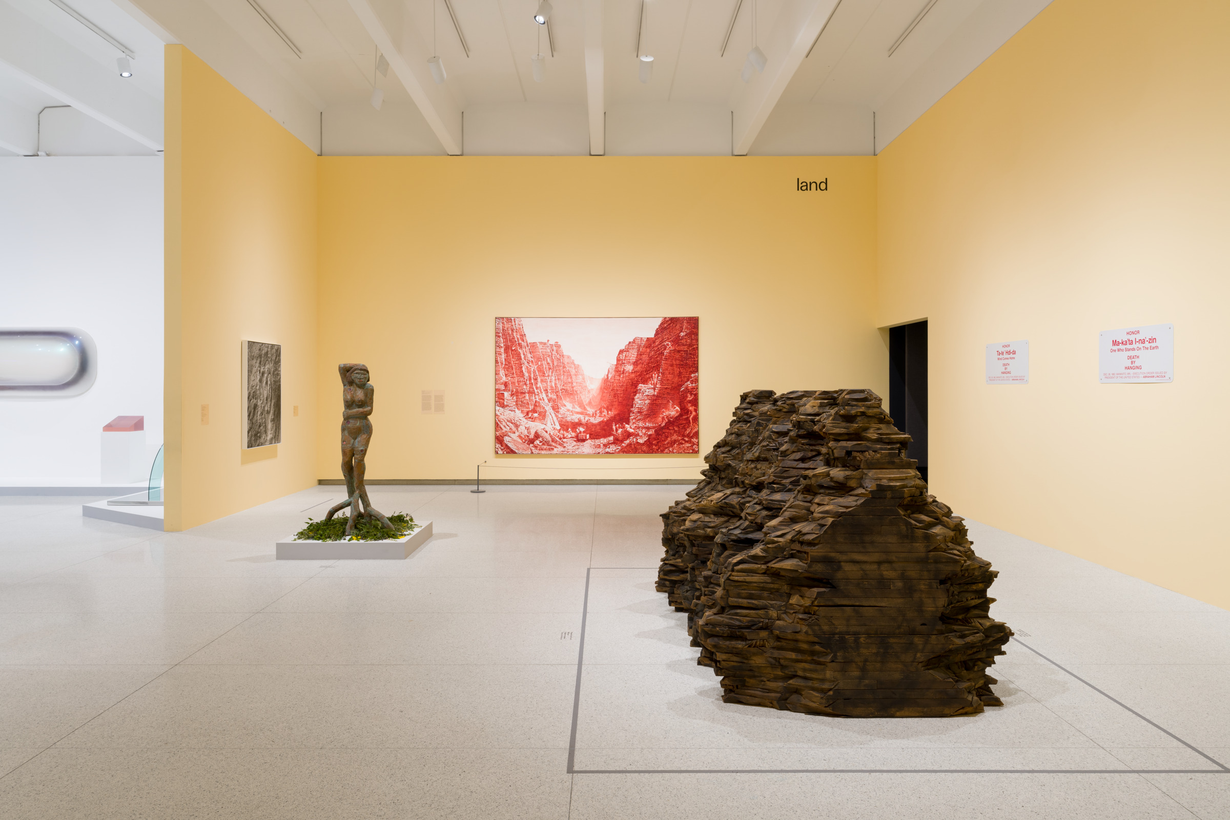
Installation view of This Must Be the Place: Inside the Walker’s Collection, Galleries 4, 5, 6.
June 20, 2024 – April 29, 2029. Photo: Eric Mueller.

Slide 26
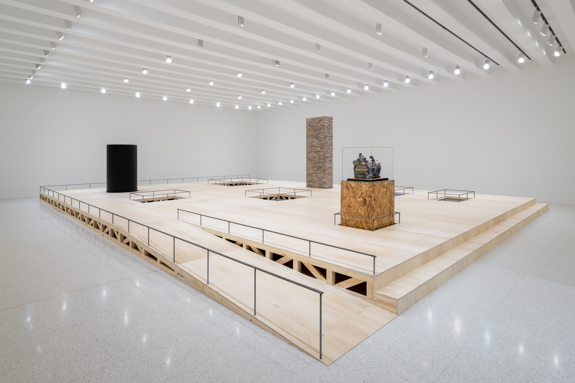
Installation view of Kahlil Robert Irving: Archaeology of the Present, Burnet Gallery.
February 23, 2023 – January 21, 2024. Photo: Eric Mueller.

Slide 27
3a. User Testing by Staff

Slide 28
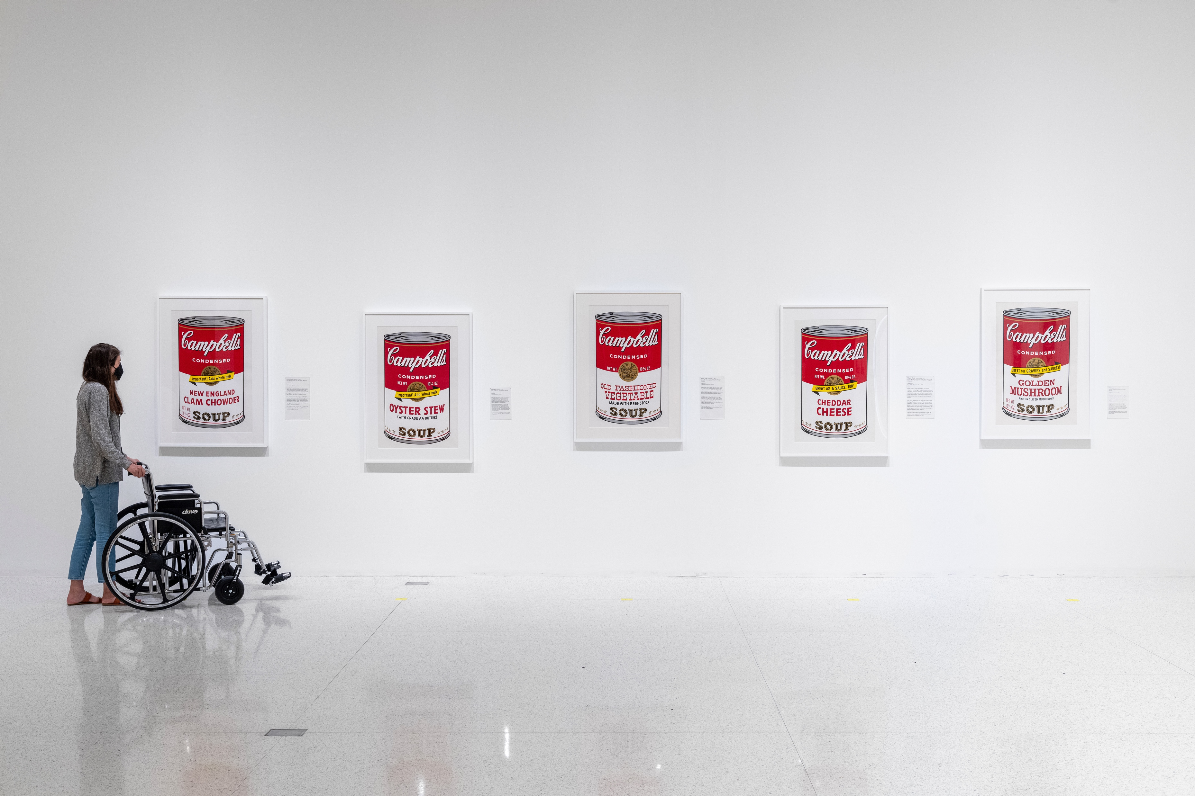
Facilitated Gallery Experience, 2022. Photo: Eric Mueller.

Slide 29
Facilitated Gallery Experience
○ Group conversations with emphasis on experience
○ Written and verbal feedback compiled to help set standards
Drafting the Guidelines – 3a. User Testing by Staff

Slide 30
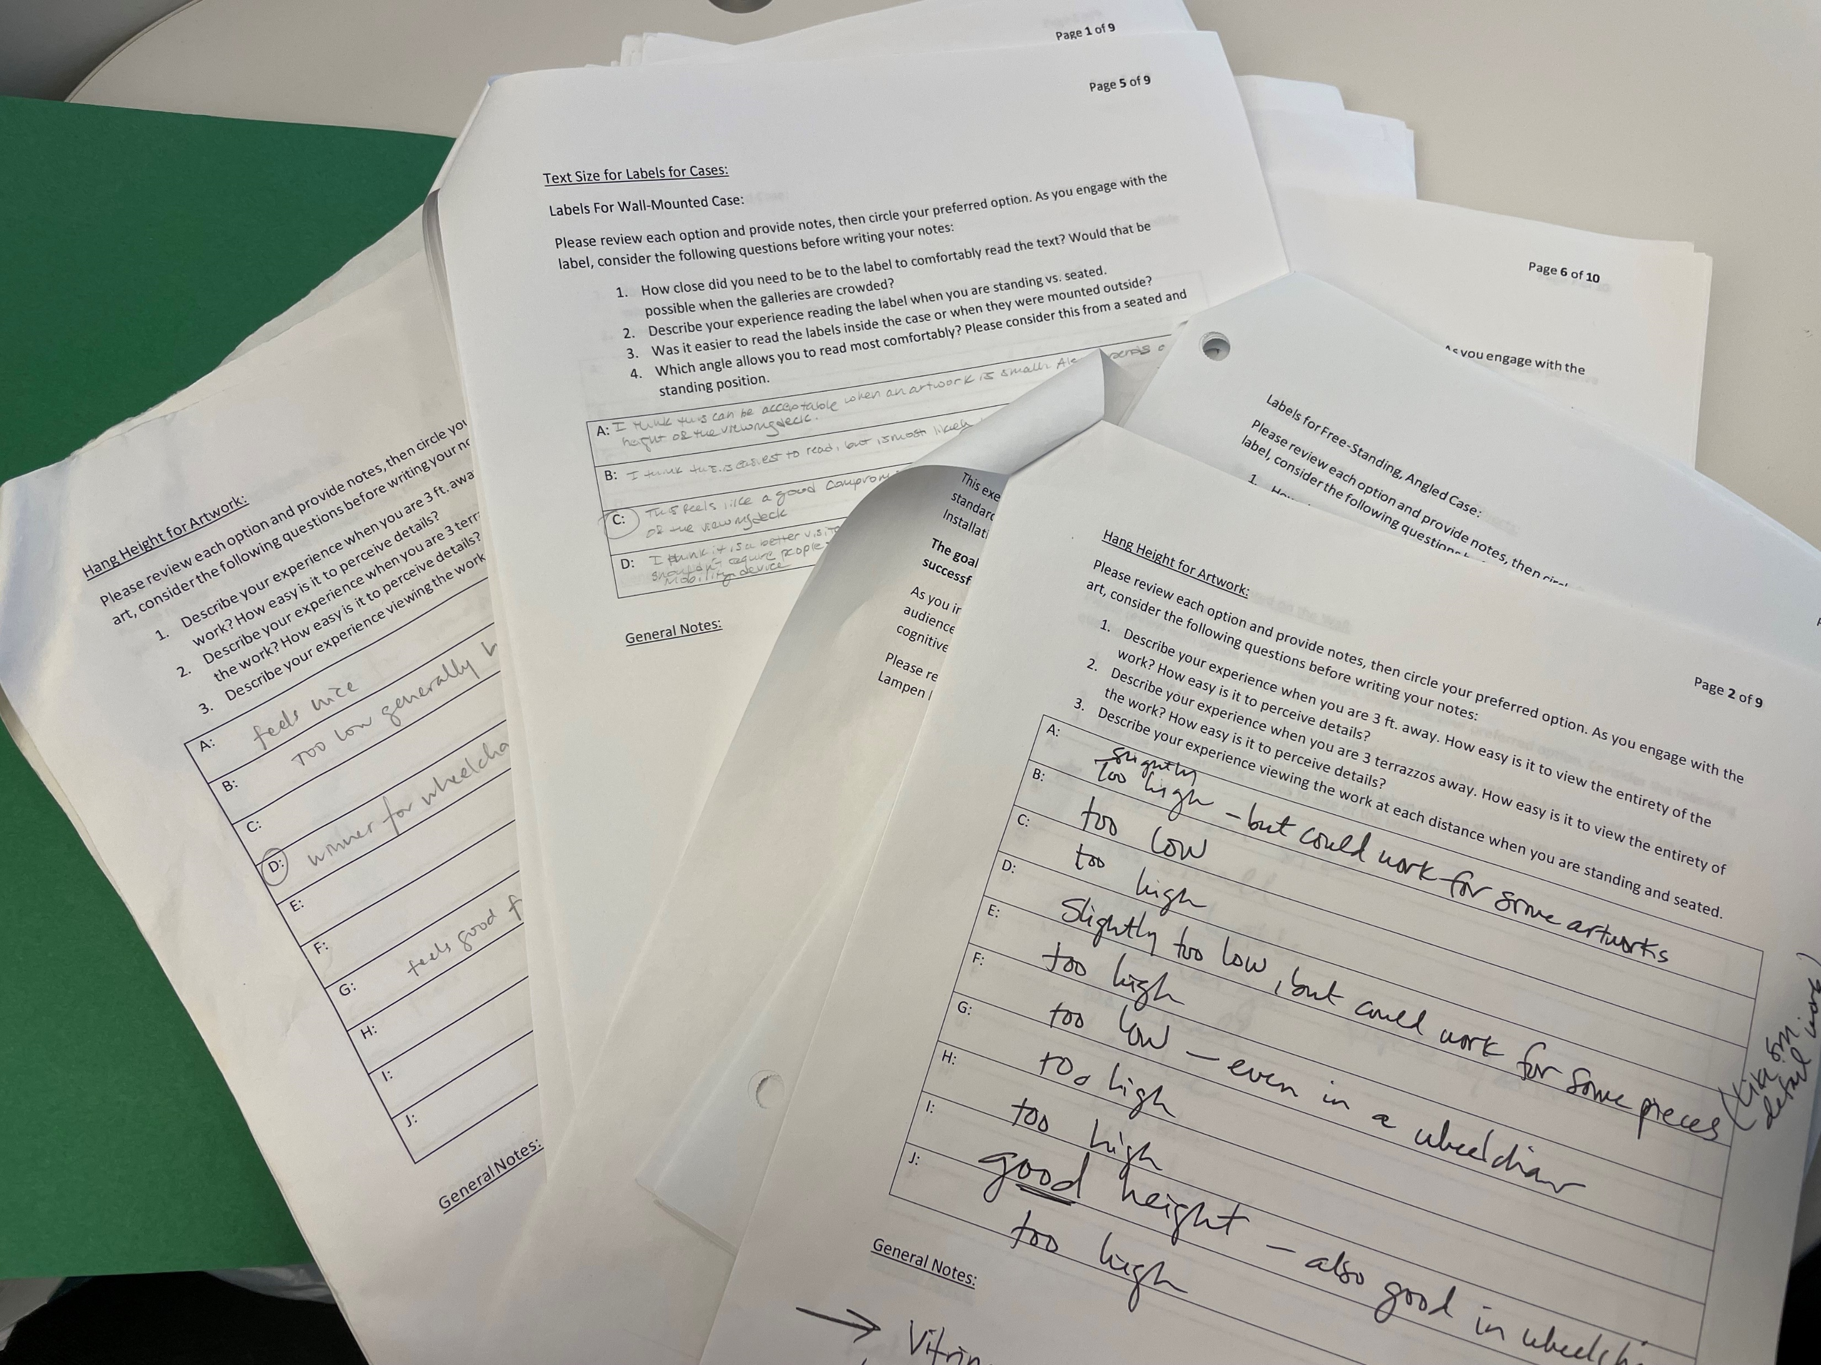
Facilitated Gallery Experience

Slide 31
Example Prompts:
○ Describe your experience when you are 3 feet away, then at 9 feet away. How easy is it to view the entirety of the artwork? How easy is it to perceive details?
○ Describe your experience viewing the work at each distance when you are standing and seated.
○ Would this label be possible to read when the gallery is crowded?
○ How close did you need to be to the label to comfortably read it?
Drafting the Guidelines – 3a. User Testing by Staff

Slide 32
What Did We Standardize?
1. Hanging height for artwork
2. Text size for different types of labels
3. Detectable/perceptible approach
Additionally:
○ Pitch/location of different types of labels
○ Distance between artworks/ stanchions/walls
Drafting the Guidelines – 3a. User Testing by Staff

Slide 33
What Did We Standardize?
1. Hanging height for artwork
For this purpose, “hanging height” refers to the height of the center of an artwork.
Drafting the Guidelines – 3a. User Testing by Staff

Slide 34
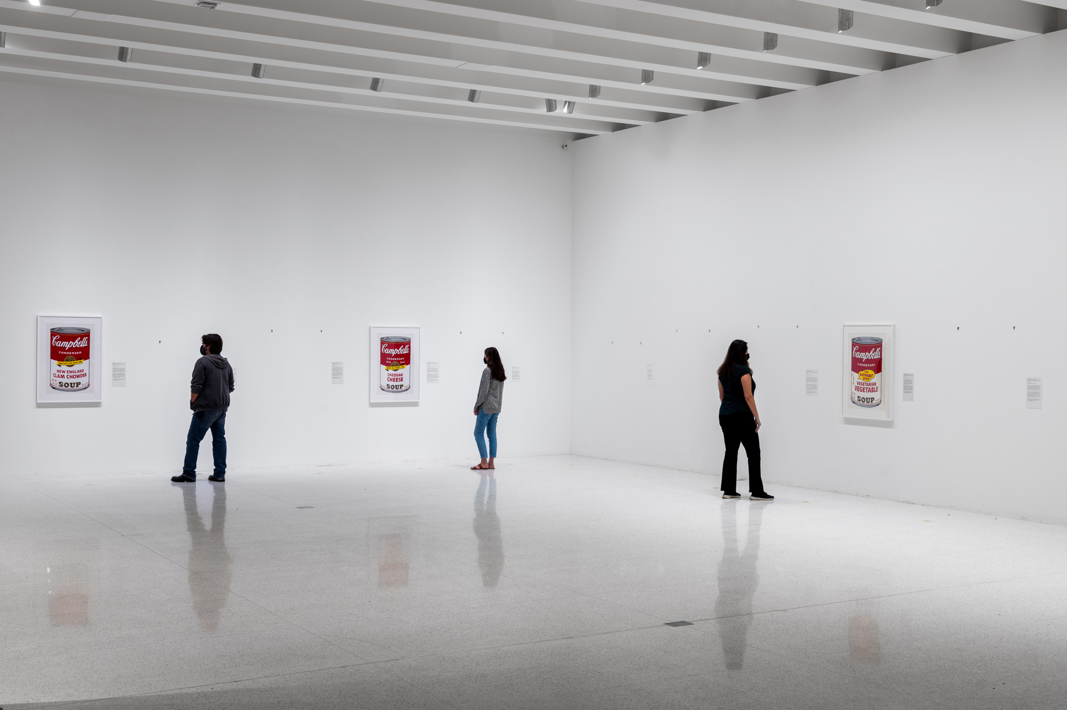
Facilitated Gallery Experience—Hanging Height, 2022. Photo: Eric Mueller.

Slide 35
What Did We Standardize?
Drafting the Guidelines – 3a. User Testing by Staff
1. Hanging height for artwork
For this purpose, “hanging height” refers to the height of the center of an artwork.
Formerly:
Curatorial Discretion
(typically 58–60 in.)

Slide 36
1. Hanging height for artwork
For this purpose, “hanging height” refers to the height of the center of an artwork.
Drafting the Guidelines – 3a. User Testing by Staff
What Did We Standardize?
Formerly:
Curatorial Discretion
(typically 58–60 in.)
Now:
56–59 in.
This was established for medium-sized works.
The measurement would be adjusted for large-scale works.

Slide 37
What Did We Standardize? 1 of 3
Drafting the Guidelines – 3a. User Testing by Staff
Letter Assigned to Each Artwork | Hanging Height | Reaction to Height *
B | 54 in. | -1
F | 55 in. | -3
D | 56 in. | 7
I | 57 in. | 7
A | 59 in. | 7
C | 60 in. | 3
E | 61 in. | 1
G | 62 in. | -3
J | 63 in. | -5
H | 64 in. | -7
* Negative = unfavorable response;
Positive = favorable response

Slide 38
What Did We Standardize?
2. Text size for different types of labels
Drafting the Guidelines – 3a. User Testing by Staff

Slide 39
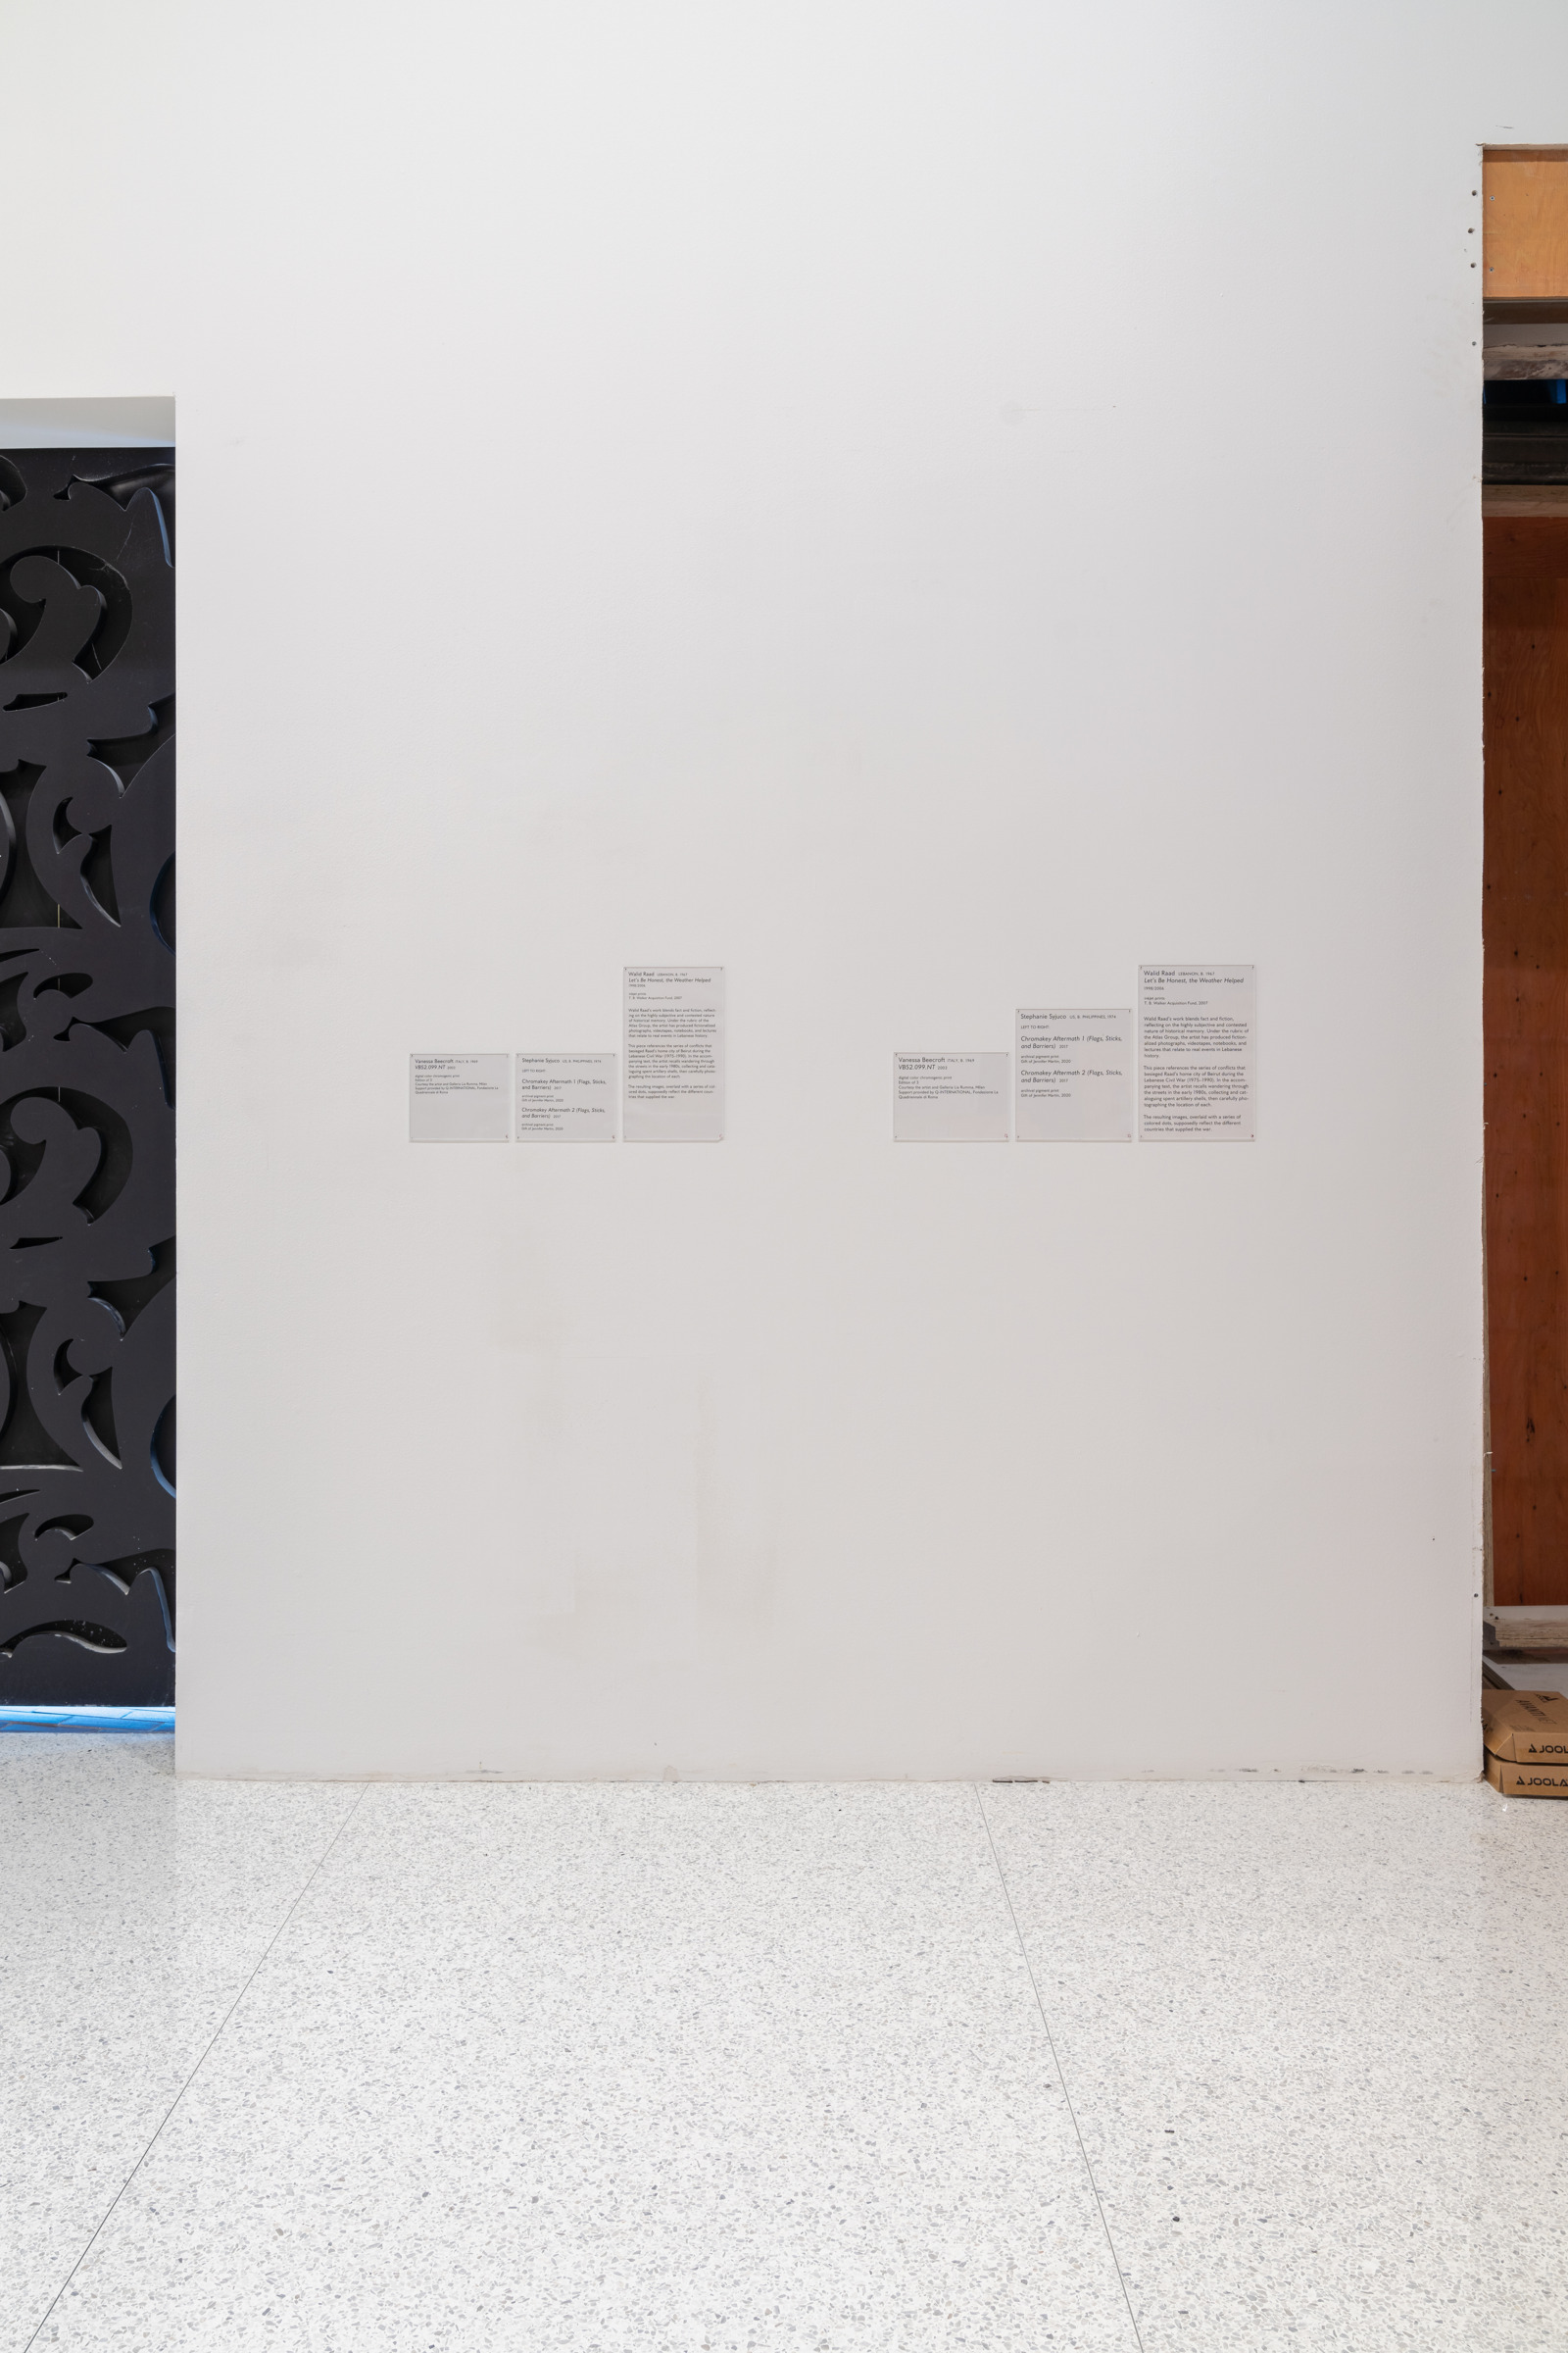
Facilitated Gallery Experience—Label Size, 2022. Photo: Eric Mueller.

Slide 40
What Did We Standardize?
2. Text size for different types of labels
Drafting the Guidelines – 3a. User Testing by Staff
Formerly:
Type size/leading:
16.5 pt / 20 pt
Label width: 6 in.

Slide 41
What Did We Standardize? 2 of 3
2. Text size for different types of labels
Drafting the Guidelines – 3a. User Testing by Staff
Formerly:
Type size/leading:
16.5 pt / 20 pt
Label width: 6 in.
Now:
Type size/leading:
20 pt / 24 pt
Label width: 7 in.

Slide 42
What Did We Socialize?
3. Detectable/perceptible approach
Drafting the Guidelines – 3a. User Testing by Staff

Slide 43
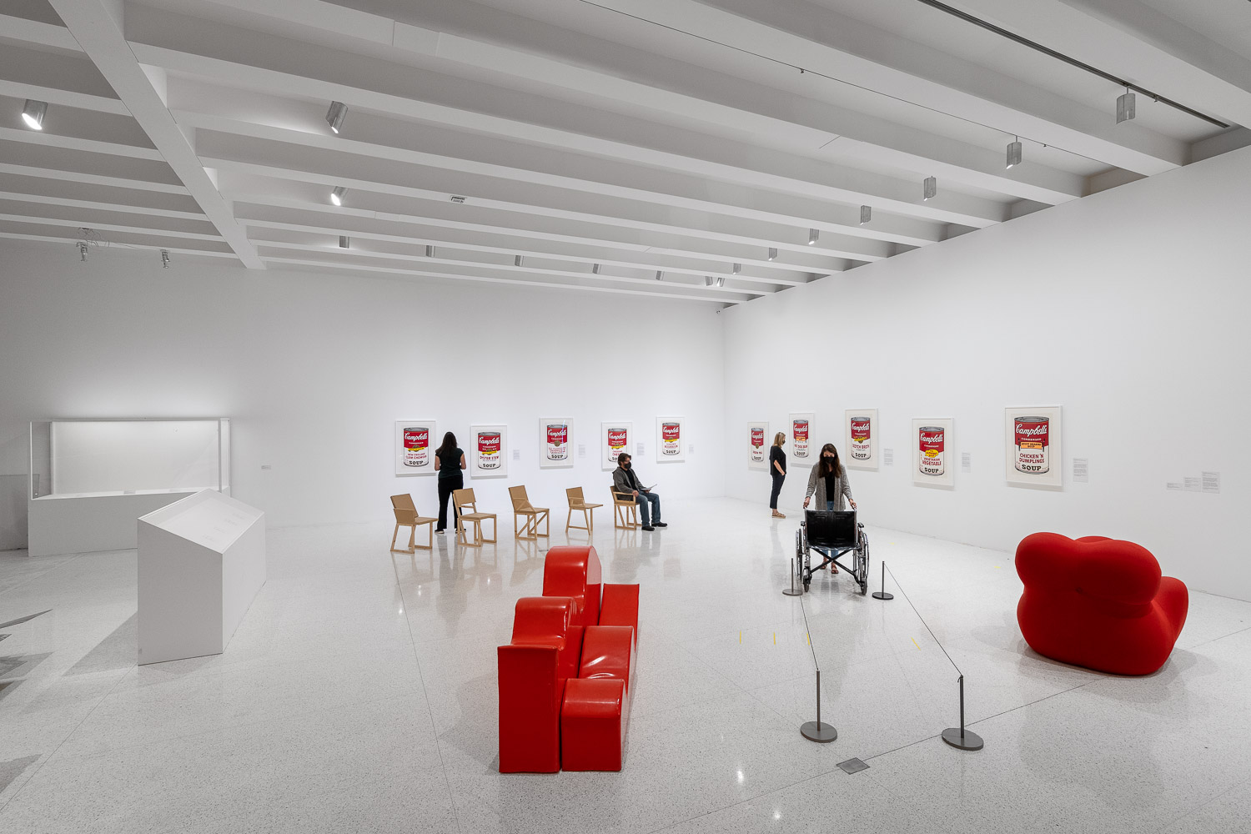
Facilitated Gallery Experience—Installation, 2022. Photo: Eric Mueller.

Slide 44
What Did We Standardize?
3. Detectable/perceptible approach
Drafting the Guidelines – 3a. User Testing by Staff
Formerly:
ADA “circulation routes”
that were interpreted as passageways and corridors

Slide 45
What Did We Standardize?
3. Detectable/perceptible approach
Drafting the Guidelines – 3a. User Testing by Staff
Formerly:
ADA “circulation routes”
that were interpreted as passageways and corridors
Now:
Center artwork and viewer’s relationship in space

Slide 46
Sound Test: Current Plan
Drafting the Guidelines – 3a. User Testing by Staff
○ Facilitate group conversations with emphasis
on experience
○ Ask staff to experience artworks at multiple volumes,
moving through space to understand how sound travels
○ Facilitate this process with 1–3 artworks with sound
sharing space

Slide 47
Installation views of Andrea Büttner: Piano Destructions, Medtronic Gallery.
November 21, 2015 – May 15, 2016. Photo: Gene Pittman.

Slide 48
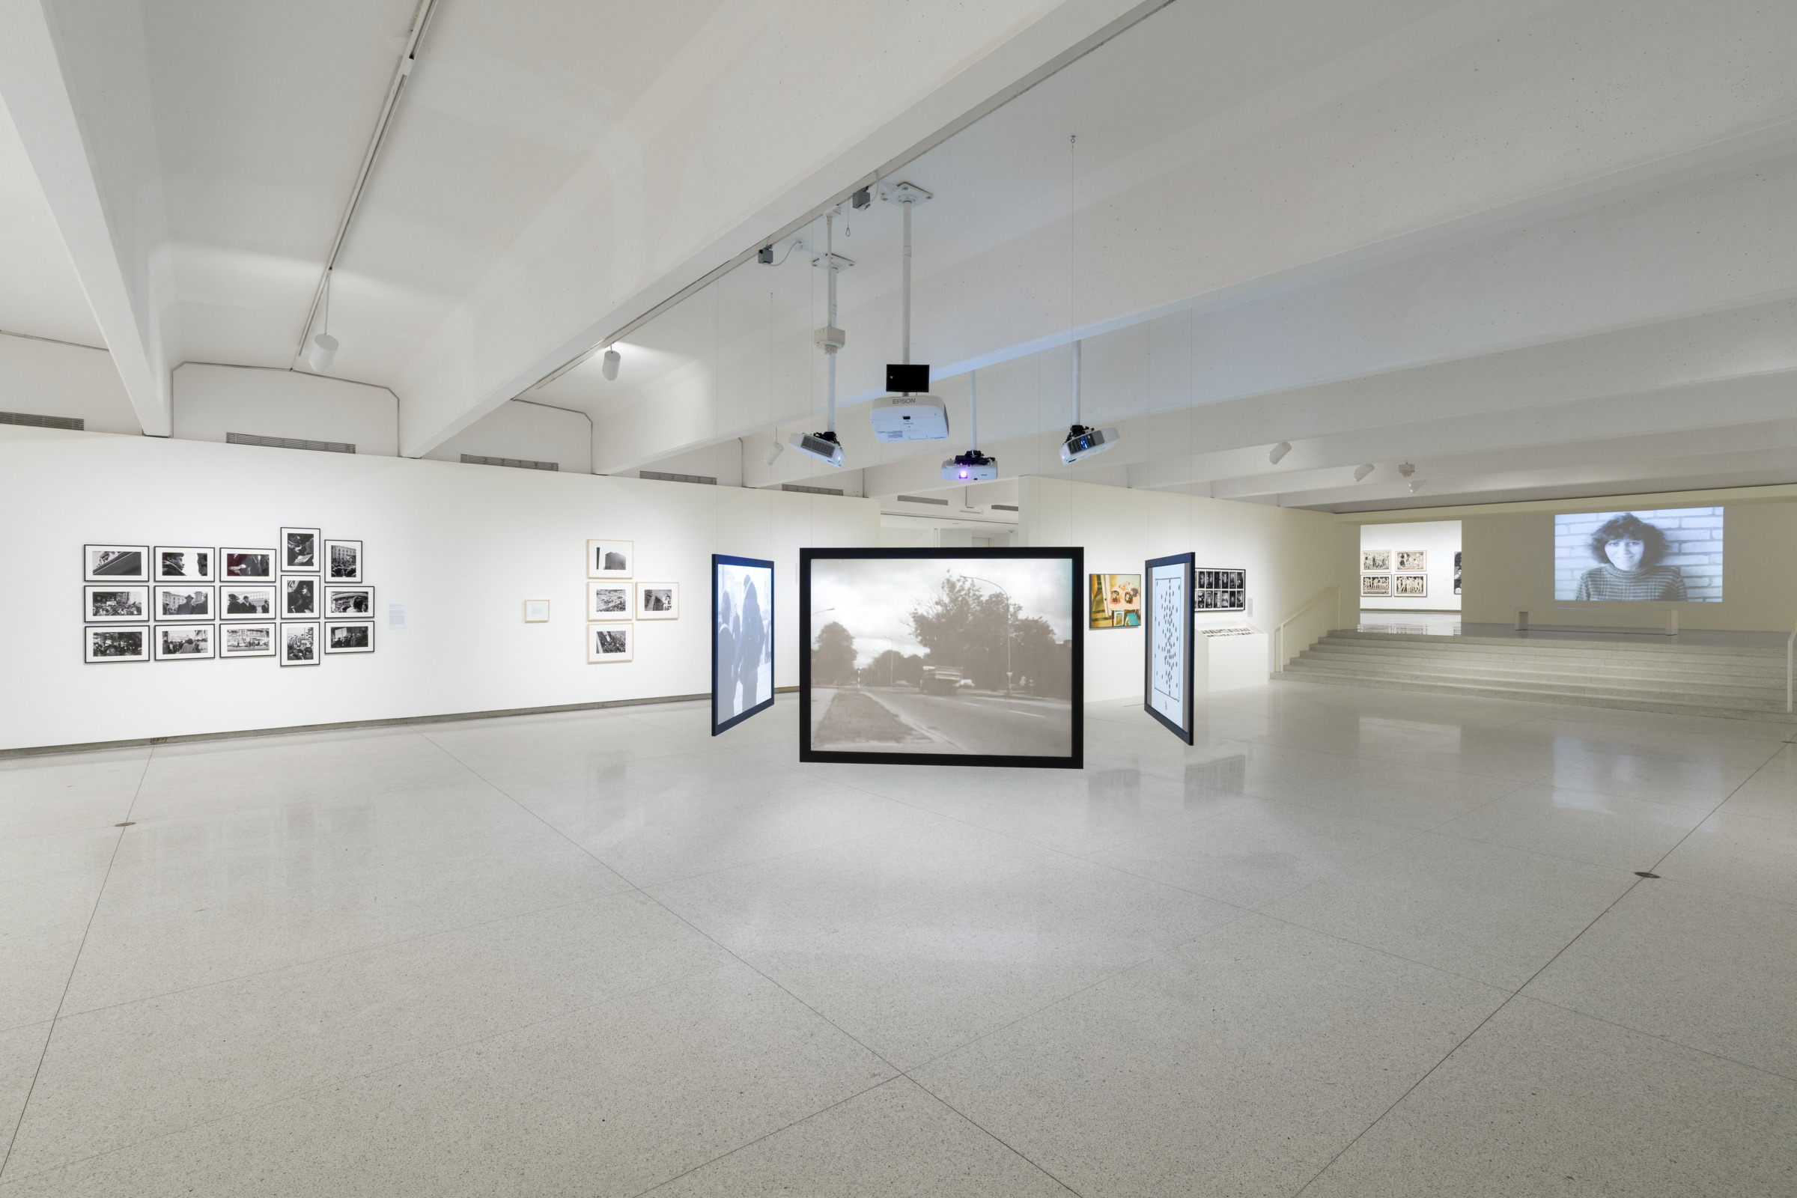
Installation view of Multiple Realities: Experimental Art in the Eastern Bloc, 1960s–1980s, Galleries 1, 2, 3, Perlman.
November 11, 2023 – March 10, 2024. Photo: Eric Mueller.

Slide 49
Sound Test: Standards in Progress
Drafting the Guidelines – 3a. User Testing by Staff
Formerly:
○ Considered in terms of maximum decibels

Slide 50
Sound Test: Standards in Progress 2 of 2
Drafting the Guidelines – 3a. User Testing by Staff
Formerly:
○ Considered in terms of maximum decibels
Current Considerations:
○ Total cumulative decibels
○ Overlapping sound from multiple artworks
○ Type of sound (e.g., ambient fan noise has
a different impact than sirens)
○ Sound travel outside of the gallery and
into adjacent and/or public spaces

Slide 51
3b. Institute for Human Centered
Design Review

Slide 52
Review of Guidelines by Institute for Human Centered Design
Revision of Guidelines – 3b. Institute for Human Centered Design Review
Site visit:
○ Reviews of current exhibitions installed according to draft
guidelines with Curatorial, Registration, Learning, and
Exhibition Installation staff
○ Meetings with staff to increase awareness and facilitate
understanding
○ Review of guidelines with feedback emphasizing
both ADA compliance and suggestions to go beyond
compliance

Slide 53
3c. User Testing by Community Stakeholders

Slide 54
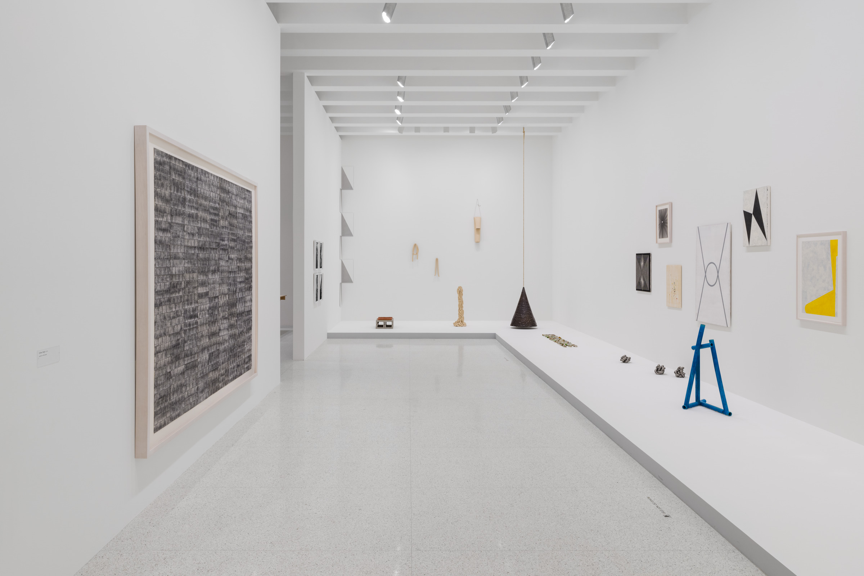
Installation view of Tetsuya Yamada: Listening, Burnet Gallery.
January 18 – July 7, 2024. Photo: Eric Mueller.

Slide 55
Feedback from Disabled Community
Revision of Guidelines – 3c. User Testing by Community Stakeholders
○ Compensated solo or guided visits,
depending on person’s preference
○ Follow-up discussions
○ Compilation of verbal and written feedback

Slide 56
Feedback from Disabled Community 2 of 2
Revision of Guidelines – 3c. User Testing by Community Stakeholders
○ Standard questions designed to understand:
  – How comfortable visitors felt in exhibitions
  – Their experience navigating exhibitions
  – Their sensory experience
  – Ease with which they were able to access
  the art and interpretation

Slide 57
Findings
Revision of Guidelines – 3c. User Testing by Community Stakeholders
○ The importance of consistency
○ The importance of contrast for legibility and visibility
○ The importance of giving visitors the opportunity to
opt into experiences with extreme sensory input
○ The importance of soliciting input from disabled partners

Slide 58
4. Refine Exhibition-Making Process,
Timeline, and Milestones

Slide 59
Exhibition Case Study:
Guidelines in Practice:
Refine Exhibition-Making Process
Installation view of Paul Chan: Breathers, Target and Friedman Galleries.
November 17, 2022 – July 16, 2023. Photo: Kameron Herndon.

Slide 60
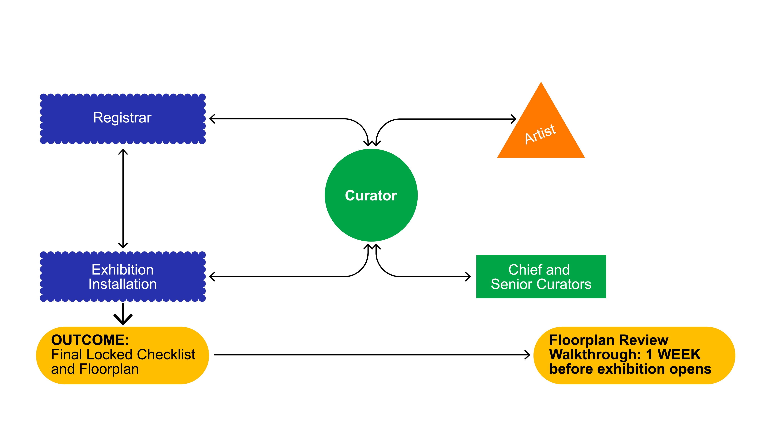
Walker Process for Exhibition Development
Refine Exhibition-Making Process

Slide 61
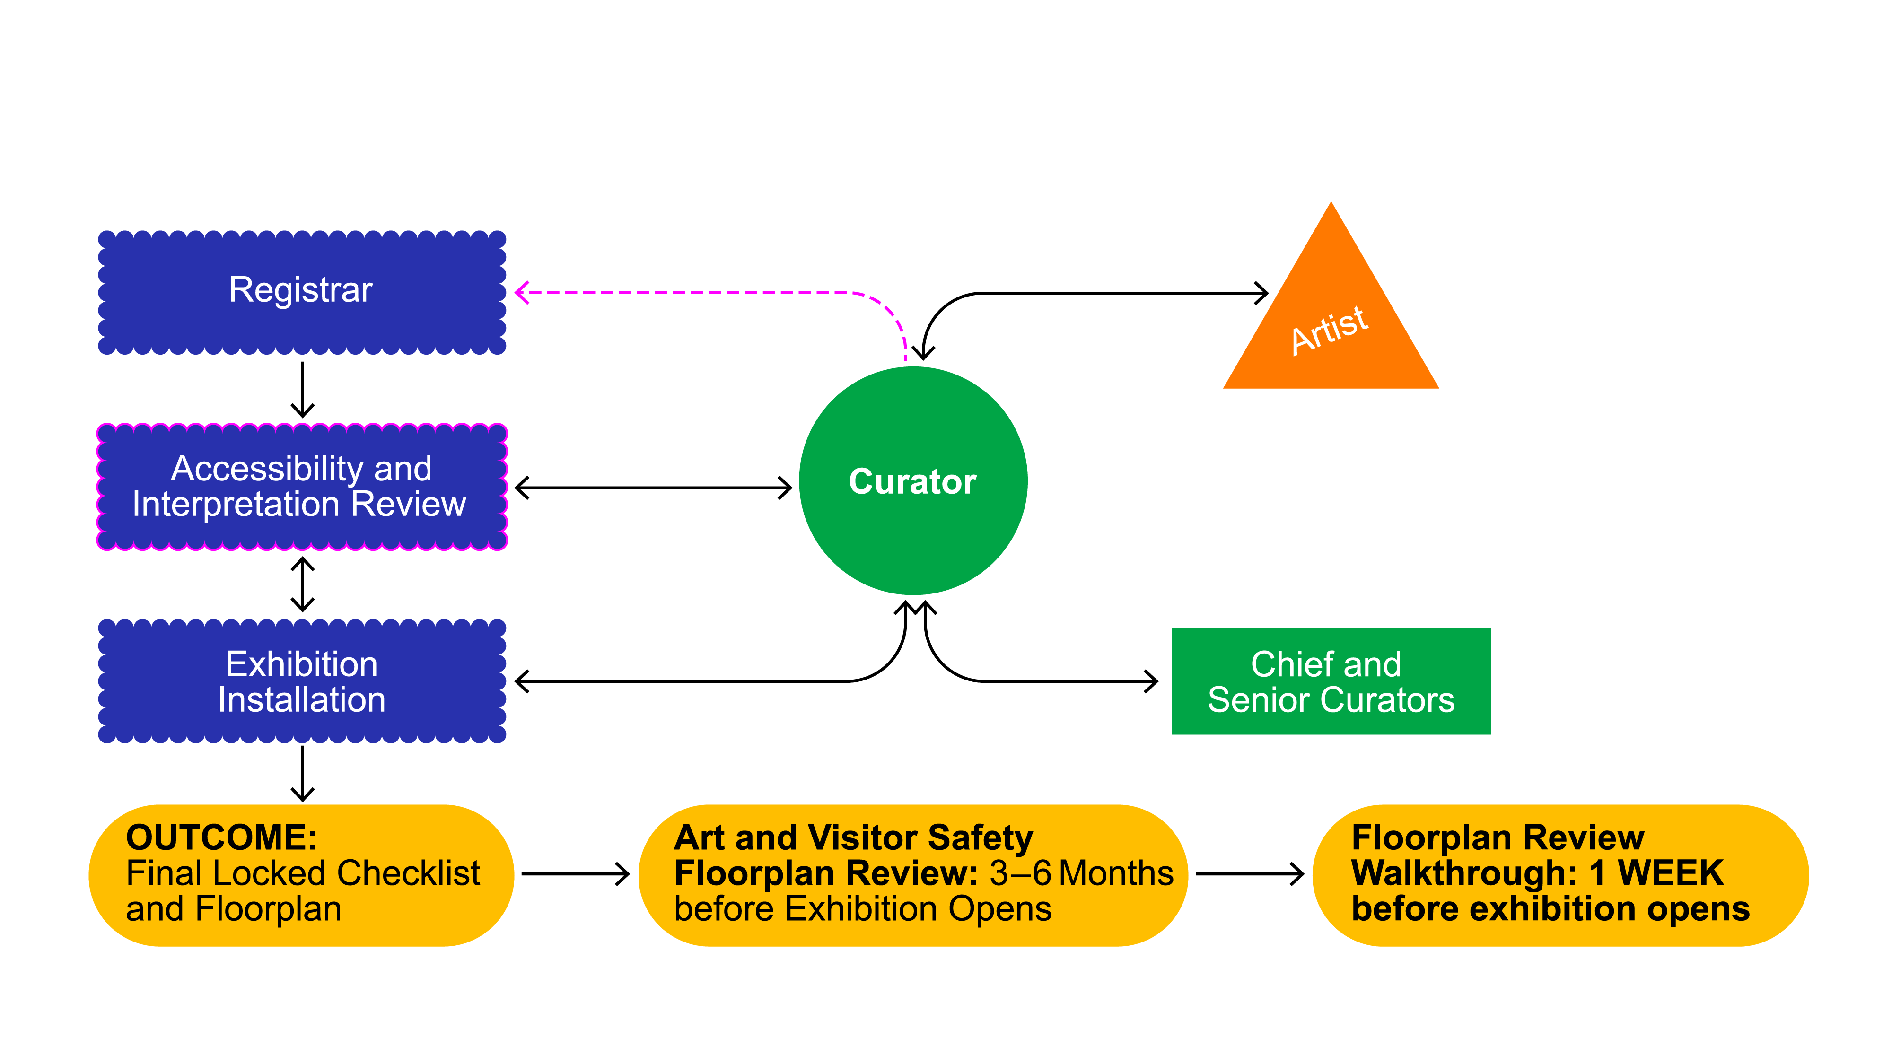
Walker Process for Exhibition Development Revised
Refine Exhibition-Making Process
*Attempt to streamline this process into
fewer transmissions from curator to registrar.

Slide 62
Walker Process for Exhibition Development
○ Curator: applies guidelines; feedback from senior curators
○ Registrar: checklist formation
○ Accessibility and Interpretation Review:
formal gate before creation of floorplan; detailed list of concerns and suggestions
○ Exhibition Installation: physical floorplan cutouts and/or digital floorplan; adds PELI colleagues to production meetings to review concerns at key moments
Refine Exhibition-Making Process

Slide 63
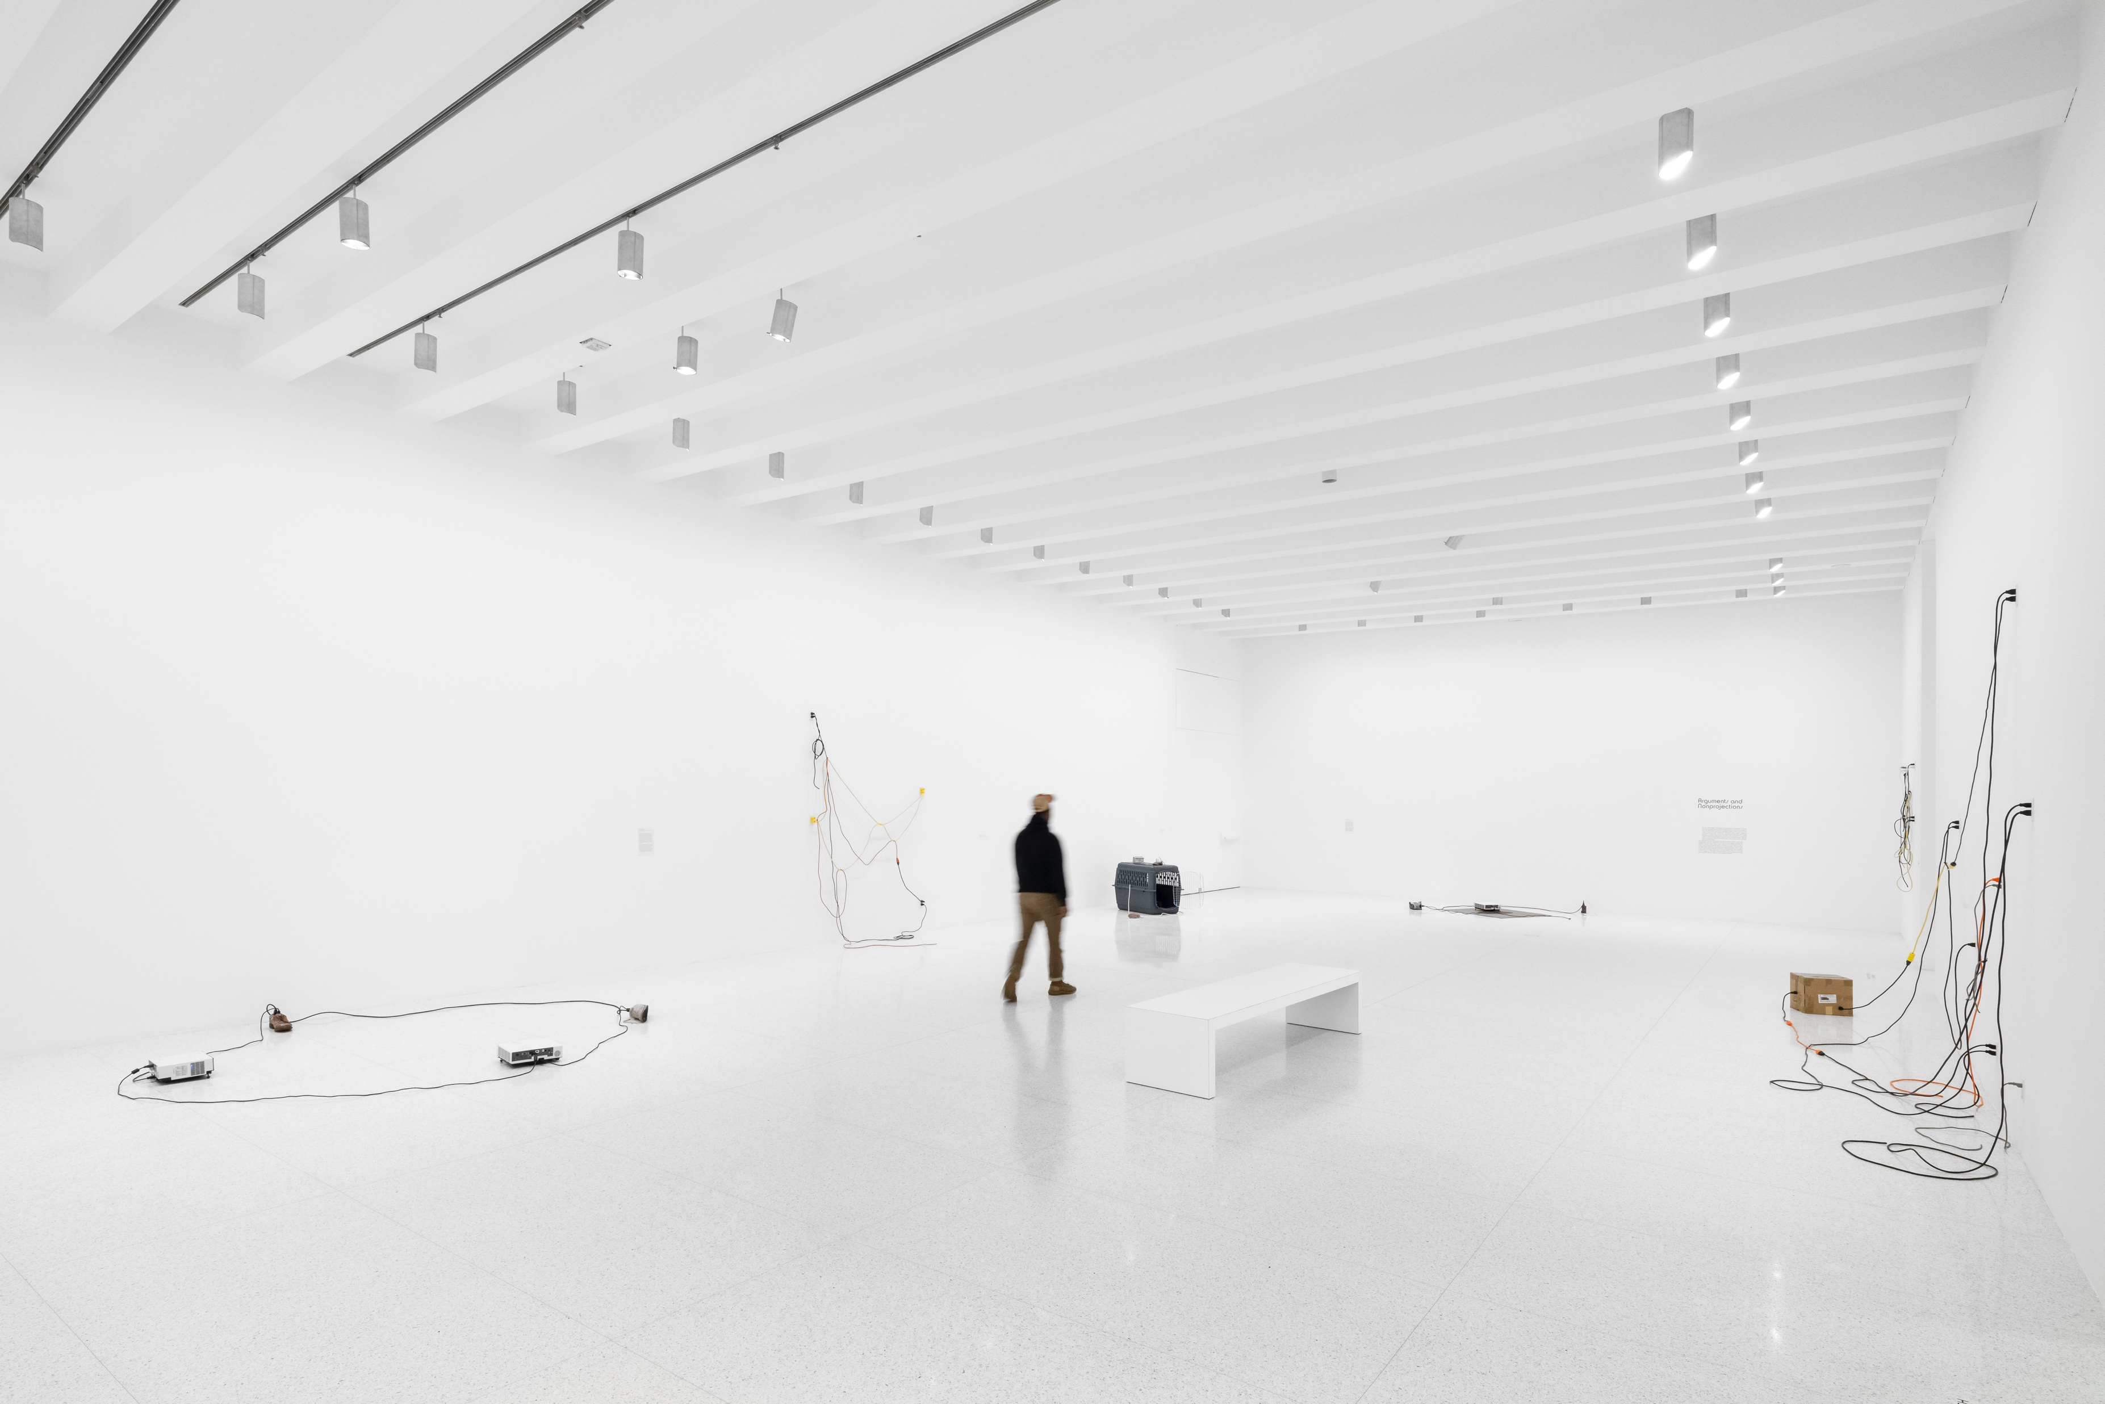
Exhibition Case Study
Refine Exhibition-Making Process
Installation view of Paul Chan: Breathers, Target and Friedman Galleries.
November 17, 2022 – July 16, 2023. Photo: Kameron Herndon.

Slide 64
5. Next Steps

Slide 65
Next Steps
○ Provide support for conversations with
  artists about audio accessibility
○ Training for Curatorial, Registration,
and Exhibition Installation staff

Slide 66
Next Steps 2 of 2
○ Living Document
  – Continue to collect feedback as we
  open new exhibitions
  – Continued revision

Slide 67
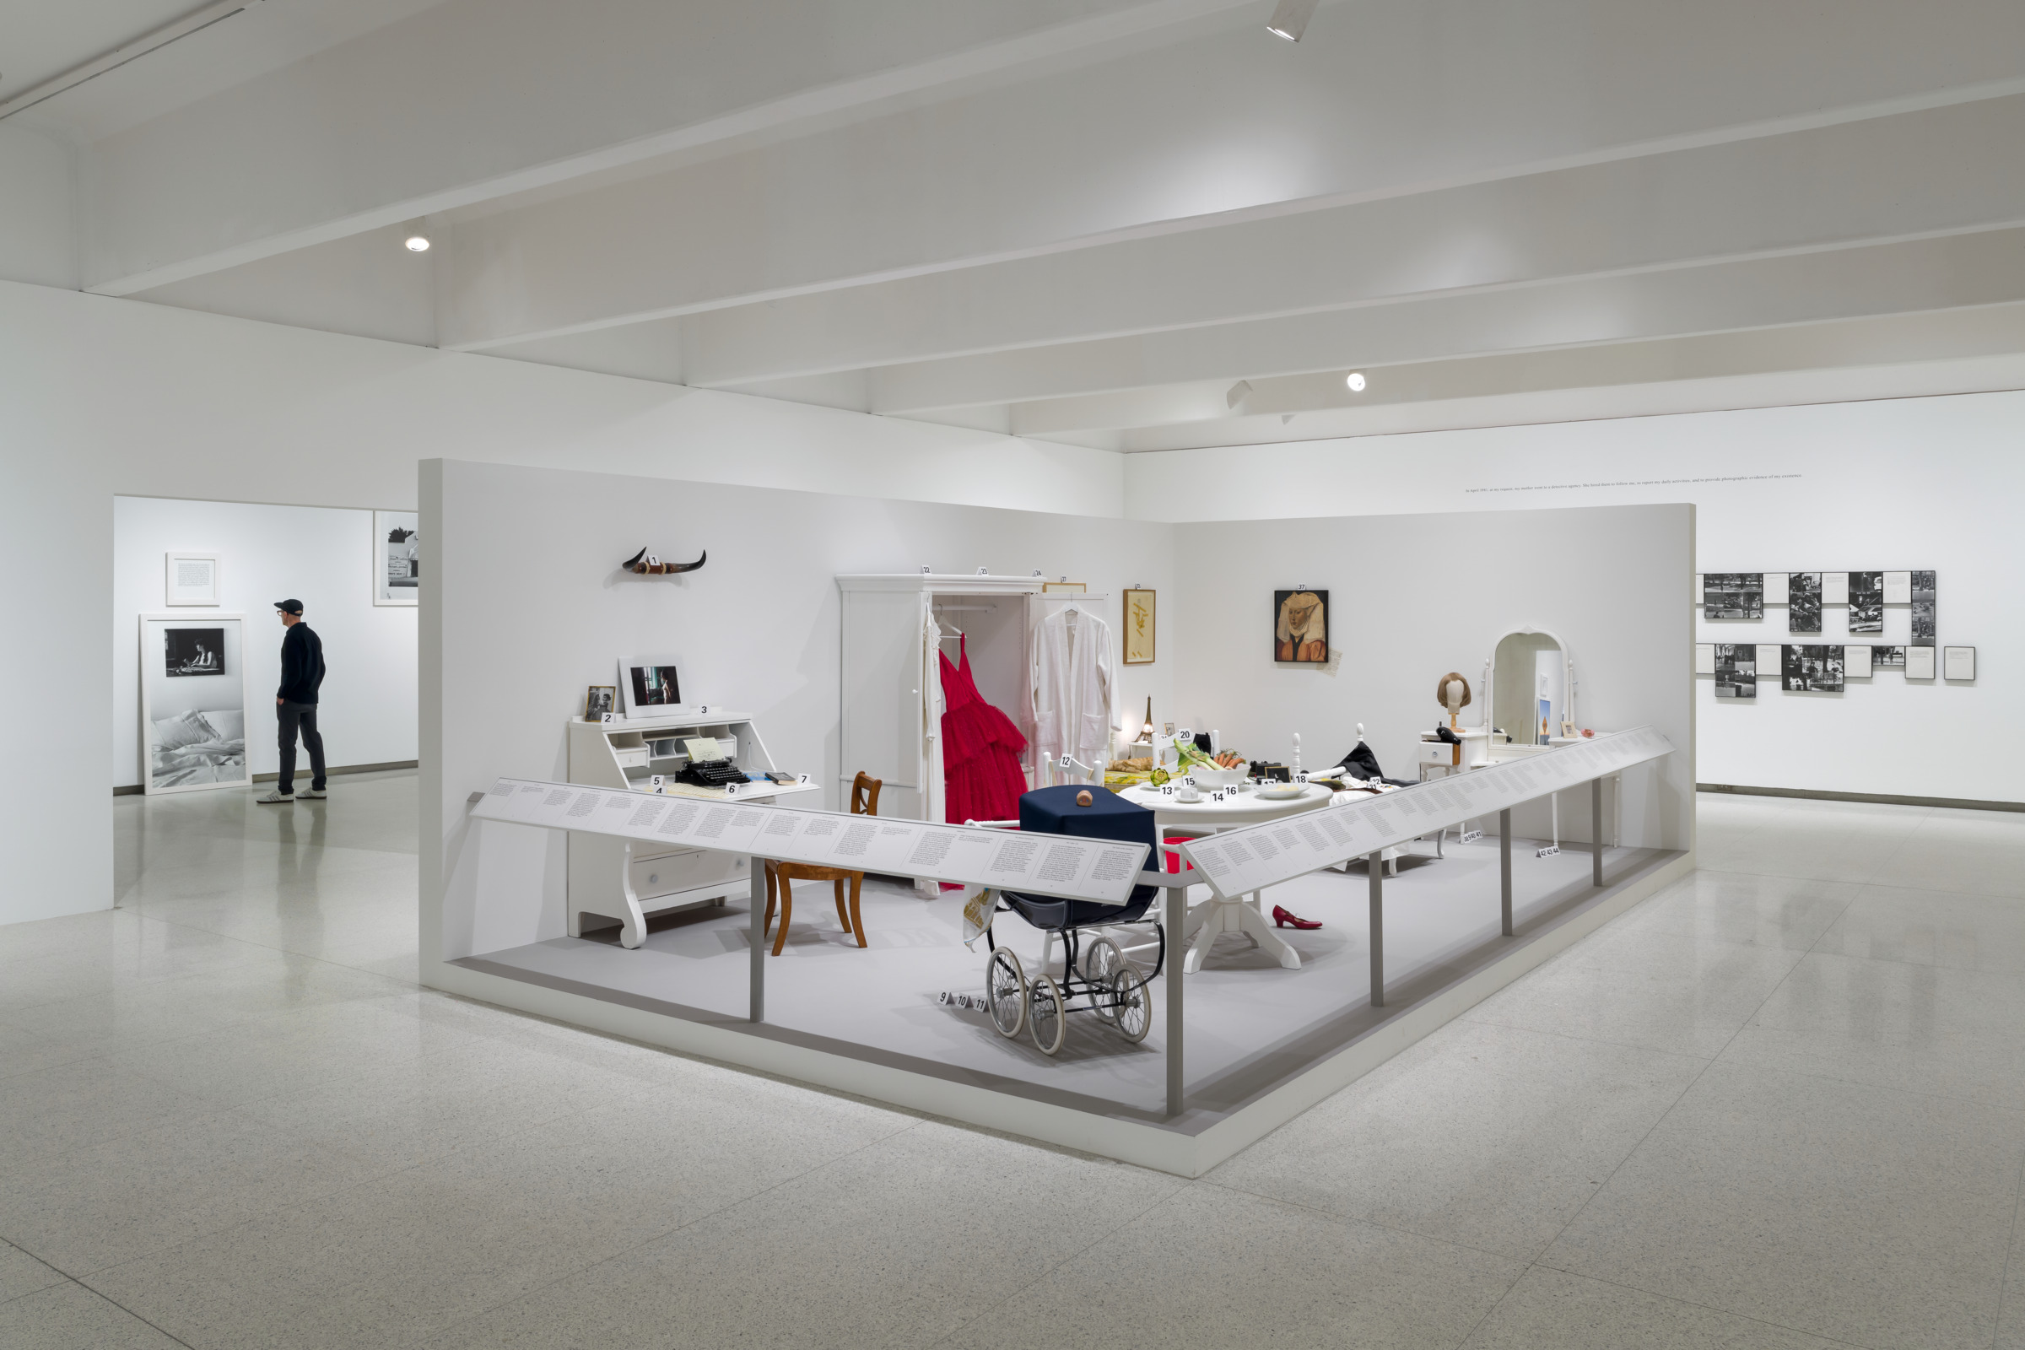
Installation view of Sophie Calle: Overshare, Galleries 1, 2, 3, Perlman.
October 26, 2024 – January 26, 2025. Photo: Eric Mueller.

Slide 68
Breakout Groups

Slide 69
Consider Your Institution
Small Group Discussions (15 minutes):
○ Who would be key partners and allies in initiating and executing this work
(staff, community, etc.)?
○ What accessibility concerns are most often raised by D/deaf and disabled
visitors to your institution?
  – If this information is not available, how might you gather it?
○ When is the right moment to address these concerns in your institution’s
exhibition-planning process?
○ What kind of intervention in your process might facilitate a consideration
of audiences and accessibility?
○ What would you need to make change at your institution (budget, buy-in,
training, etc.)?

Slide 70
Share Out (20 minutes)
○ What commonalities surfaced in your group?
○ What challenges have you encountered in this work?
○ Have you experienced success in this work? Do you have advice to share?

Slide 71
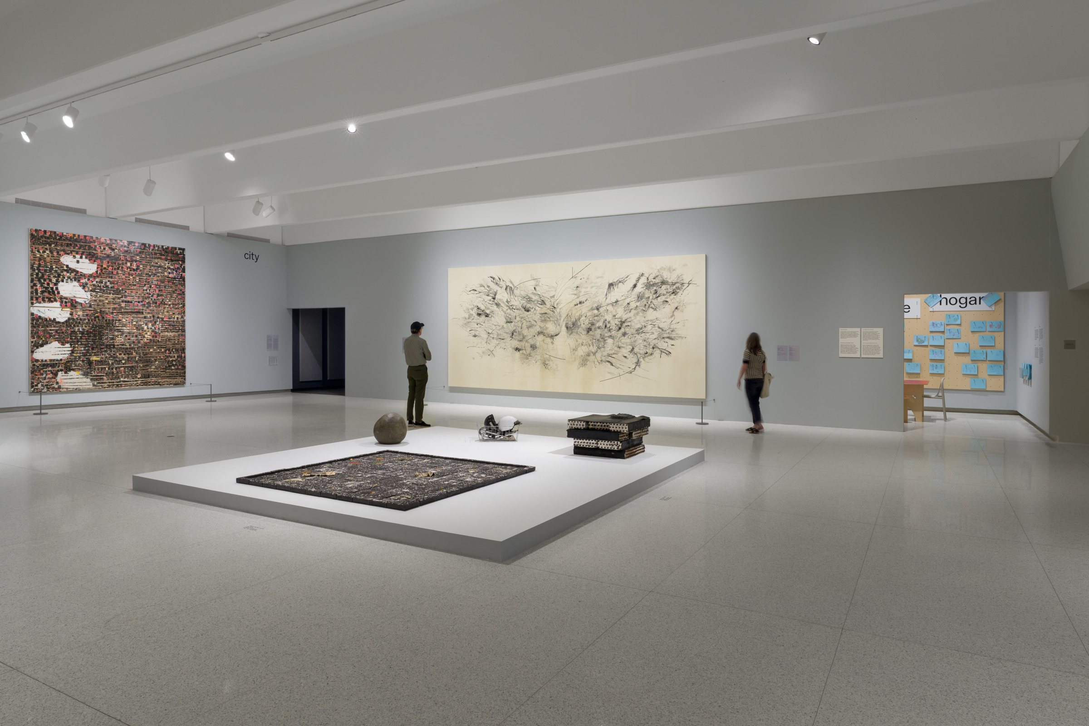
Questions?
Installation view of This Must Be the Place: Inside the Walker’s Collection, Galleries 4, 5, 6.
June 20, 2024 – April 29, 2029. Photo: Eric Mueller.

Slide 72
Thank You!
Walker Art Center
Doc Czypinski, Sarah Lampen, Erin McNeil
May 6, 2025
American Alliance of Museums Annual Meeting

