Slide 1
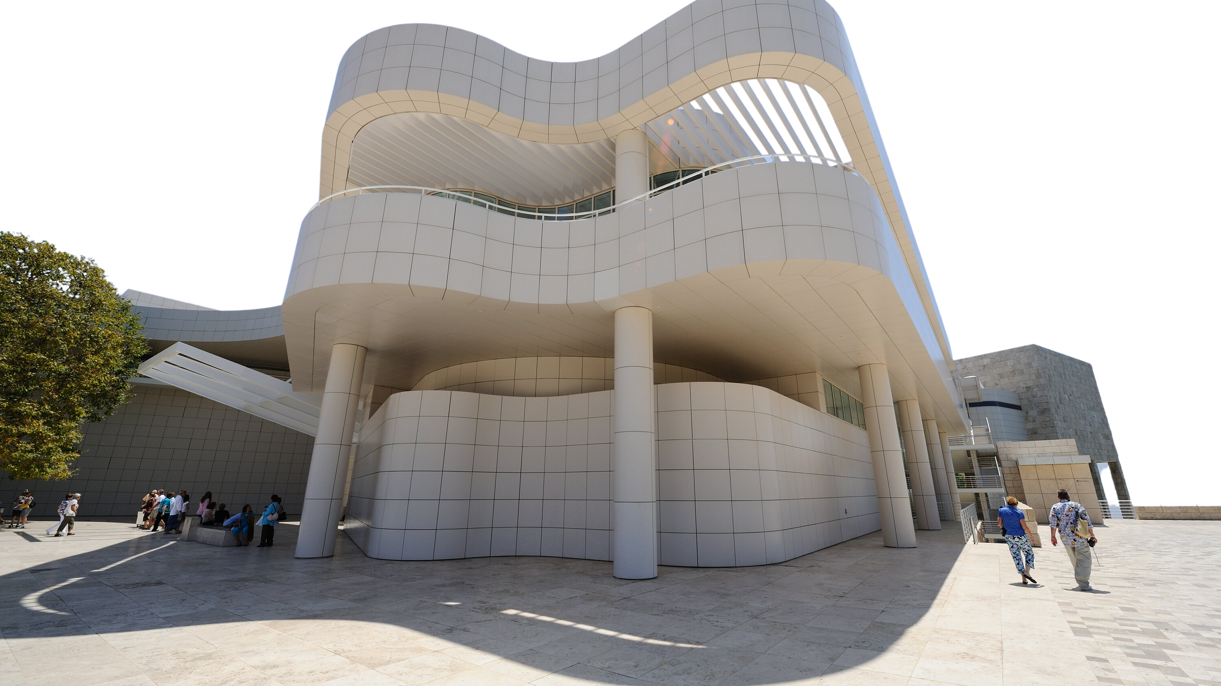
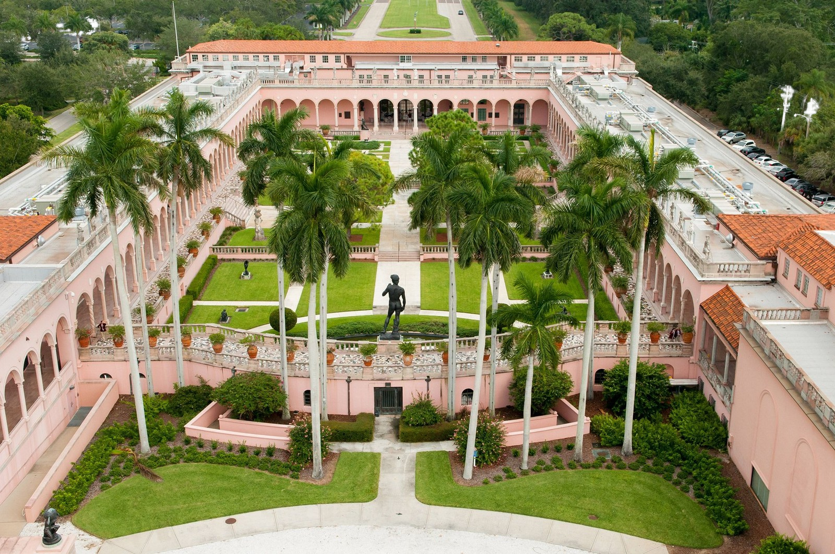
AMERICAN ALLIANCE OF MUSEUMS,
LOS ANGELES
MAY 2025
BEYOND THE TOUR:
BUILDING TRUST BY REIMAGINING PUBLIC
PROGRAMMING
LILIT SADOYAN, J. PAUL GETTY MUSEUM, LOS ANGELES, CA
AMES MORTON-WINTER, THE RINGLING MUSEUM OF ART, SARASOTA, FL
KATIE NICKEL, THE RINGLING MUSEUM OF ART, SARASOTA, FL

Slide 2

WELCOME
INTRODUCTIONS
BOX BREATHING
TURN AND TALK AND INTRODUCE YOURSELF TO A NEIGHBOR
TRANSFERABLE SKILLS:
ACTIVE LISTENING, CLOSE LOOKING, COLLABORATION, COMMUNICATION, CRITICAL THINKING, EMPATHY, SELF-AWARENESS
Homage to the Square, 1970s
Josef Albers
Screenprint
Gift of Mrs. Robert Feitz
SN8551.16

Slide 3
OVERVIEW
LILIT SADOYAN- ACTIVITY-BASED TEACHING, ART IMPACT: MINDFULNESS
AMES MORTON-WINTER - TEEN MINDFULNESS, TRUST, VISITOR RESPONSE PEDAGOGIES
KATIE NICKEL - CULTURAL HUMILITY, BULIDING TRUST WITH SPECIFIC AUDIENCES

Slide 4
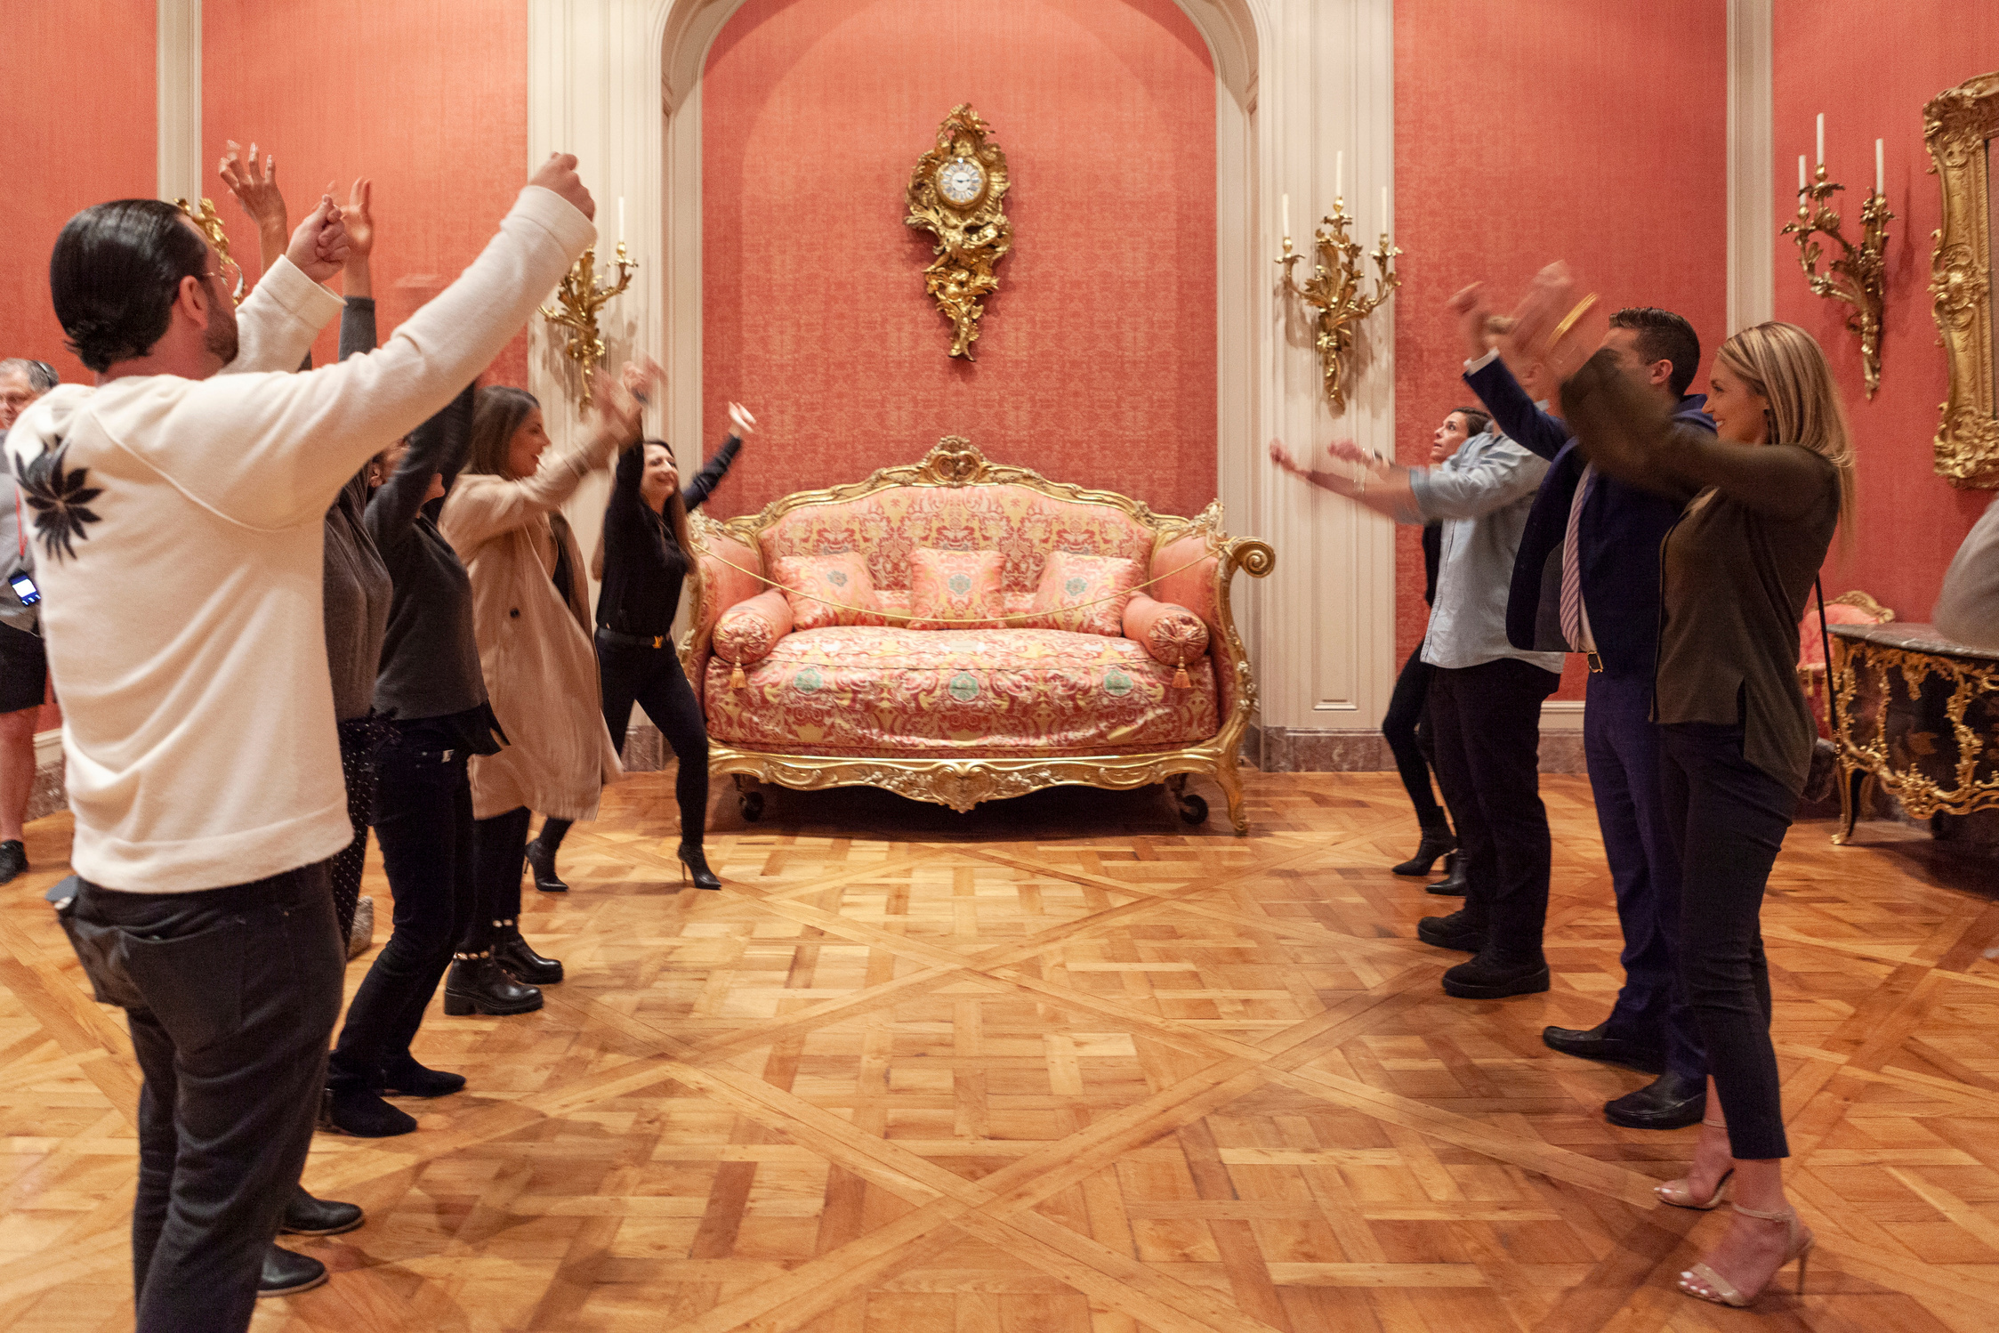
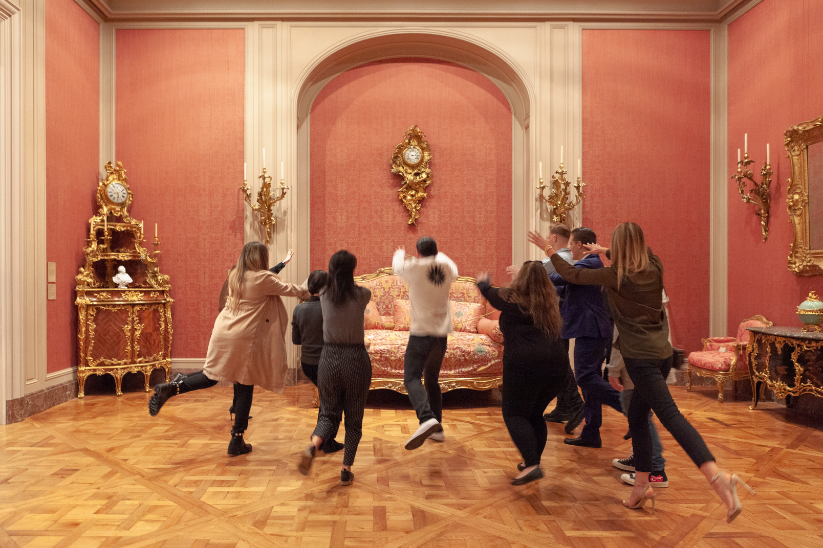
ACTIVITY-BASED TEACHING
IN THE ART MUSEUM | GETTY

Slide 5
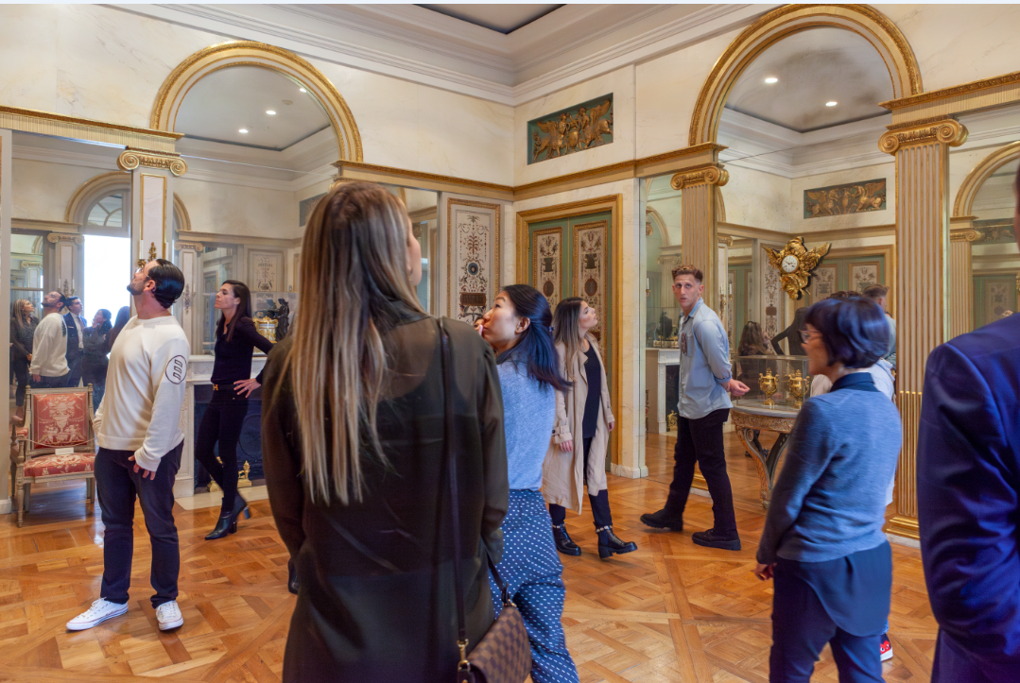
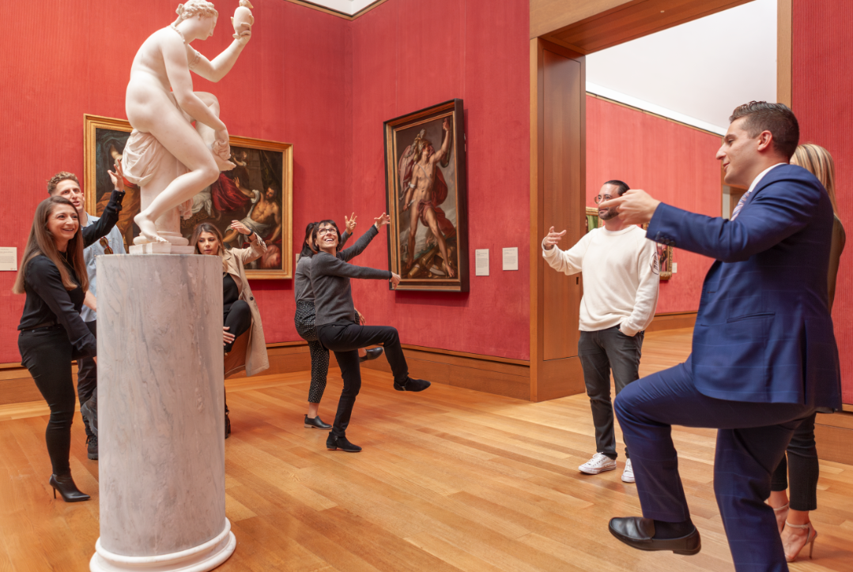
PRINCIPLES OF PLAY
Embodiment
Affordances

Slide 6
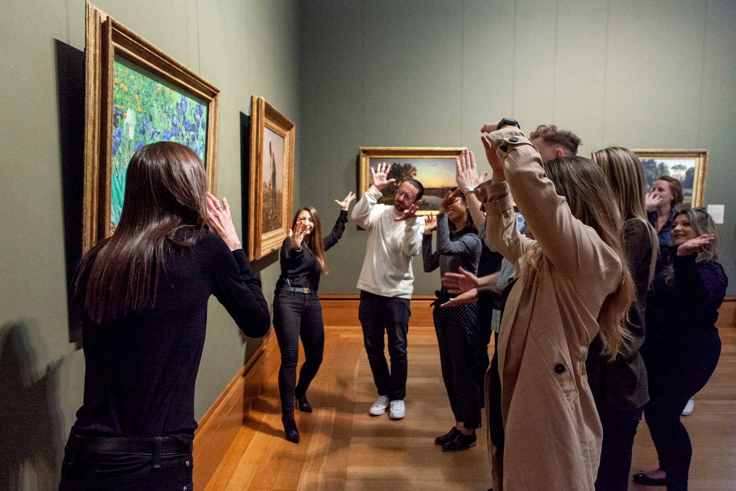
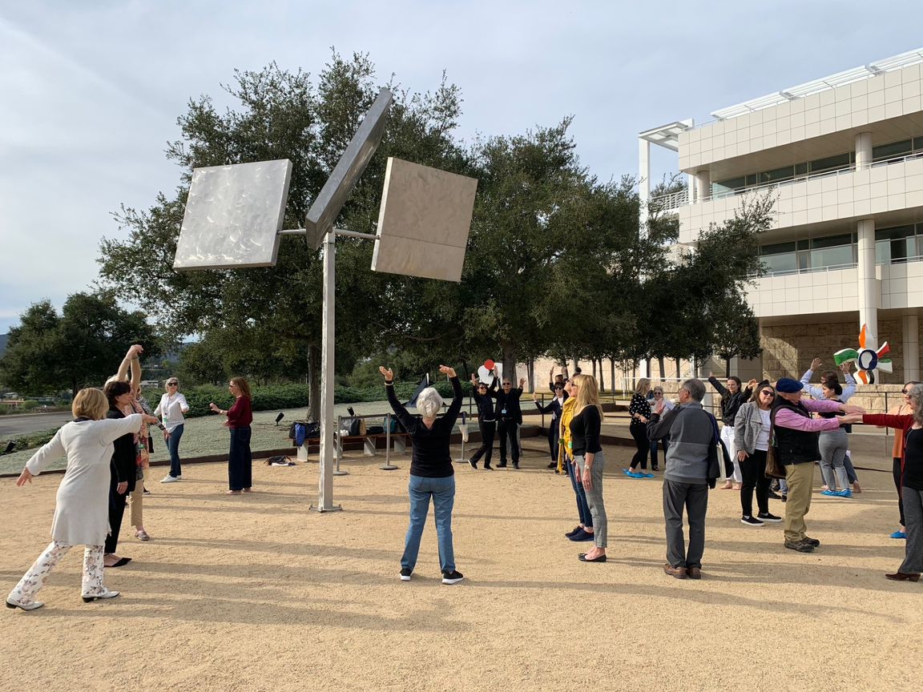
PRINCIPLES OF PLAY
Movement
Skills

Slide 7
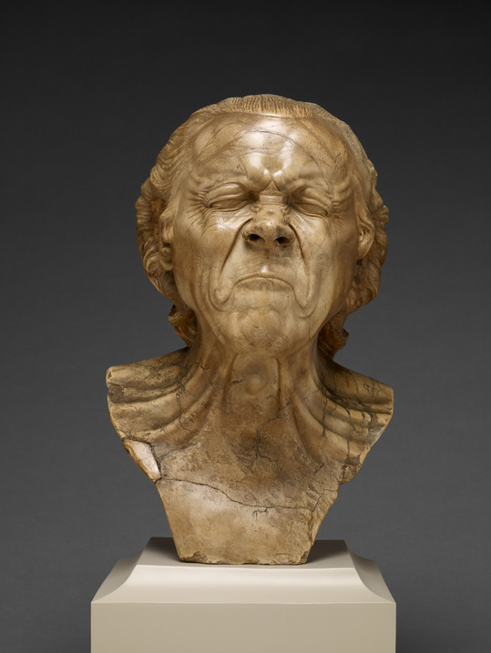
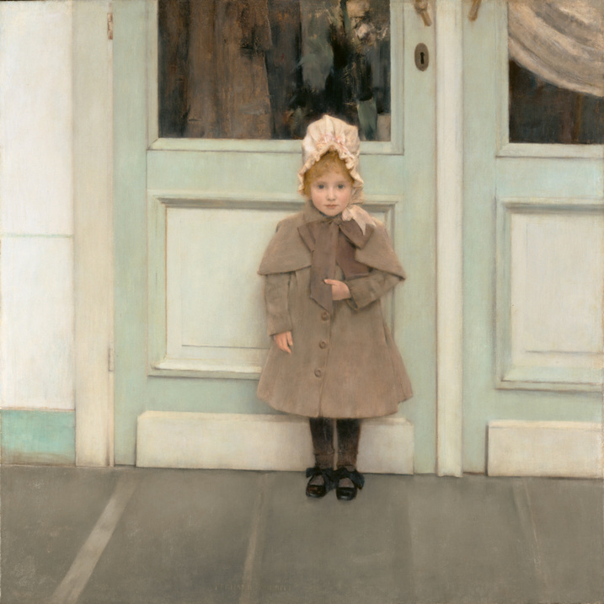
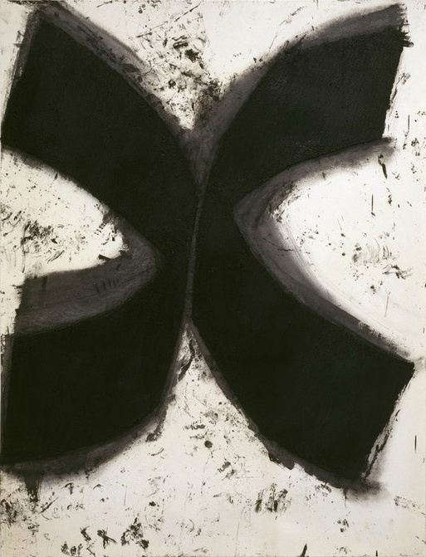
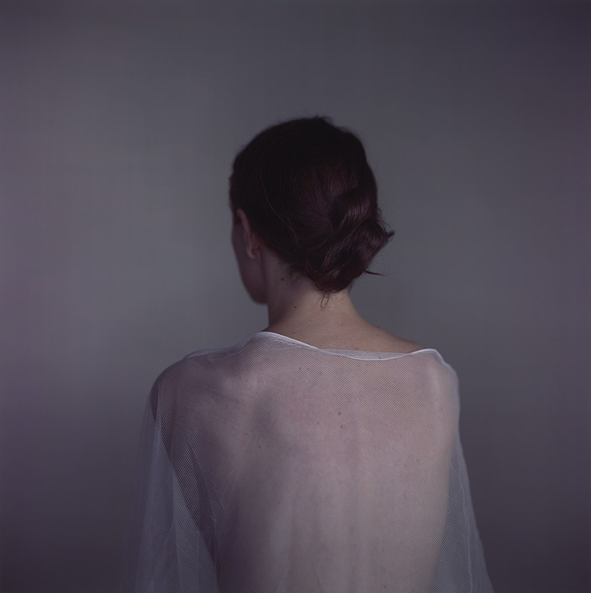
PRINCIPLES OF PLAY
Emotion
Intersubjectivity
Empathy
Franz Xaver Messerschmidt,
The Vexed Man, 1771-83.
Fernand Khnopff, Jeanne Kefer, 1885.
Richard Serra, Nova Scotia III, 1983.
Richard Learoyd, Vanessa, 2013.

Slide 8
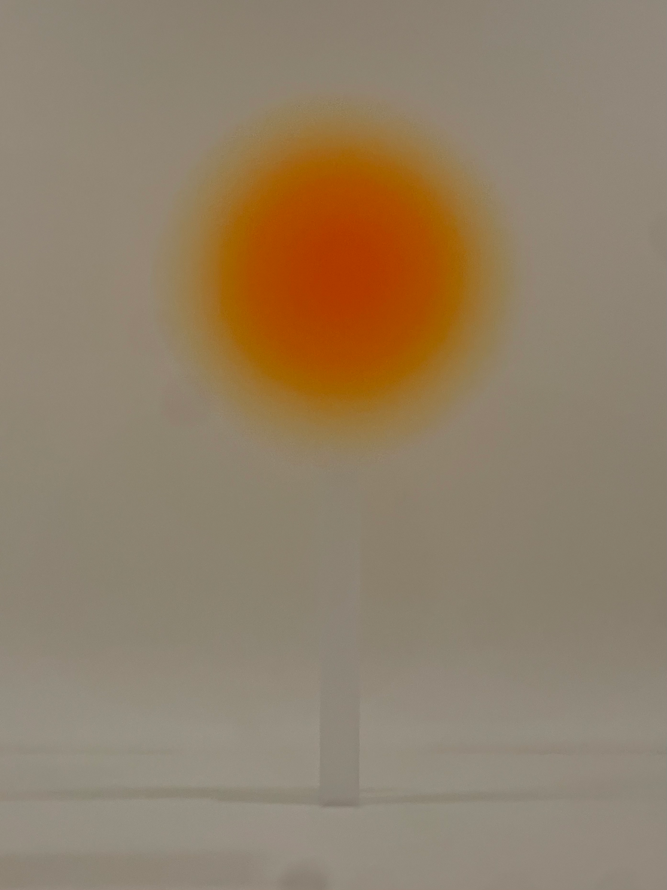
MINDFUL MOMENT
Helen Pashgian, Untitled (Lens), 2023.
Courtesy of the Artist © Helen Pashgian.

Slide 9
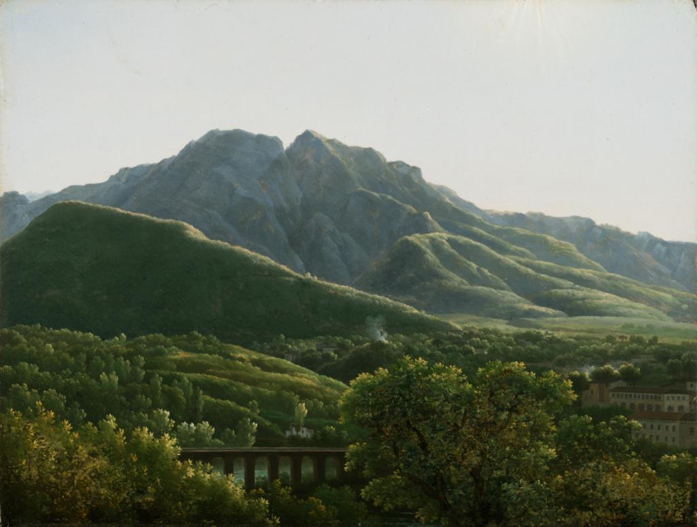
MINDFUL MOMENT
Jean-Joseph-Xavier Bidauld, View of the Bridge and Part of the Town of Cava, Kingdom of Naples, 1785-90.

Slide 10
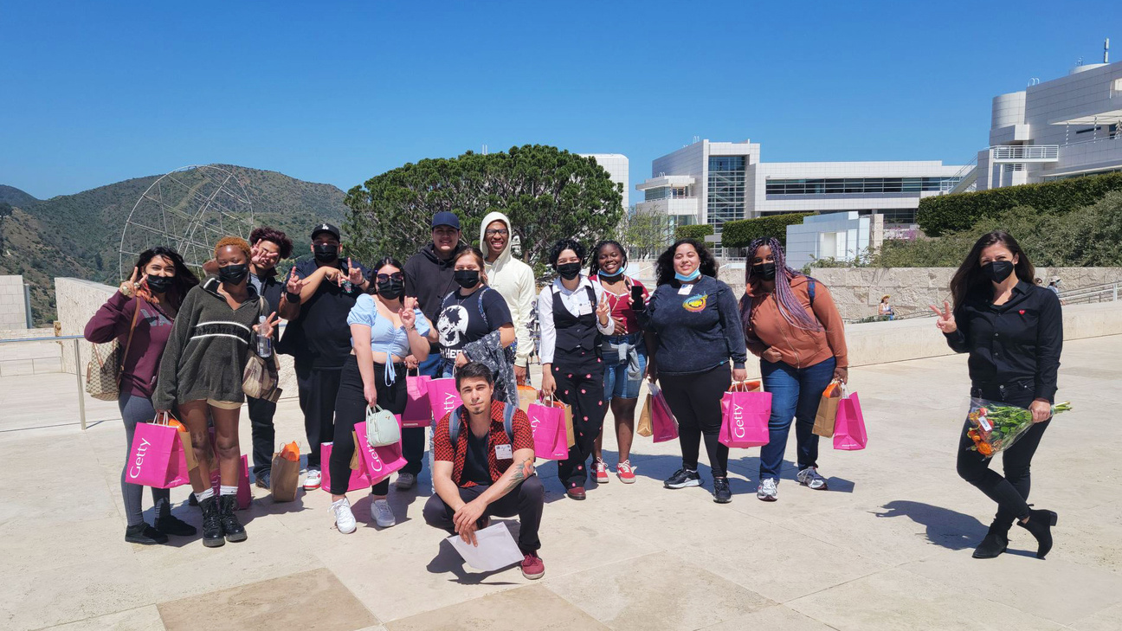
ART IMPACT: MINDFULNESS
GETTY MUSEUM
  GETTY X ARTWORXLA
  PILOT PROGRAM FOR TEENS
  12 ARTWORXLA INTERNS
  8 SESSIONS: 1 PRE-VISIT, 6 ON-SITE, 1 POST-VISIT

Slide 11
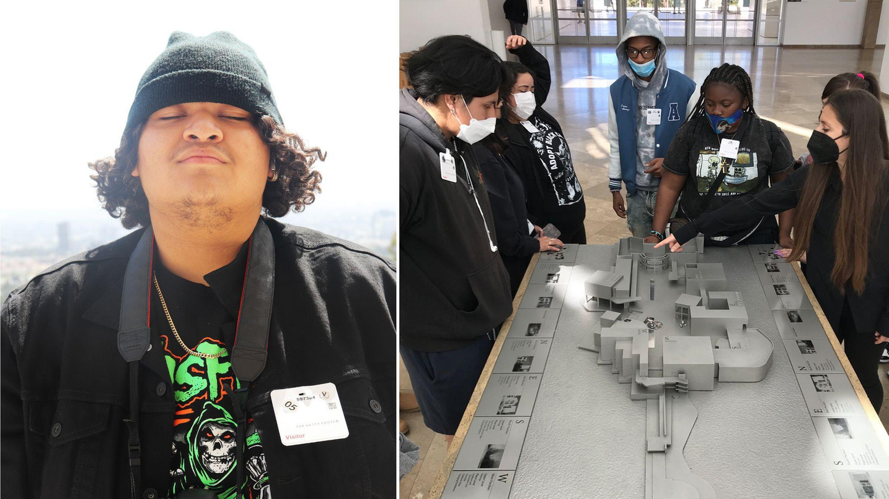
ART IMPACT: MINDFULNESS
GETTY MUSEUM
SESSION STRUCTURE
  ARRIVAL AT 9AM
  QUIET GALLERY TIME BEFORE 10AM (NO PUBLIC)
  INDEPENDENT GALLERY EXPLORATION
  LUNCH TOGETHER
  REFLECTION

Slide 12
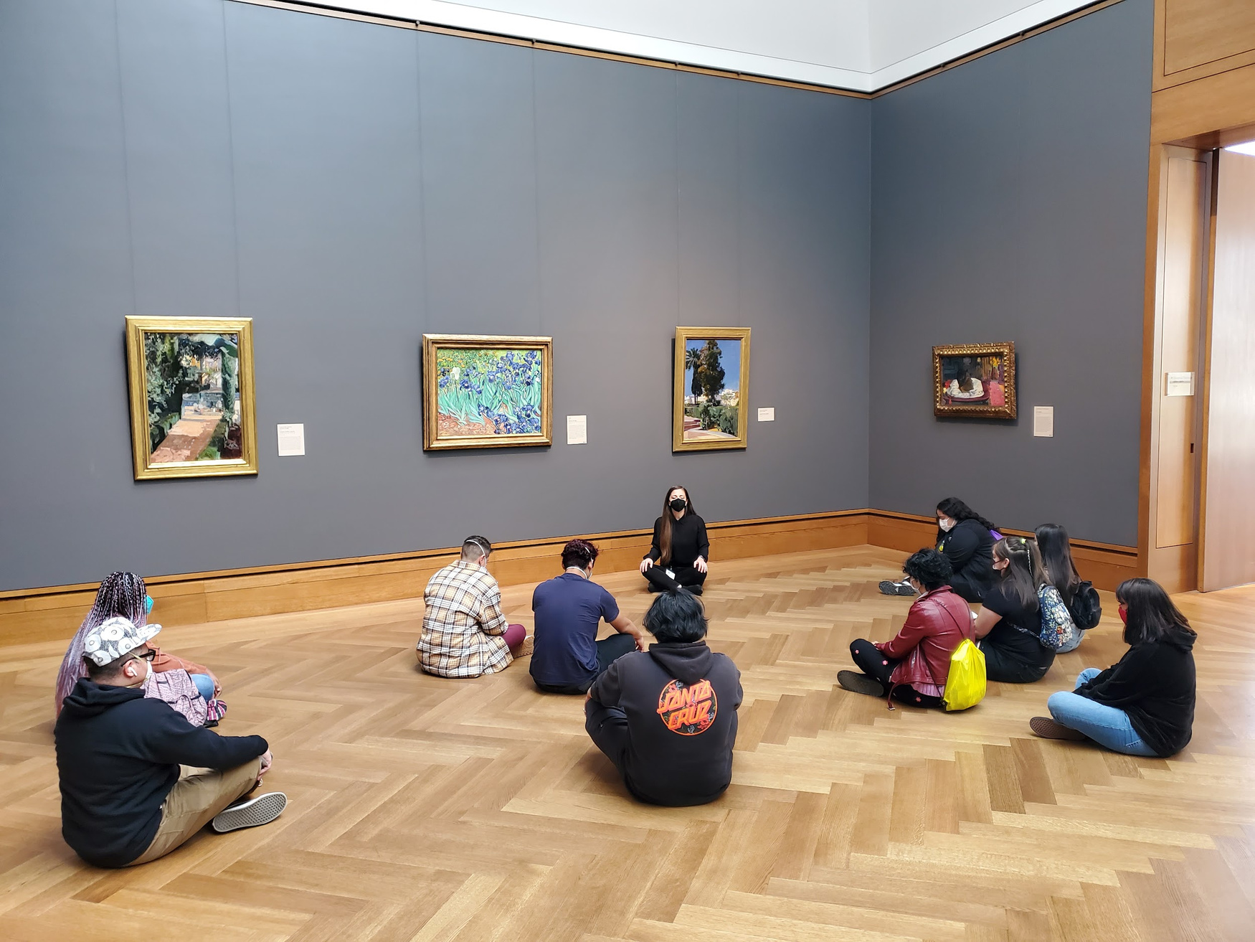
Session 2 Vincent van Gogh,
Irises, 1889

Slide 13
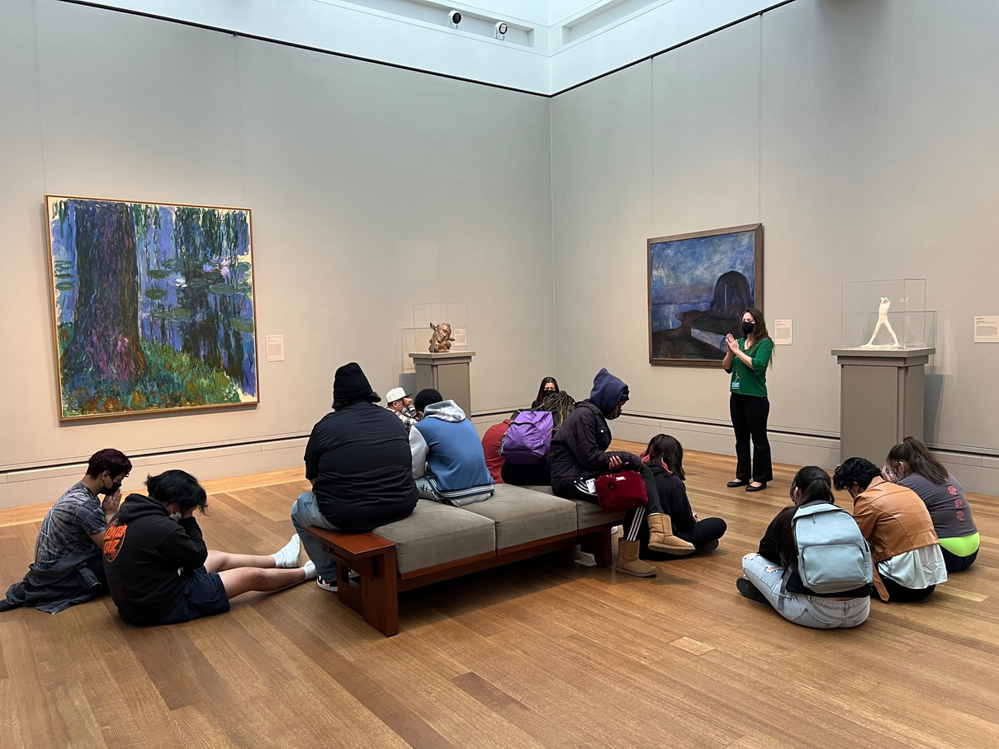
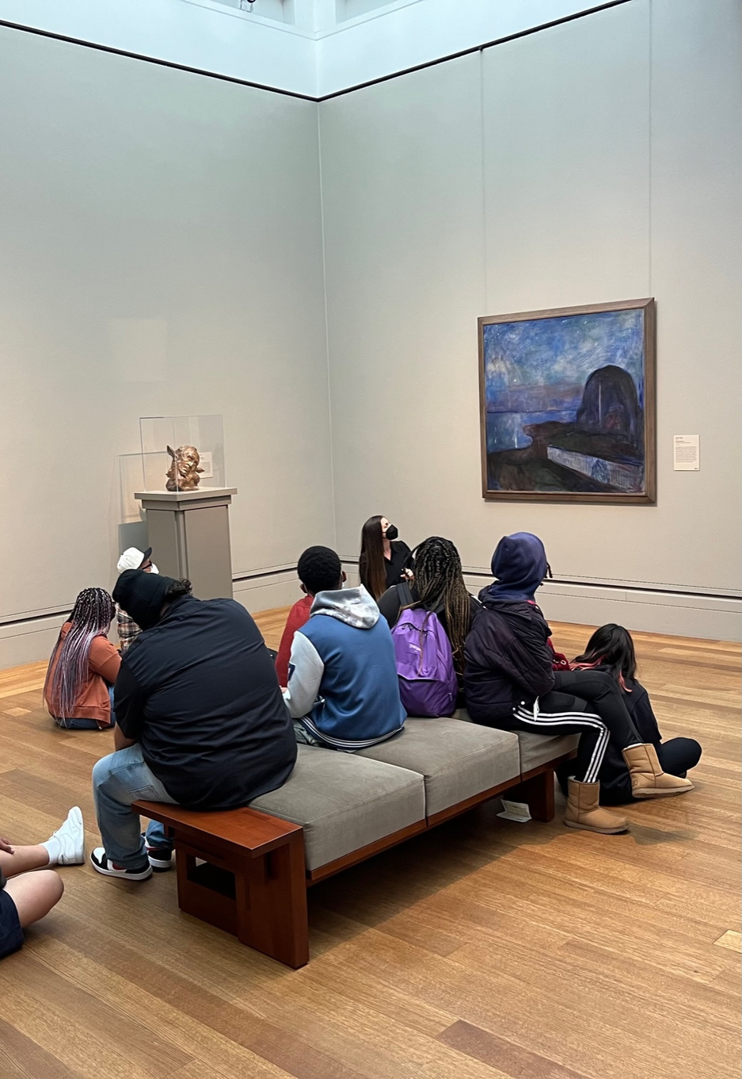
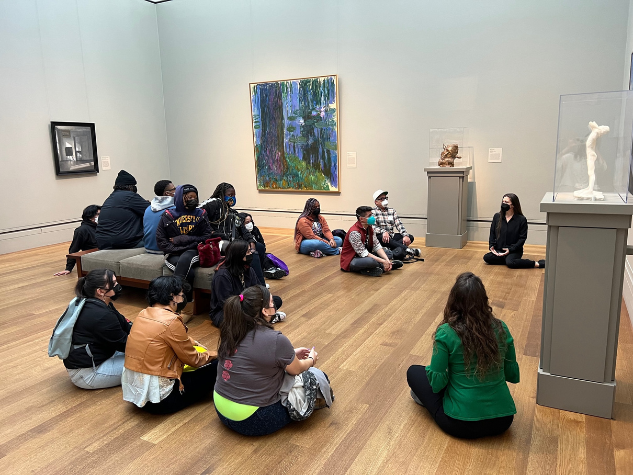
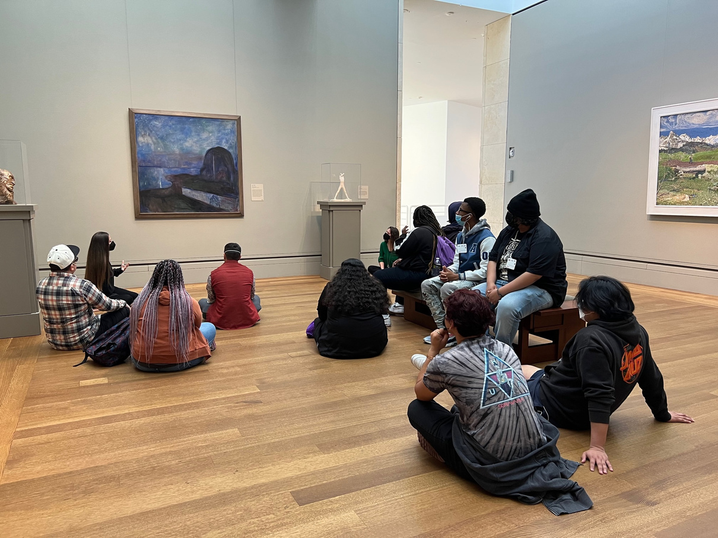
Session 3
Edvard Munch, Starry Night, 1893

Slide 14
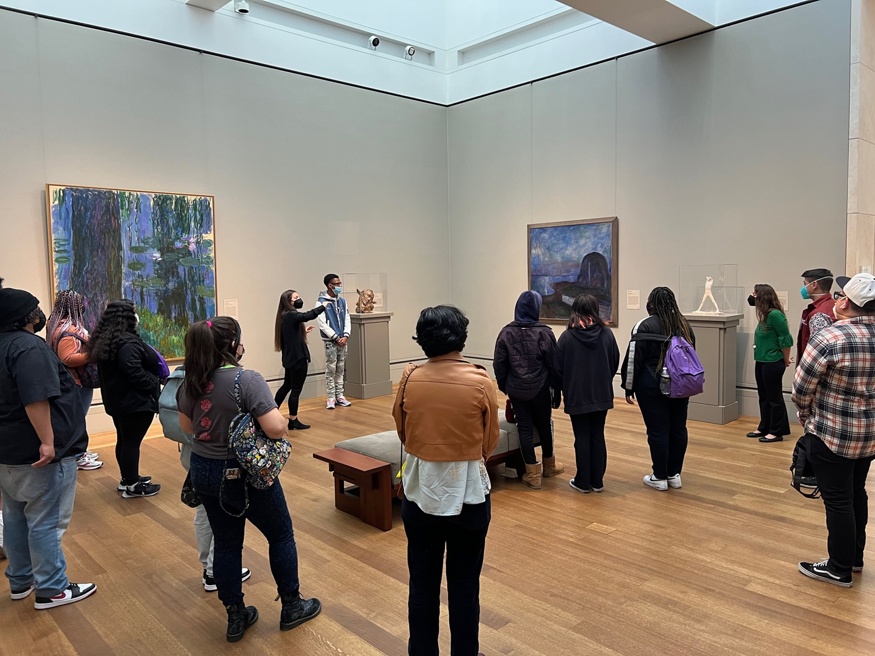
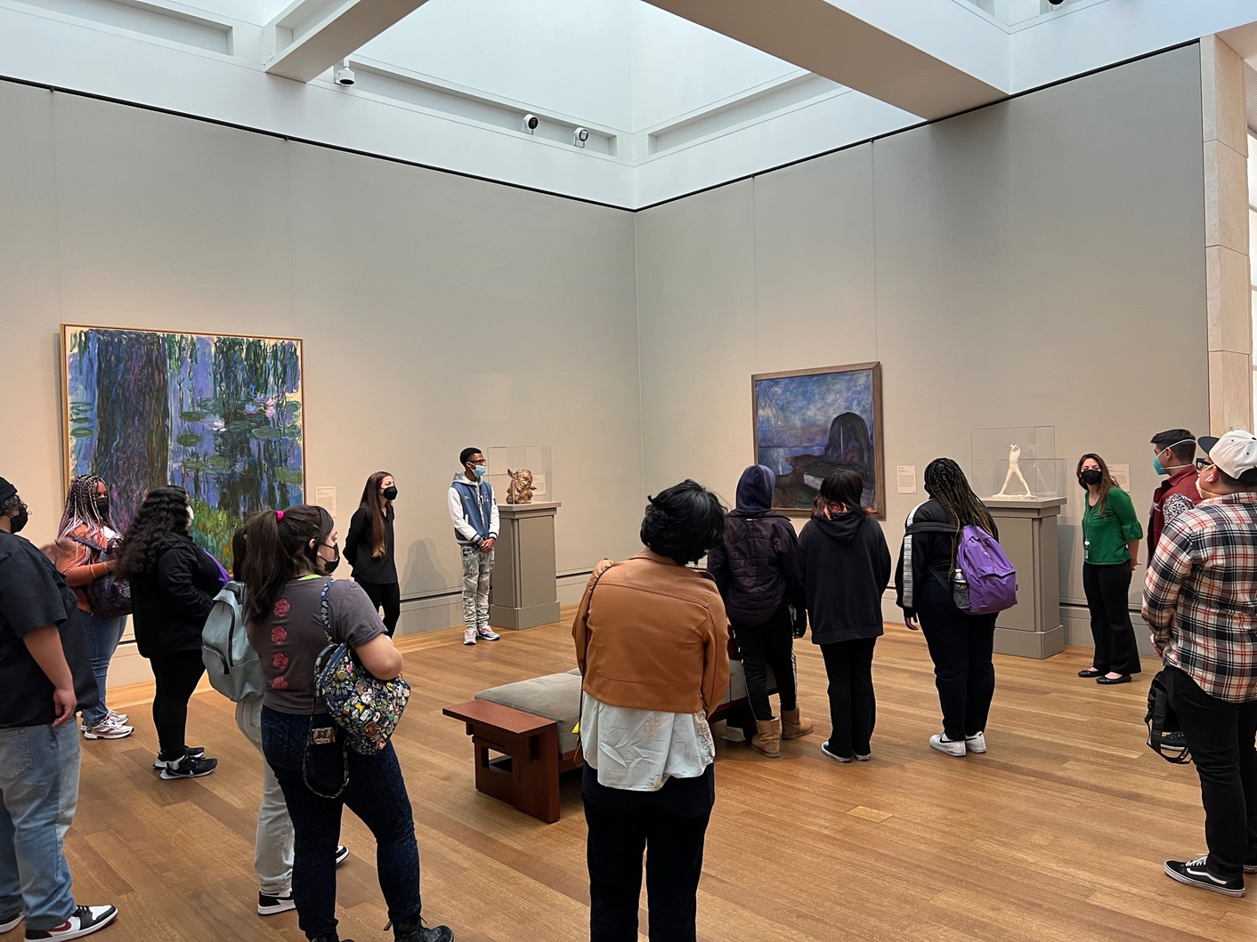
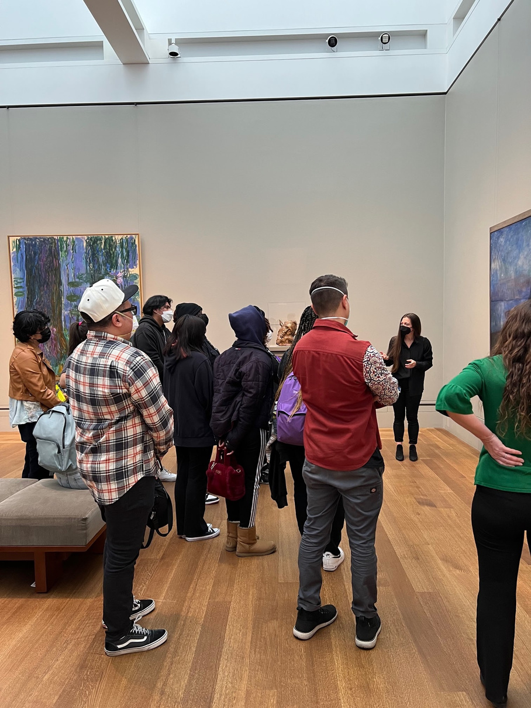
Session 3
Edvard Munch, Starry Night, 1893

Slide 15
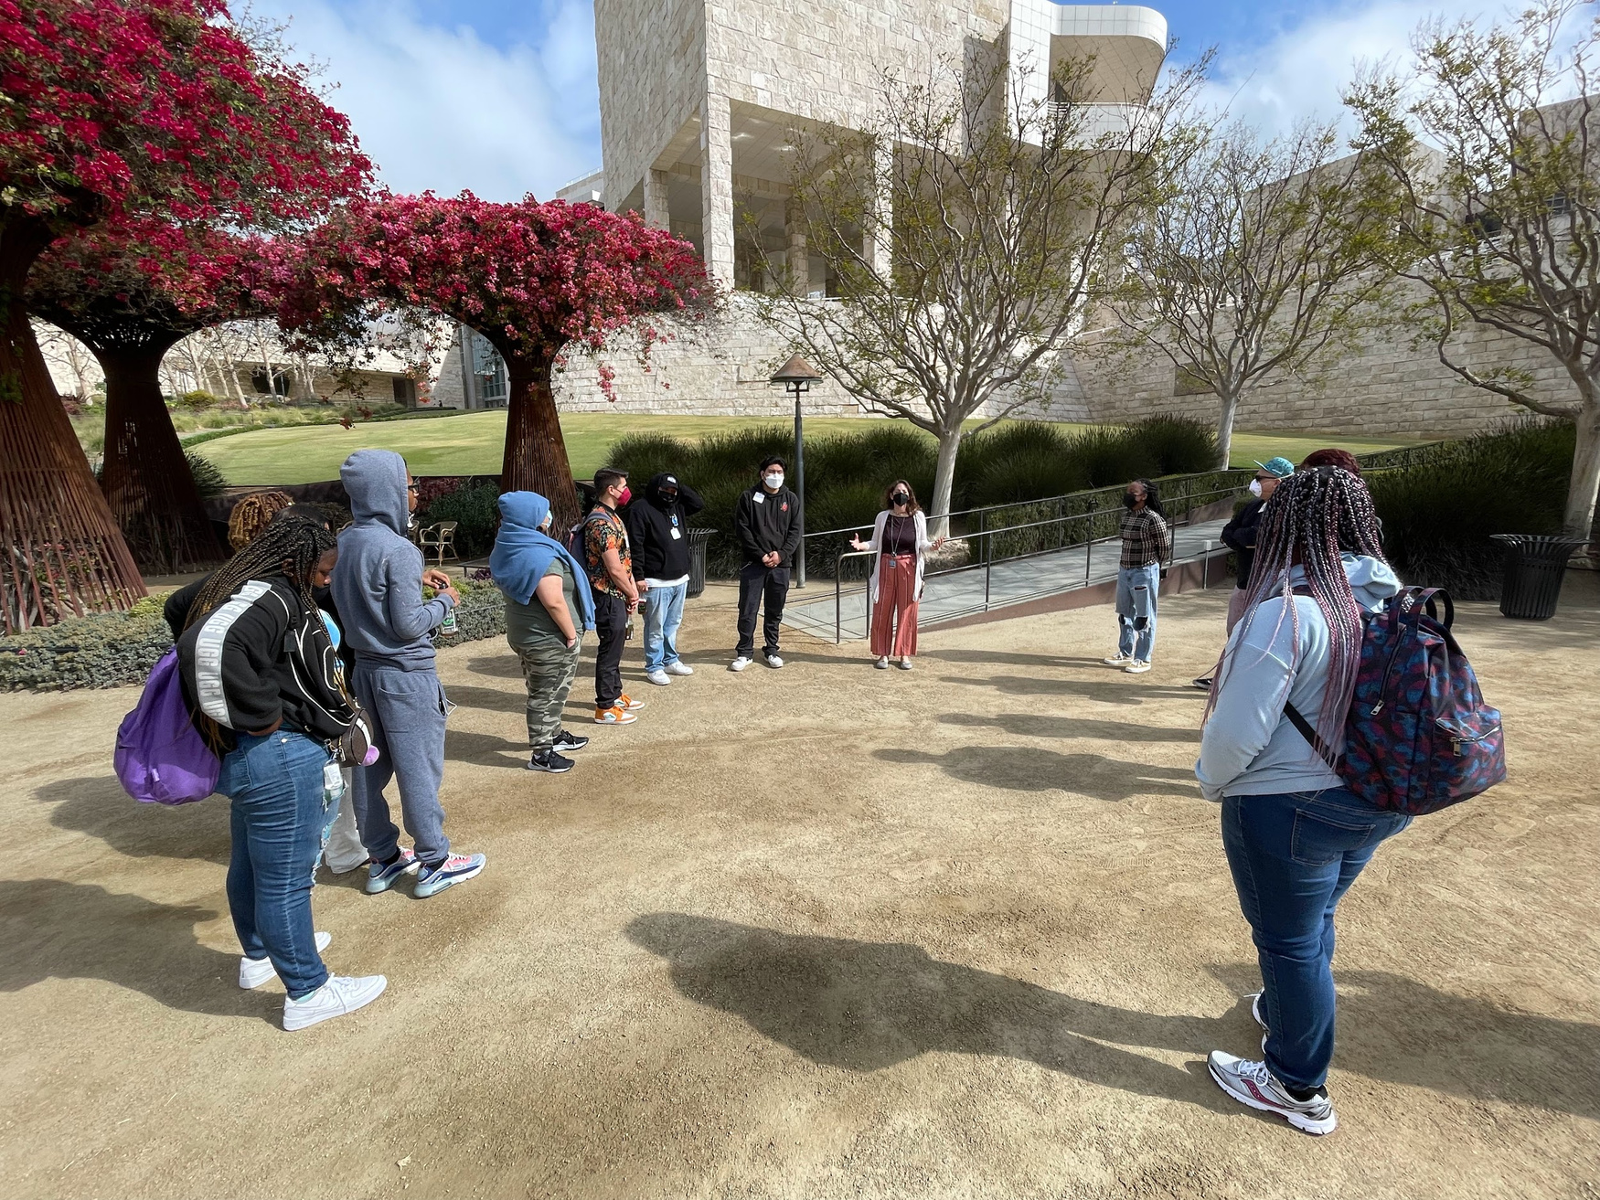
Session 4
Robert Irwin,
Central Garden, 1997

Slide 16
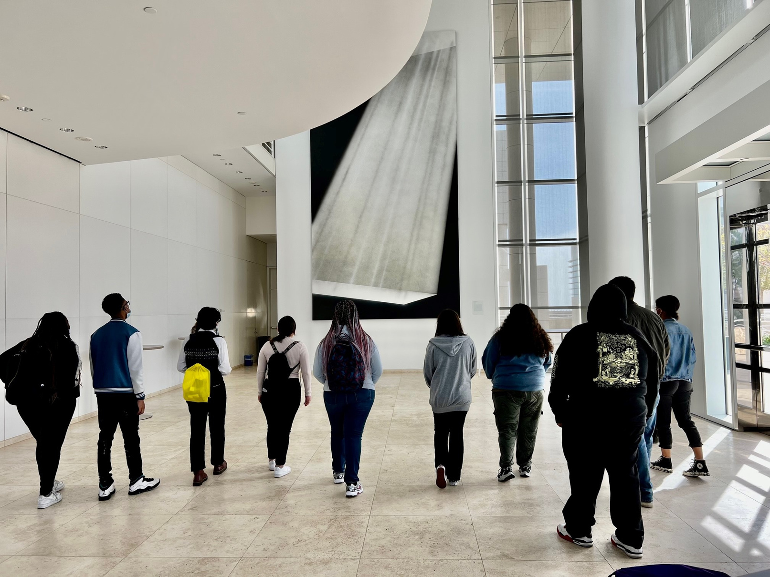
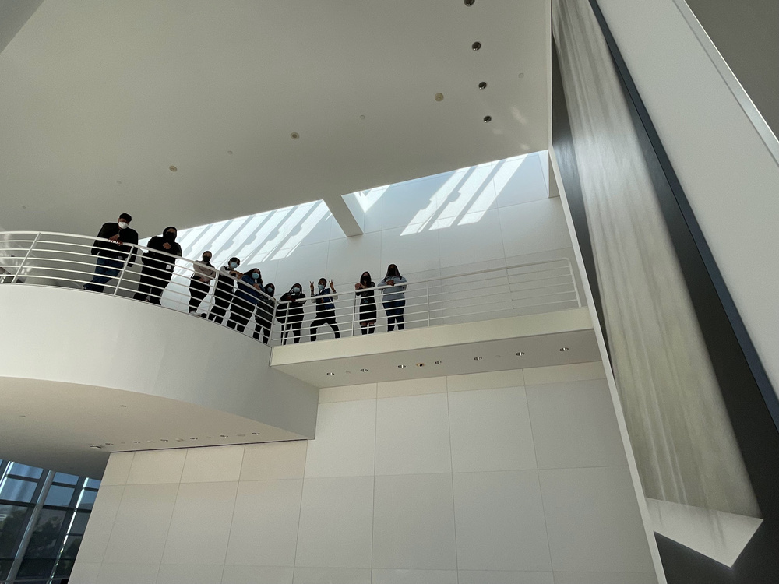
Session 5
Ed Ruscha,
PICTURE WITHOUT WORDS, 1997

Slide 17
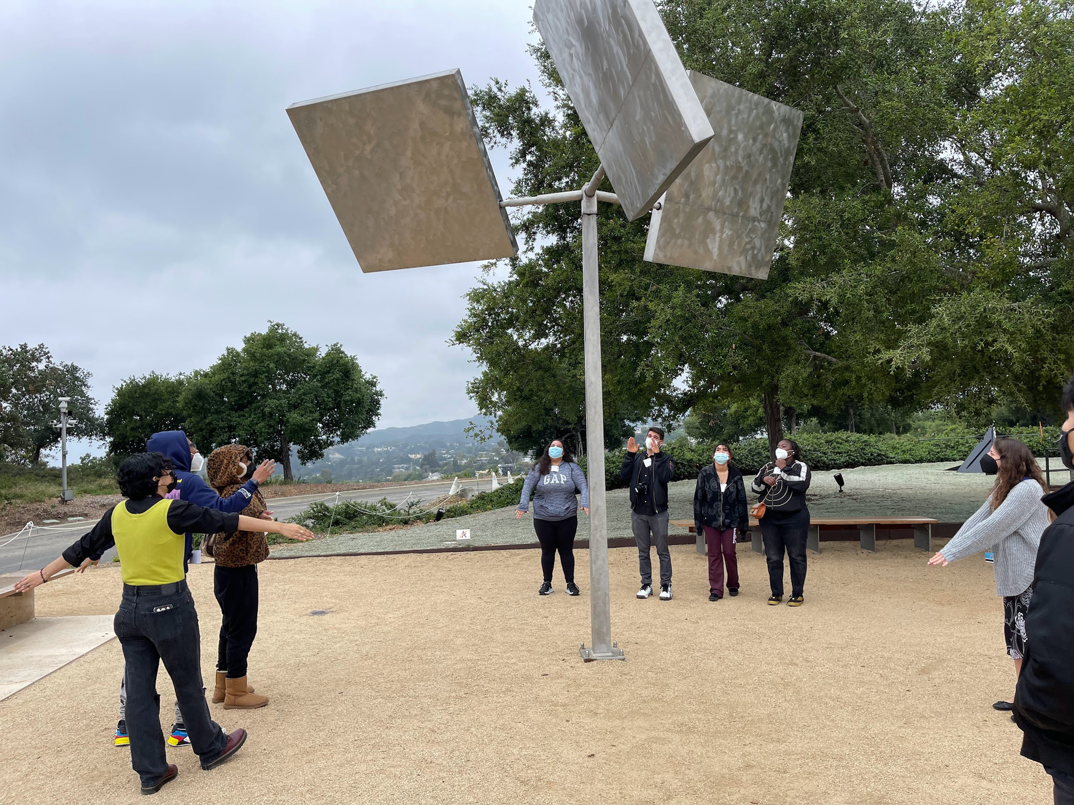
Session 6
George Rickey,
Three Squares Gyratory, 1971

Slide 18
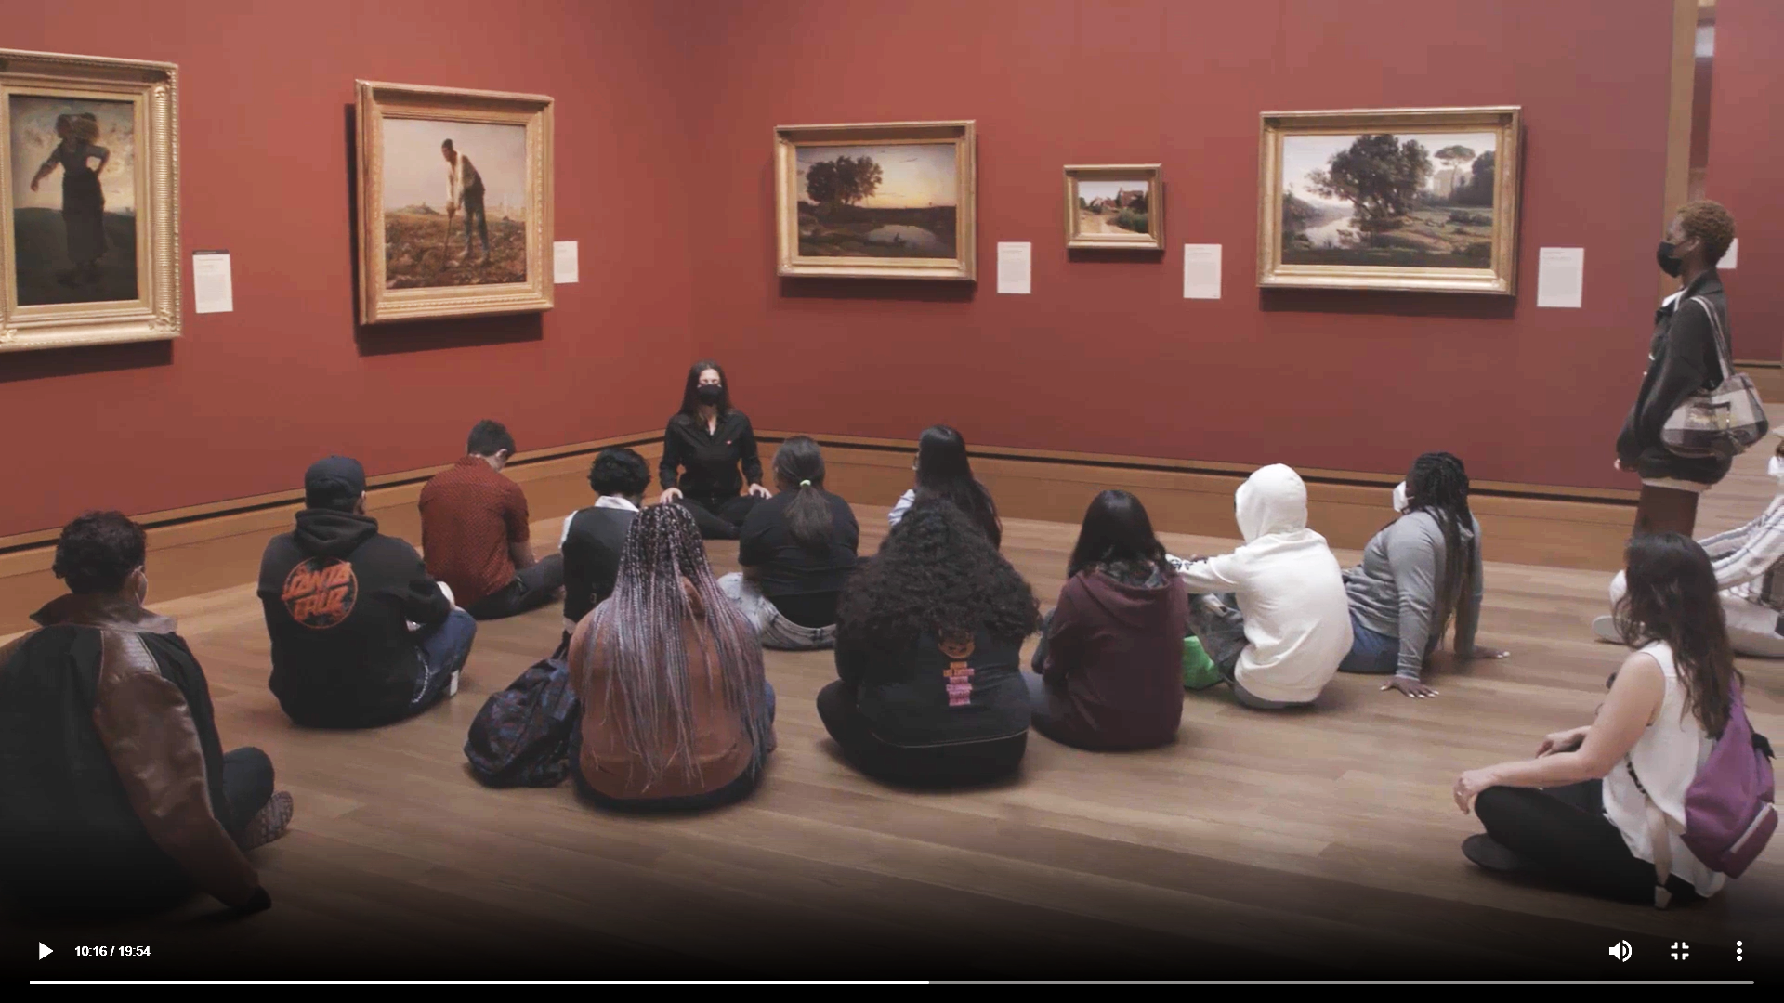
Session 7 | Jean-Francois Millet, Man with a Hoe, 1860-63

Slide 19
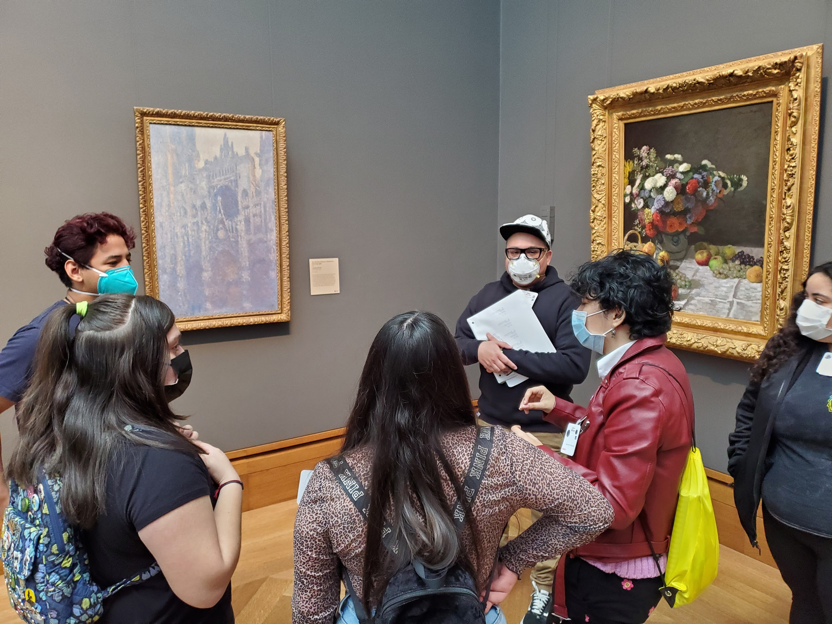
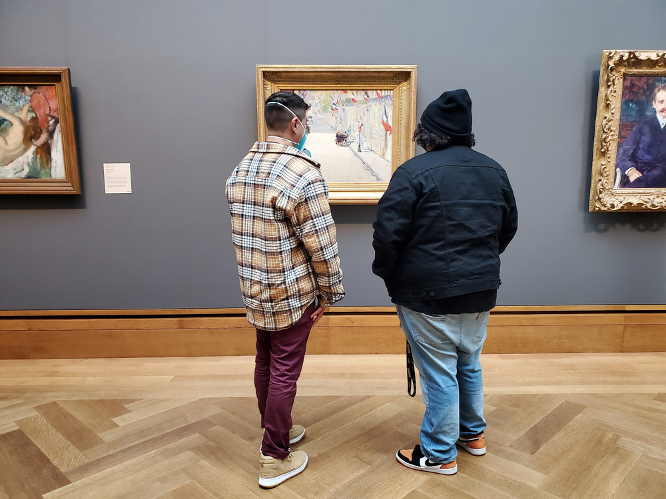
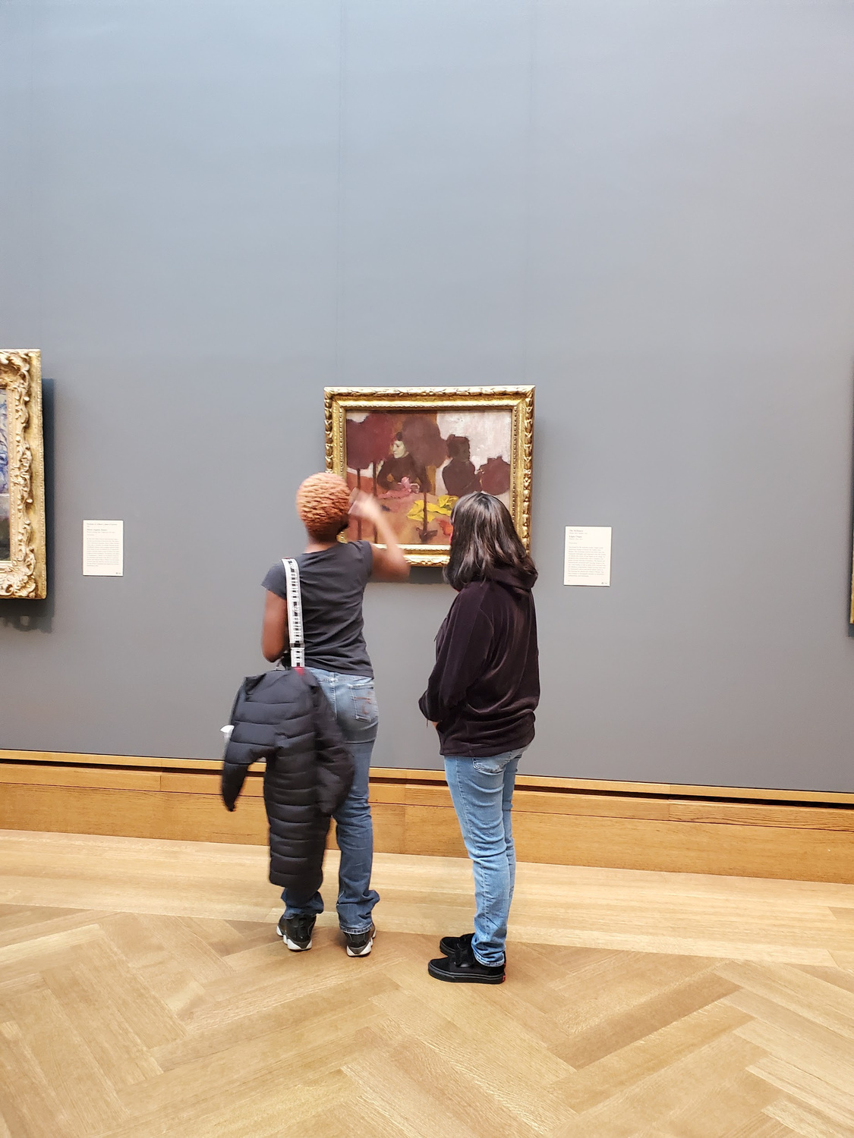
Independent Exploration in the Galleries

Slide 20
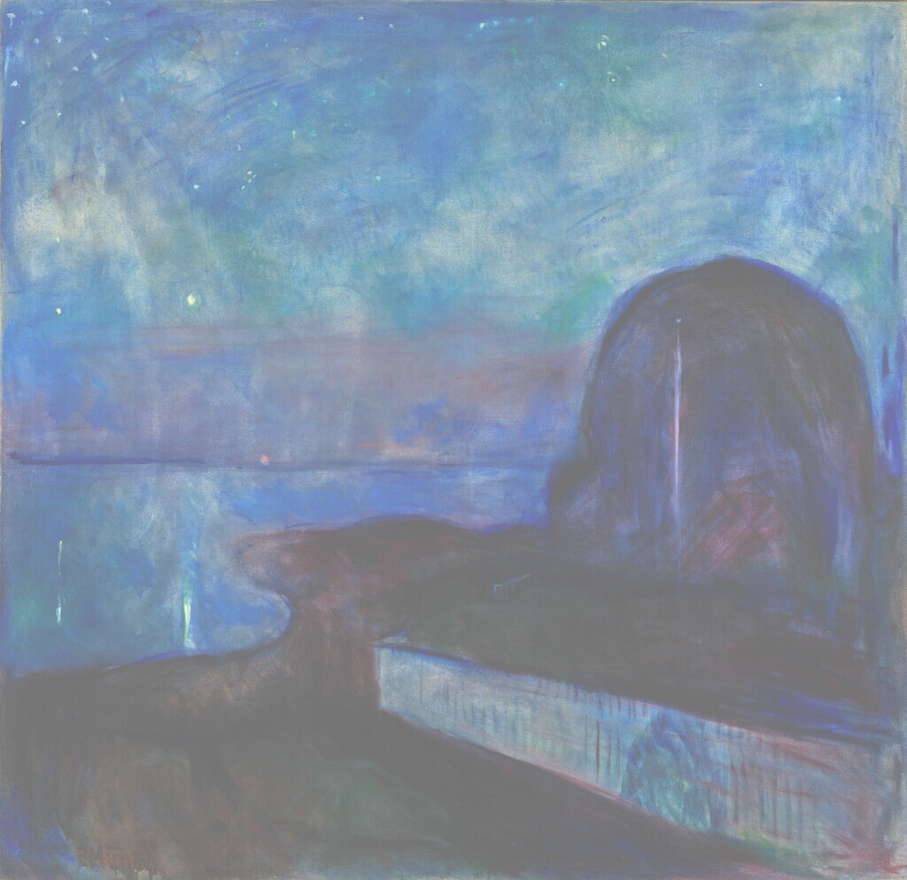
CORE VALUES
Present and Attentive
Curious
Non-judgmental
Respectful
Authentic
Open and Accessible

Slide 21
KEY FINDINGS
Increased curiosity
Increased enjoyment of art
Increased awareness
Improved focus
Applied practices
More open to new experiences

Slide 22
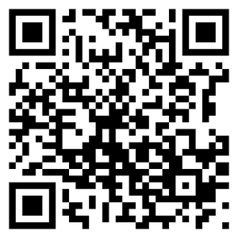
IMPACT
“I just find myself asking more questions.
I wonder more.
There’s so much to wonder about.”
- Art Impact Participant

Slide 23
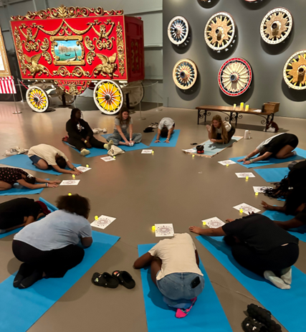
TEEN MINDFULNESS:
THE RINGLING MUSEUM
  Cooperated with a community partner:
Girls Inc.
  Utilized specialized facilitators
  Incorporated journaling and art-making
  Day 1: Color and Emotion
  Day 2: Movement
  Day 3: Yoga and Breathing
  Day 4: Sound

Slide 24
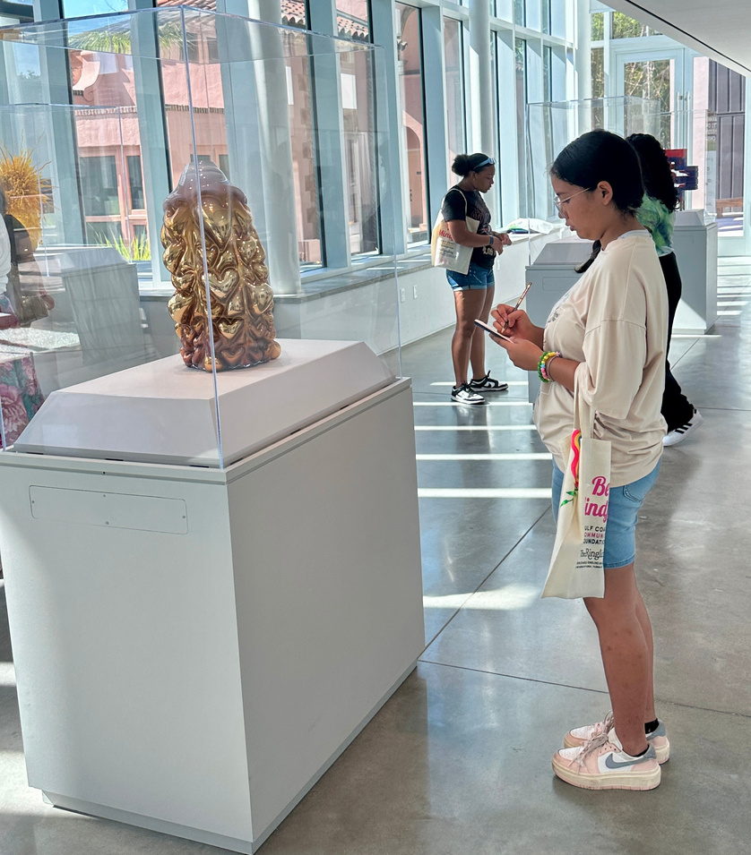
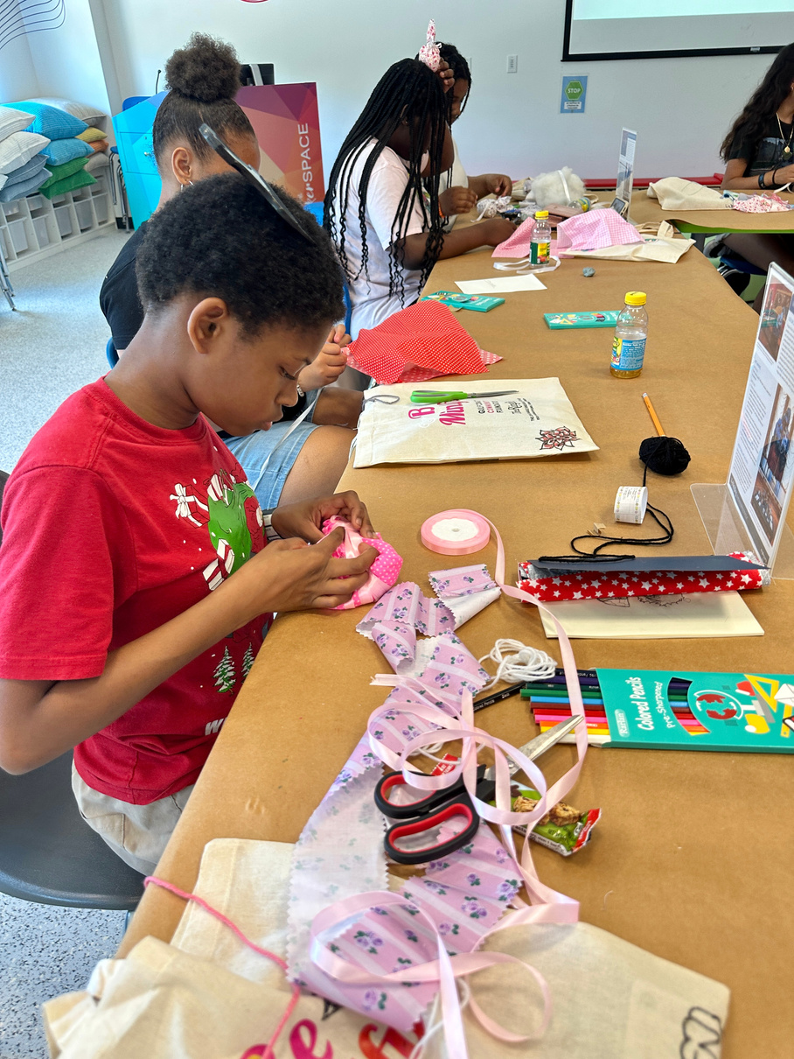
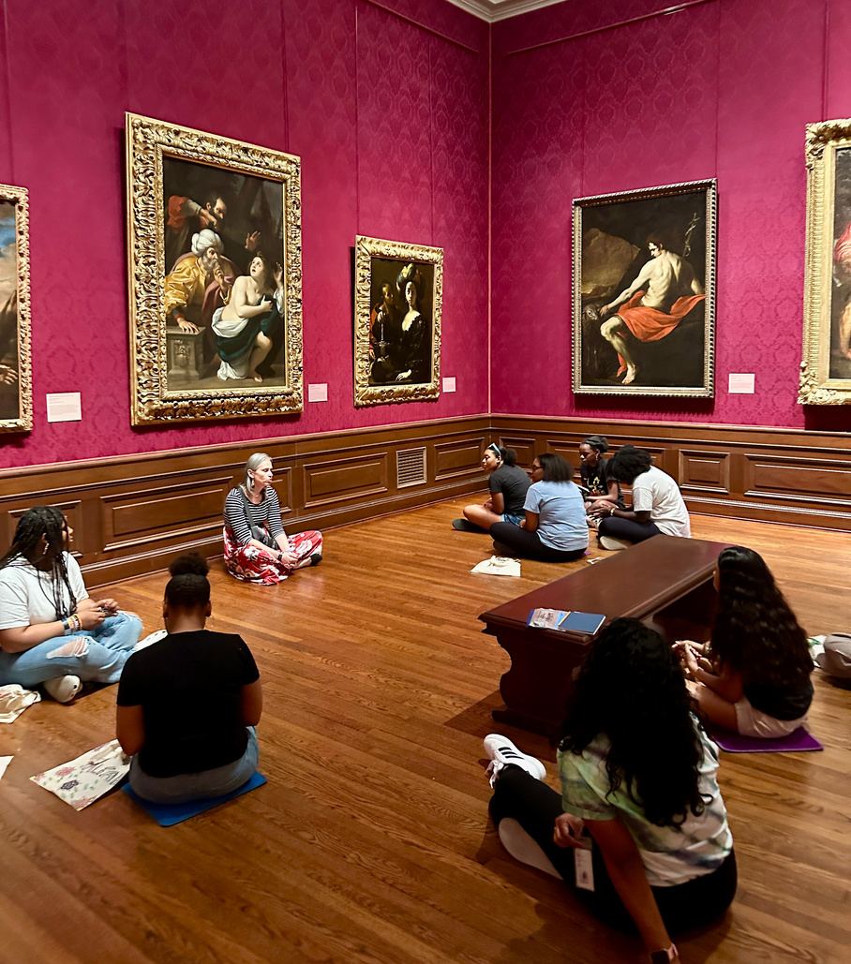
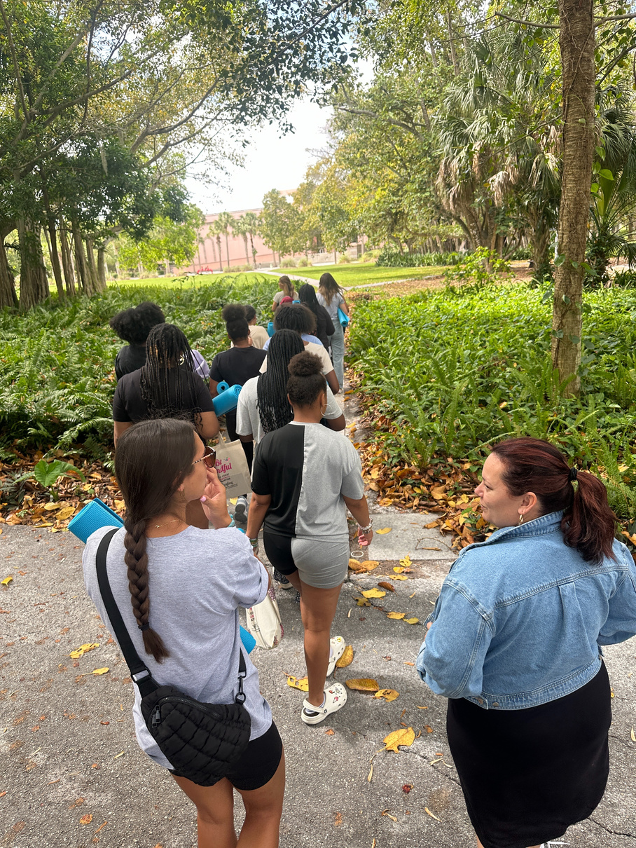
DAILY SCHEDULE
9:30AM MINI ART PROJECT, MINDFUL MOMENT, INTENTIONS
10:00AM IN-GALLERY EXPERIENCES
11:00AM GALLERY EXPLORATION, VISUAL JOURNALING
11:30AM-1PM ART MAKING, LUNCH, REFLECTIONS

Slide 25
IN THEIR WORDS. . . .
“I really enjoyed the yoga. It was nice to do yoga in different places throughout the grounds. I love how we had the creative freedom to create what makes us happy.”
“The dancing, yoga, and focusing have been so powerful!”
“I loved what I learned about how to be mindful in my life.”
“It made me want to change how the world is comin’ apart.”
“I wish we could do this forever!”

Slide 26
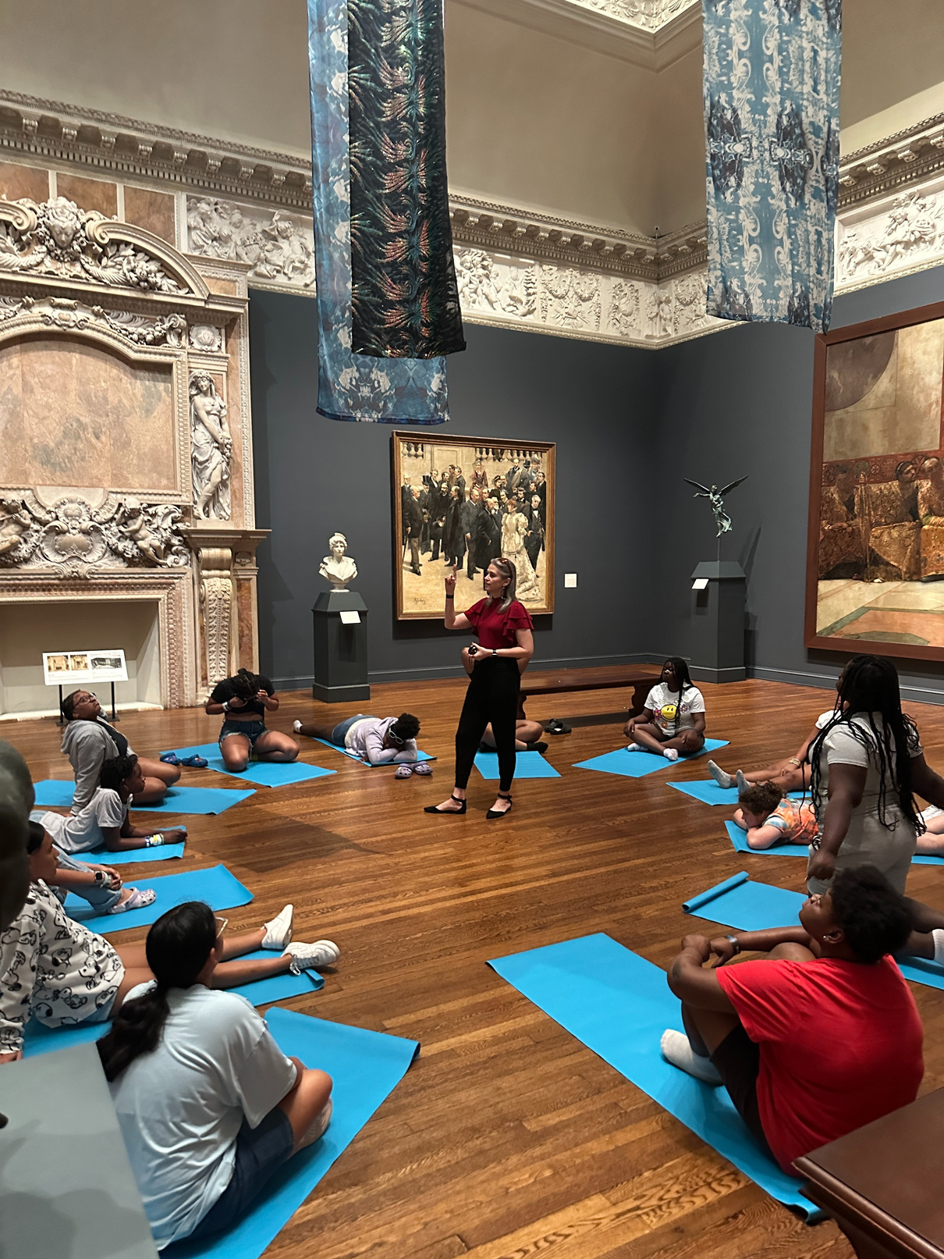
TEEN MINDFULNESS:
THE RINGLING MUSEUM
Mindfulness is a powerful, restorative practice well suited to museums which tend to be places of calm contemplation. It prepares individuals to be more present and engage more deeply which can lead to significant impacts on social-emotional learning and transferable skills.

Slide 27
BUILDING TRUST WITH
FLEETING
INTERACTIONS
How do you make an Impact with short interactions that are often fleeting and singular?
How do you create trust with your visitor and make it a safe place for the collective visitor group?
How do you choose gallery activities that move the needle in some way for the visitor?
What are the criteria for creating an impactful experience/choosing an activity?
ACTIVE LISTENING CLOSE LOOKING COLLABORATION COMMUNICATION CRITICAL THINKING EMPATHY SELF-AWARENESS

Slide 28
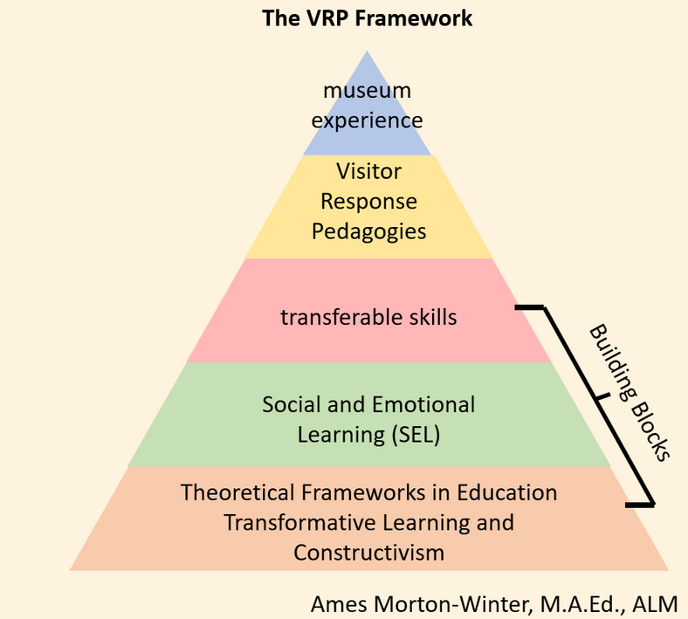
VISITOR RESPONSE
PEDAGOGIES
Educational practices that harness participants’ reactions or responses to art or other kinds of artifacts in order to build transferable skills.
VRPs build trust by honoring varied entry points and diverse perspectives, enriching the activity or experience

Slide 29
7 TRANSFERABLE
SKILLS
ACTIVE
LISTENING
CLOSE
LOOKING/
OBSERVATION
Skills that are utilized in many forms of learning
SELF
AWARENESS
COLLABORATION
VISITOR
RESPONSE
PEDAGOGIES
EMPATHY
COMMUNICATION
CRITICAL
THINKING
Mindfulness programming addresses
all 7 transferable skills.
Ames Morton-Winter, M.A.Ed, ALM

Slide 30
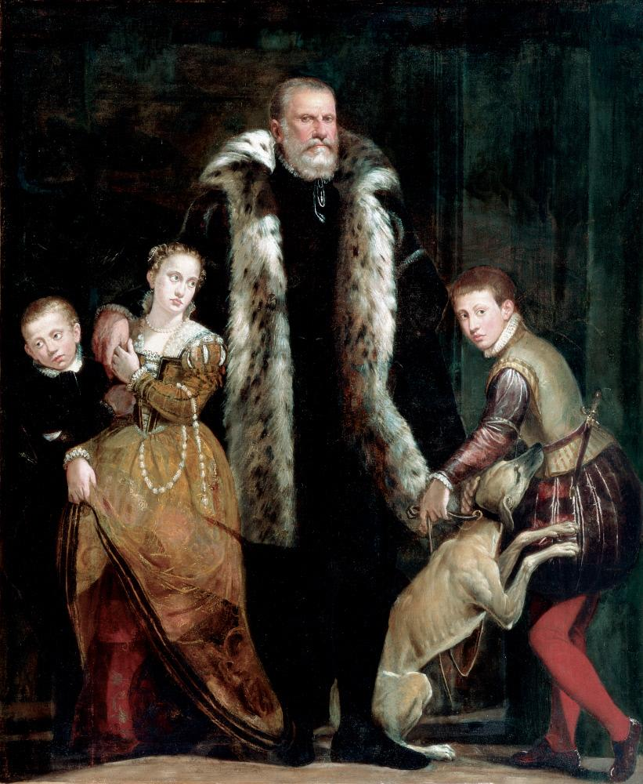
VRP:
SIX-WORD
STORIES
WRITE ONE SENTENCE, USING ONLY SIX WORDS, TO REFLECT WHAT YOU SEE, FEEL, OR IMAGINE WHEN LOOKING AT THIS WORK OF ART.
TURN AND TALK TO A FEW NEIGHBORS AND SHARE YOUR SIX-WORD STORY!
TRANSFERABLE SKILLS:
ACTIVE LISTENING, CLOSE LOOKING, COLLABORATION, COMMUNICATION, CRITICAL THINKING, EMPATHY, SELF-AWARENESS
Portrait of a Family Group
Giovanni Antonio Fasolo
Italian, 1530-1572
SN 83, oil on canvas, c. 1561-65

Slide 31
VRP:
NAMING
FEELINGS
TURN AND TALK!
WHAT EMOTIONS DO YOU SEE IN THE FACES AND BODY LANGUAGE OF THESE FIGURES?
TRANSFERABLE SKILLS:
ACTIVE LISTENING, CLOSE LOOKING, COLLABORATION, COMMUNICATION, CRITICAL THINKING, EMPATHY, SELF-AWARENESS
Portrait of a Family Group
Giovanni Antonio Fasolo
Italian, 1530-1572
SN 83, oil on canvas, c. 1561-65

Slide 32
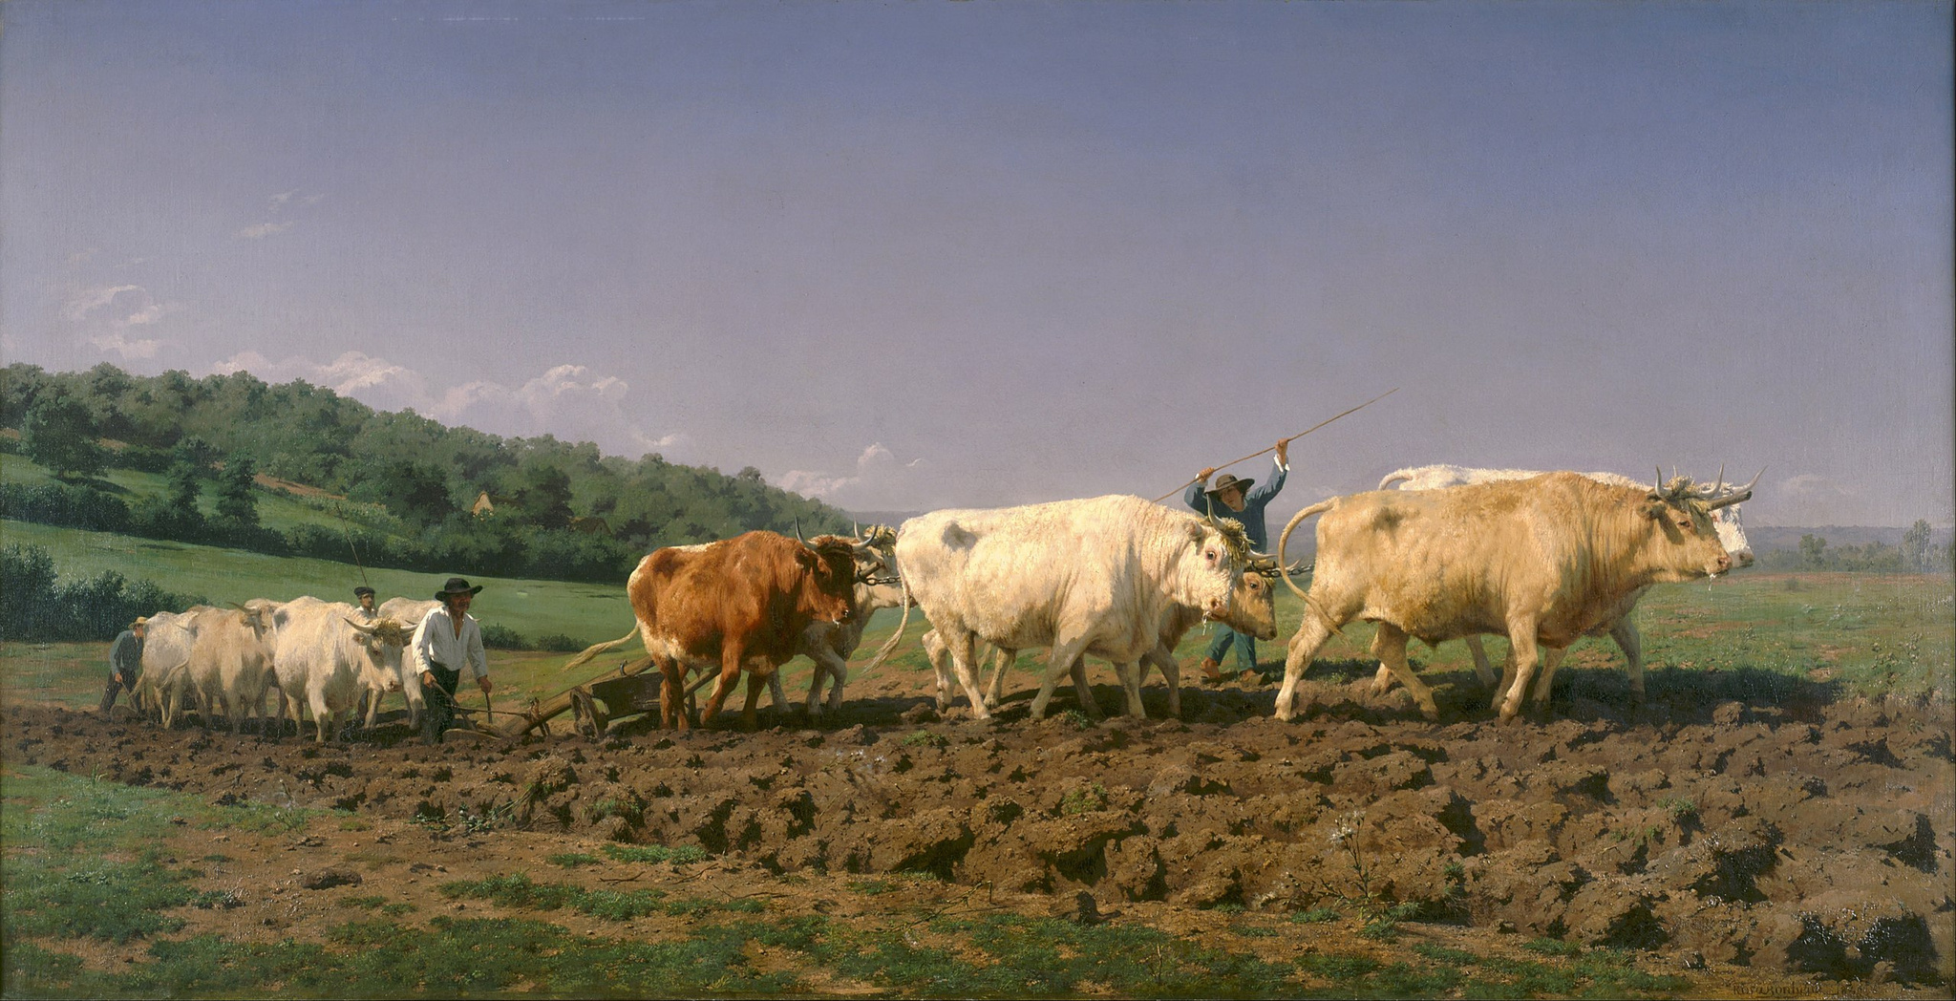
SENSORY SOUNDSCAPE
TRANSFERABLE SKILLS:
ACTIVE LISTENING, CLOSE LOOKING, COLLABORATION,
COMMUNICATION, CRITICAL THINKING, EMPATHY, SELF-AWARENESS
PLOWING IN THE NIVERNAI, 1850
Rosa Bonheur
oil on canvas
Bequest of John Ringling, 1936
SN433

Slide 33
A TO Z VRP TOOLKIT
art detectives
arts and letters
awe walk
before & after
blind drawing
box breathing
breathing
cabinet of curiosities
color by number
color your emotions
curator challenge
daily schedule
embodiment
5-4-3-2-1 breathing
fortunately, unfortunately
5 senses immersion experience
geocaching
group poetry
imagined conversations
juxtapose this
loving kindness meditation
mind mapping
mindfulness
multiple interpretations
museum melodies
observe, connect, reflect
one word
personal response tour
photobomb
rapid fire response
repeat photography
see, think, wonder
seek and finds
sleep sessions
social practice programs
sound baths
staff suggestions
tableau vivant
talkback wall
tour by theme
20 questions
think, pair, share
tools of the artist
turn and talk
upside down drawing
viewfinders
viewpoints
visual journaling
visual thinking strategies
yoga

Slide 34
INTENTIONAL PROGRAMMING FOR OUT-OF-SECTOR AUDIENCES USING
CULTURAL HUMILITY
What is cultural humility?
How can we build trust with skeptical and out-of-sector audiences?
How can we incorporate activity-based learning & VRP with specific audiences?

Slide 35
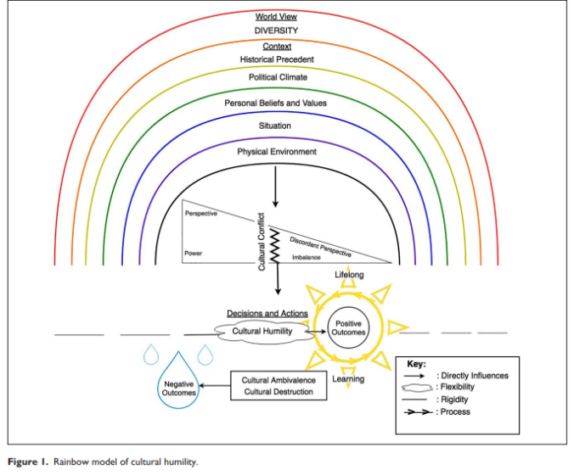
THEORY OF CULTURAL HUMILITY
Cultural humility is a theory which suggests cultural learning is a lifelong process.
(Foronda et al., 2016, Foronda, 2020)
The attributes of cultural humility are:
  Openness
  Self-Awareness
  Being ego-less
  Critical self-reflection
  Supportive dialogues & interactions with diverse individuals

Slide 36
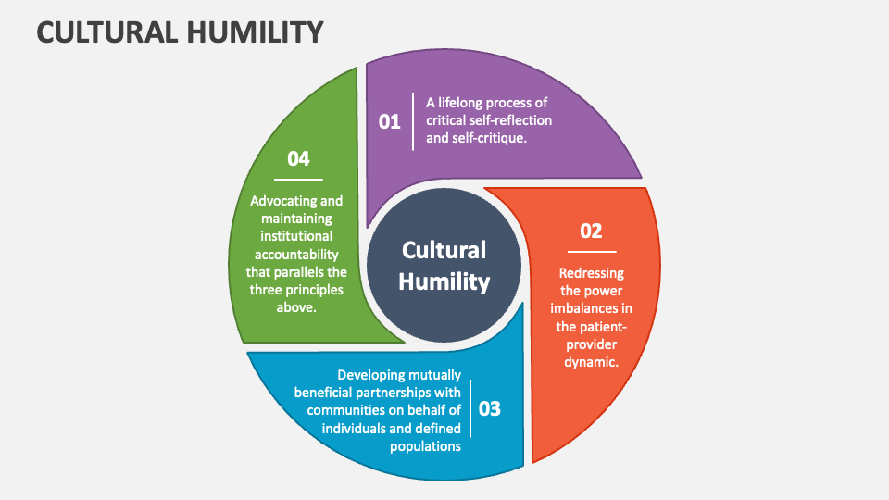

Slide 37
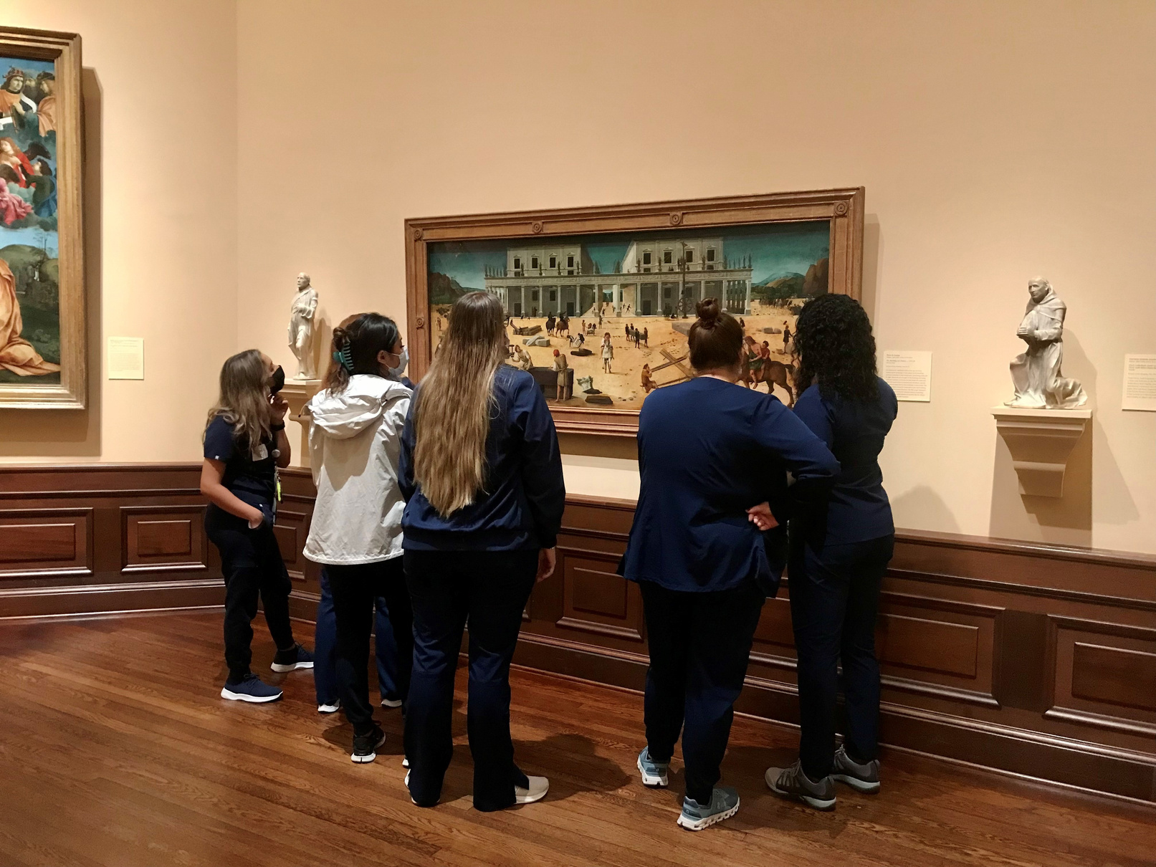
BUILDING PUBLIC TRUST WITH SPECIFIC AUDIENCES
  Seek to understand group’s values, needs, and workflow
  Spend time at group’s location
  Plan over meals
  Share authority to develop programs collaboratively
  Find common ground to understand each other’s perspectives

Slide 38
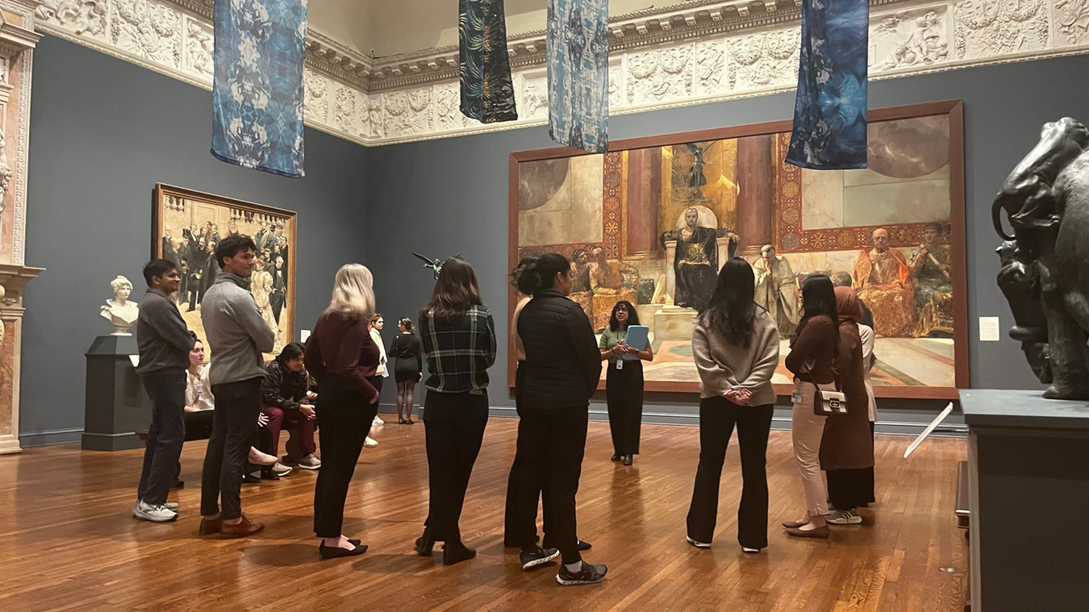
Case Study: Artful Leadership
Audience: healthcare leaders
Setting: 3 sessions at museum, virtual/Zoom, and hospital
Objective: to ward against burnout by developing cultural humility through the arts
Activities:
  Visual Thinking Strategies
  Multiple Interpretations
  Personal Responses Tour
  Mindful Looking
  Narrative Medicine

Slide 39
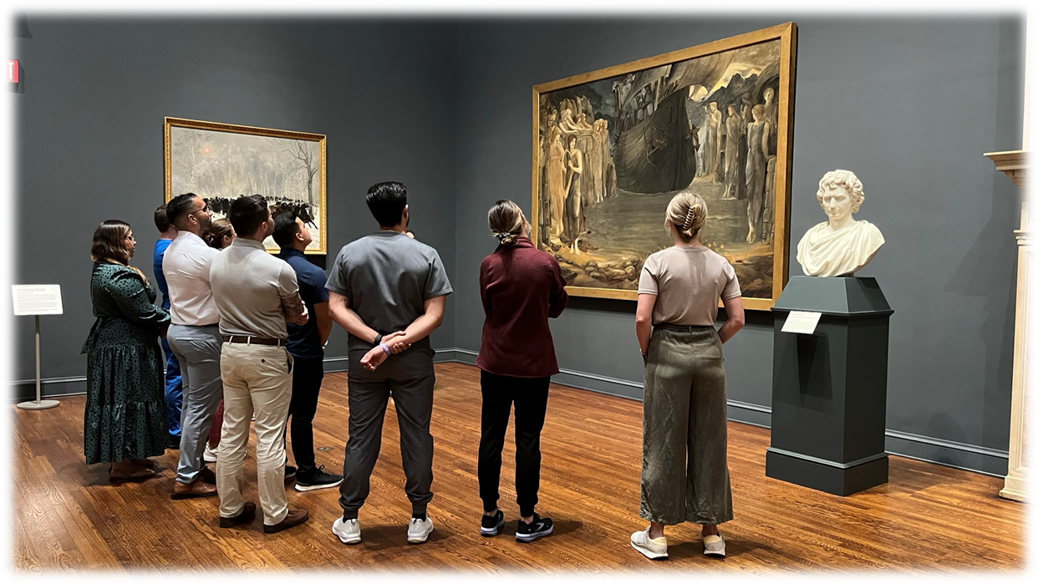
Session 1: VTS

Slide 40
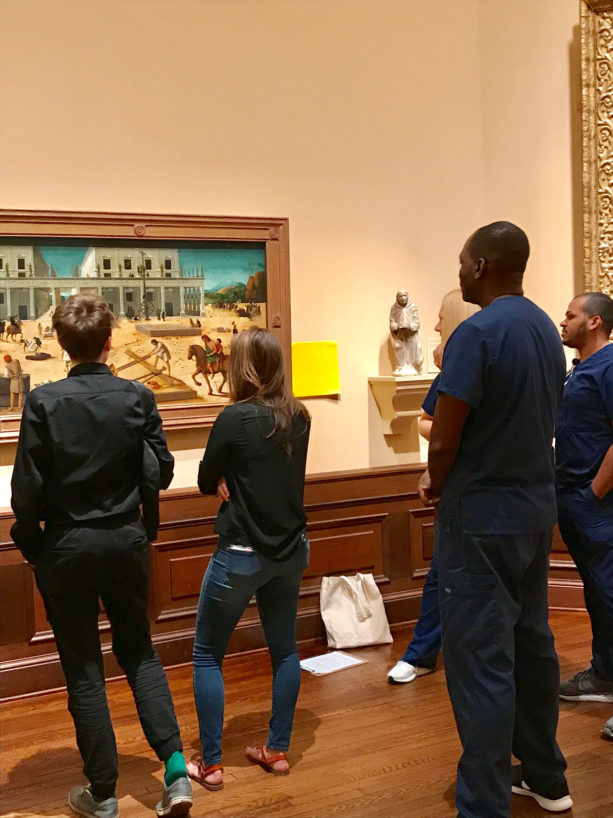
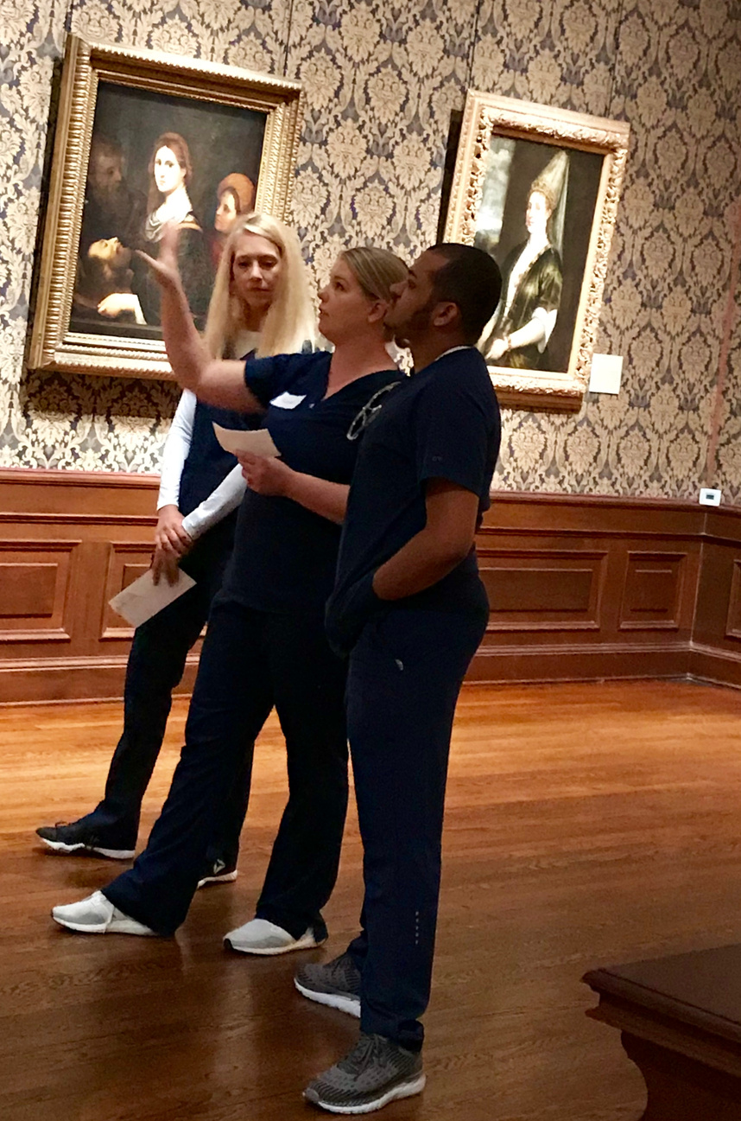
Session 1: Multiple Interpretations

Slide 41

MULTIPLE INTERPRETATIONS
Choose an interpretation.
Find 3 pieces of visual evidence to support your interpretation.
Turn and talk!
Debrief.
Giovani Antonio Fasolo (Italian, 1530-1572), Family Group, c.1565, oil on canvas. 102 ⅝ x 88 ¼ x 3 15/16 in. Bequest of John Ringling, 1936. SN83.

Slide 42
INTERPRETATION 1: The father is controlling and conniving. He wants to marry off his daughter to a wealthy man and have his son take over the family business. He commissioned this portrait to show off his status and promote his interests.
INTERPRETATION 2: The father is loving and protective and cares deeply about the welfare of his children. He commissioned this portrait to demonstrate how much they’ve grown up.
INTERPRETATION 3: The father is sad and lonely. He misses his deceased wife and is too depressed to deal with his three children. He commissioned this portait to draw attention to the absence of his wife.

Slide 43

Session 1: Mindful Looking (5 Senses)

Slide 44

Rosa Bonheur (French, 1822-1899), Plowing in the Nivernais (Labourages nivernais), 1850, oil on canvas. 52 ½ in. x 102 in.. Bequest of John Ringling, 1936. SN433.

Slide 45

Session 1: Personal Responses Tour

Slide 46

NARRATIVE MEDICINE
Narrative medicine incorporates the humanities and the arts into healthcare. Centered on building and practicing empathy, narrative medicine uses writing and storytelling to convey compassion, reflect upon practice, and convey and develop empathy to contribute to patient-centered care.
Healthcare Provider / Patient
Healthcare Provider / Healthcare Team
Healthcare Provider / Public
Healthcare Provider / Self
Toward empathetic engagement & improved outcomes
Toward effective communication
Toward reflection & resilience
Toward increased trust
Charon (2009.)

Slide 47

NARRATIVE MEDICINE
55-WORD STORY
Write about this man’s well-being story.
INDIVIDUALLY - free write (2 minutes)
IN SMALL GROUPS - assemble 55-word poem using words from free write (7 minutes)
Let’s share!

Slide 48
KEY FINDINGS
Cultural Humility can be developed through engagement with the arts.
The arts promote leadership and communication skills not taught in traditional healthcare professional development.
Participants reported high levels of transferable skills to their workplace, along with feelings of respite and well-being.

Slide 49



For more information check out:
Stay in touch!
Lilit Sadoyan
LSadoyan@getty.edu
Ames Morton-Winter
ames.morton-winter@ringling.org
Katie Nickel
Katie.Nickel@ringling.org
Nickel, K.L. (2024). Developing cultural humility
through the arts: Evaluating an arts intervention
for healthcare provider leaders. [Dissertation].
University of South Florida, 31328699.

